Slide 1



2022

Slide 3
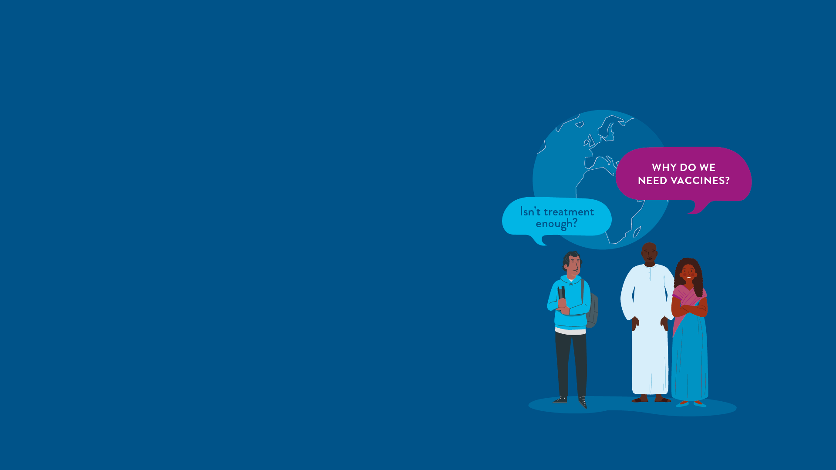



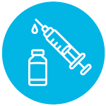
MODULE 1:
VACCINES AND THE GLOBAL RESPONSE TO INFECTIOUS DISEASES
HIV
TB
Lassa Virus
Vaccines

Slide 4
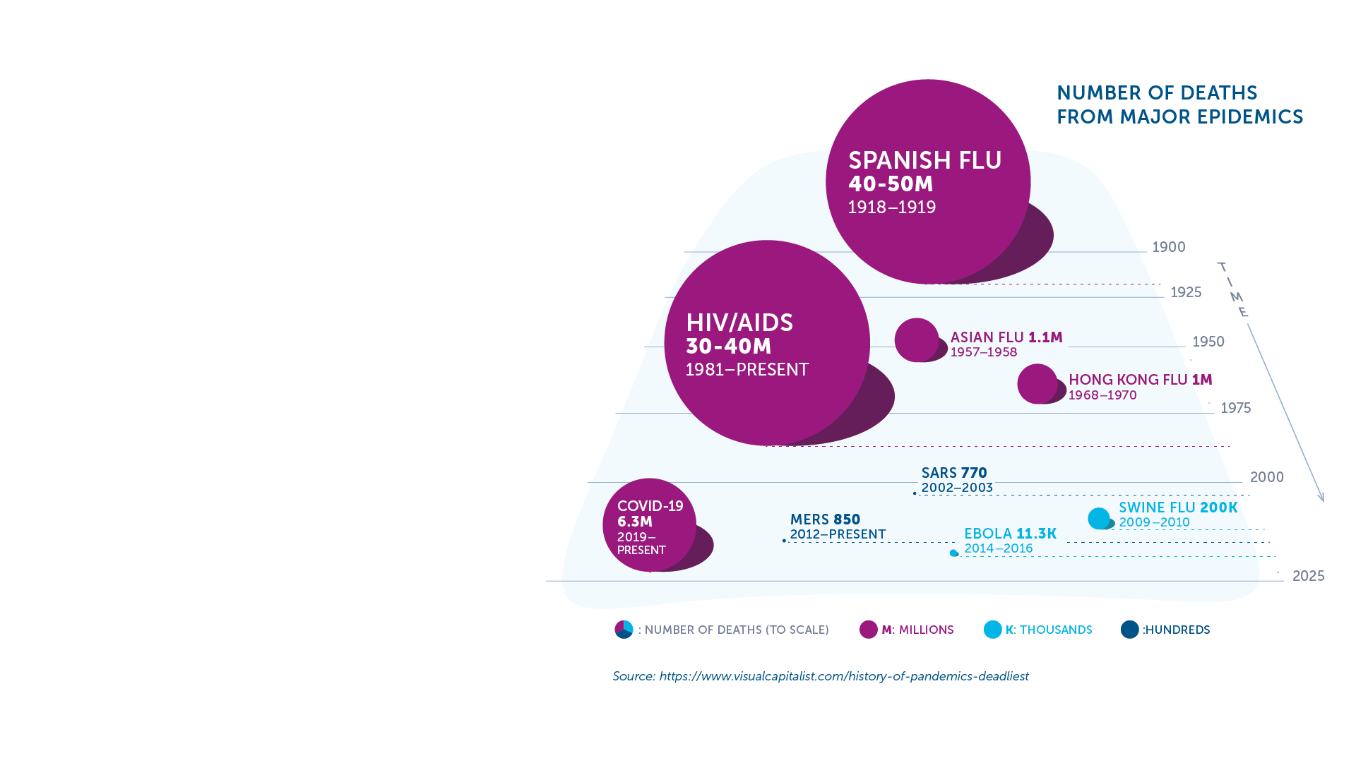
Global Health and Emerging Epidemics​
Every year, millions of people worldwide are affected by infectious diseases caused by bacteria, viruses, fungi or parasites.​
COVID-19 has taught us the danger of new, emerging epidemics that have the power to bring our world to a standstill.​
Infectious diseases are leading causes of death for children under five (WHO).​
Six of the top 10 causes of death in low-income countries are infectious diseases.​
Despite significant advances in research, prevention, and treatment, the successful control of these diseases faces major challenges​.
IAVI VACCINE LITERACY LIBRARY | MODULE 1

Slide 5
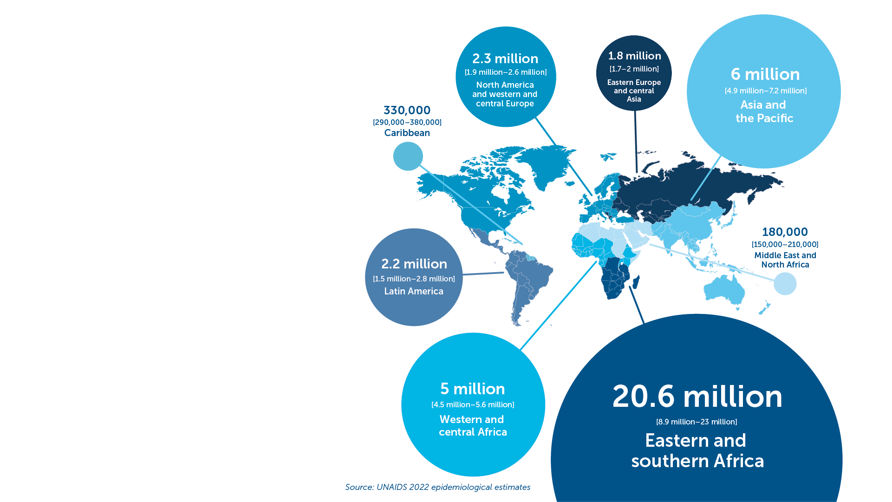
HIV
HIV is one of the worst epidemics the world has ever seen.​
84.2 million people have acquired HIV since it was identified in 1981.​
38.4 million people globally were living with HIV in 2021, including 1.7 million children.​
AIDS is a leading cause of death in sub-Saharan Africa.​
Over half of all people living with HIV are women and girls.​
IAVI VACCINE LITERACY LIBRARY | MODULE 1
Adults and children estimated to be living with HIV, 2021
TOTAL: 38.4 million

Slide 6
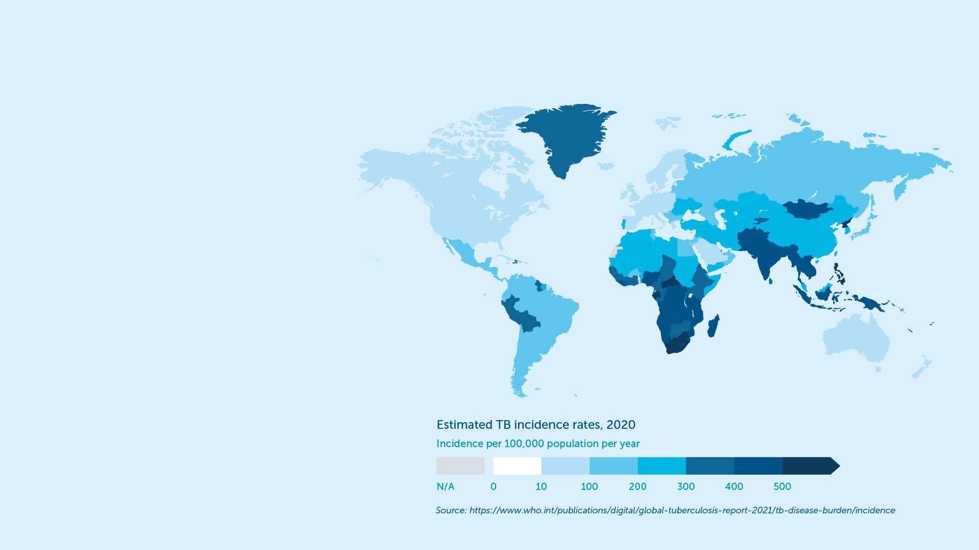
Tuberculosis (TB)
Over 2 billion people are living with TB worldwide and 1.5 million die every year.​
1.2 million children get sick with TB each year.​
Africa accounts for a quarter of all TB cases and deaths globally.​
Due to TB, people can typically face costs or suffer income loss equivalent on average to more than 50% of their income.​
IAVI VACCINE LITERACY LIBRARY | MODULE 1
Prior to COVID-19, TB was the leading infectious disease killer worldwide.​

Slide 7
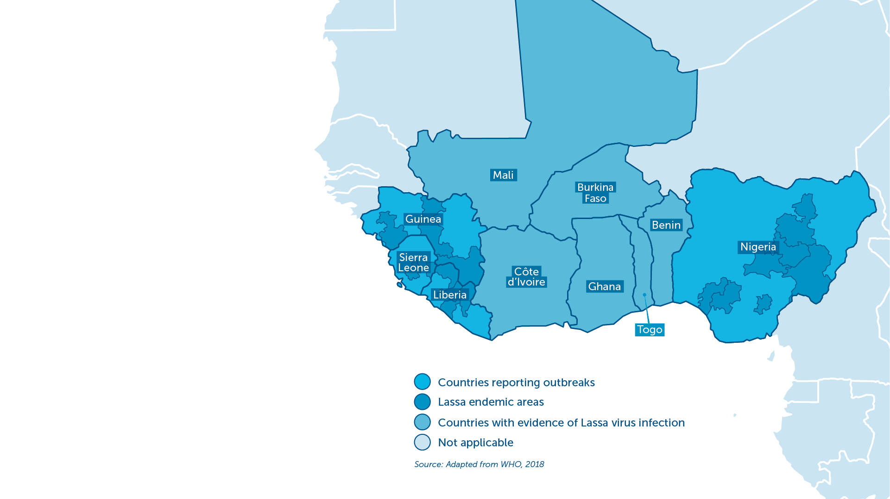
Lassa Haemorrhagic Fever
An acute viral illness endemic in parts of West Africa.​
An estimated 100,000–300,000 cases and 5,000 related deaths each year.​
Particularly dangerous to pregnant women and small children.​
Deafness occurs in approximately one-third of infections, and in many cases hearing loss is permanent.​
WHO has identified Lassa fever as one of the top emerging diseases likely to cause severe outbreaks in the near future.
IAVI VACCINE LITERACY LIBRARY | MODULE 1

Slide 8

The World Needs Vaccines
Vaccines are the most powerful tool at our disposal to defeat epidemics and pandemics caused by infectious diseases.​
Without immunisation, epidemics can easily cause health systems to collapse. Health professionals looking after the sick can be at risk of infection themselves.​
Vaccines work by preparing a person's immune system (the body’s natural defences) to recognise and defend itself against a specific disease.​
No epidemics have been successfully brought under control without the use of vaccines.
IAVI VACCINE LITERACY LIBRARY | MODULE 1

Slide 9
Vaccines Save Lives
Vaccines are a crucial tool in controlling the spread of infectious diseases together with addressing long-term structural factors such as poverty, poor housing, and inadequate sanitation that put people at increased risk of certain infectious diseases.​
By providing protection from disease at an individual level and stopping its spread in the community, vaccines can protect highly vulnerable people from severe illness and death.​
Vaccination prevents 2–3 million deaths every year.
IAVI VACCINE LITERACY LIBRARY | MODULE 1

Slide 10
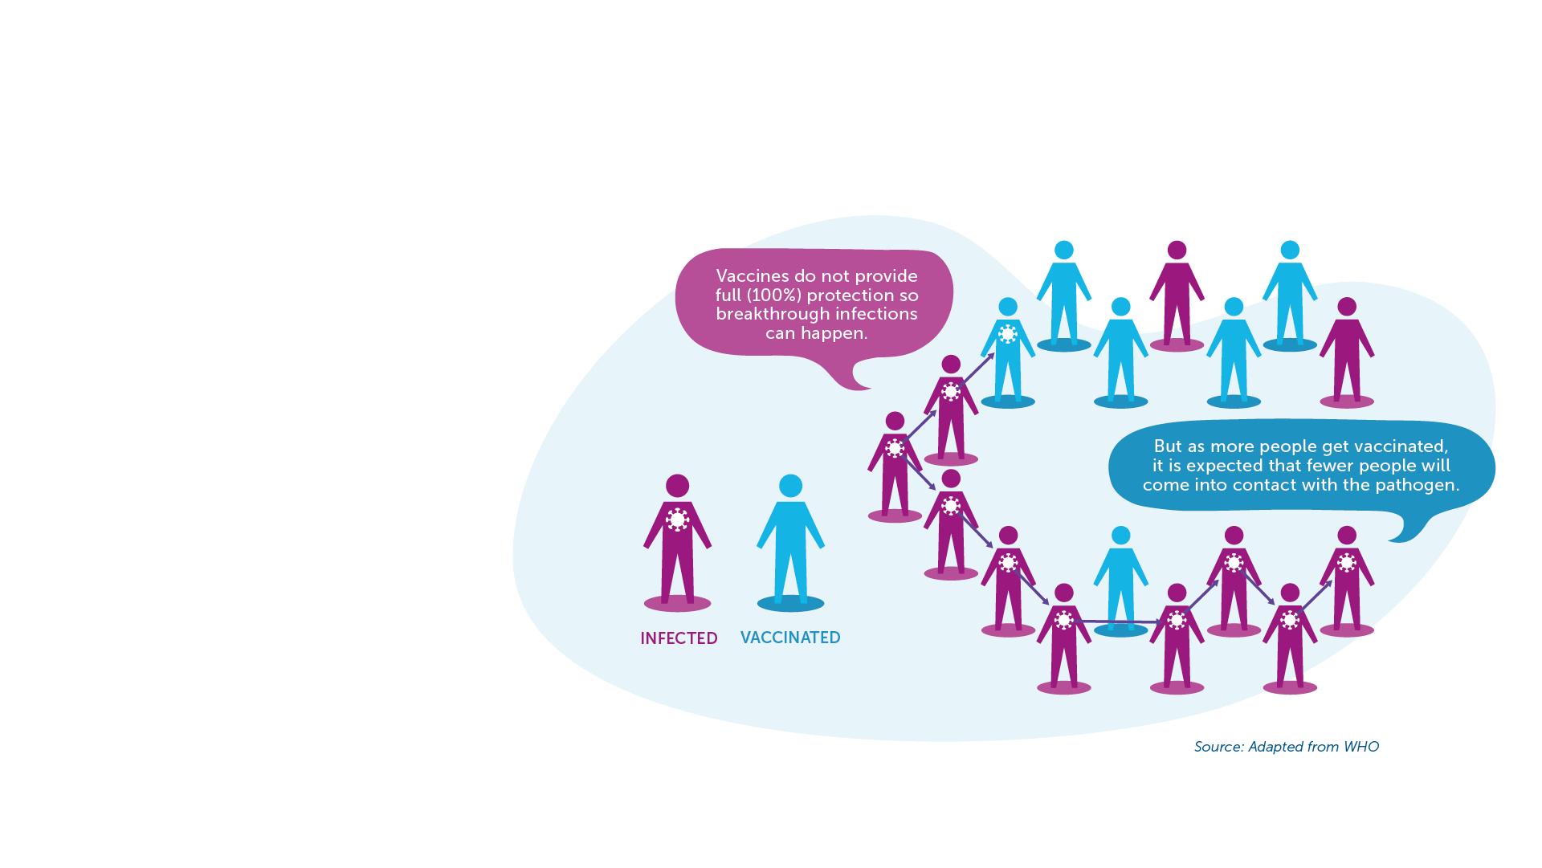
Vaccines End Epidemics
Infectious diseases can spread rapidly through a community, and with today’s international travel, reach every part of the world.​
Vaccines play a critical role in the prevention and control of disease outbreaks and in promoting global health.​
Without vaccination, we are unlikely to see an end to the big killer diseases such as HIV, TB, and other emerging infectious diseases.​
Vaccines and Herd Immunity​
When many people are vaccinated, even those who are not vaccinated in that community may also get some protection.
IAVI VACCINE LITERACY LIBRARY | MODULE 1

Slide 11
Vaccines Are Cost Effective
Vaccination is one of the most cost-effective health interventions that money can buy.​
Vaccines provide savings to the health system by lowering the number of people who need treatment and lifetime care.​
Vaccination also prevents lost wages and lost productivity.​
Border controls, quarantine, lockdowns, self-isolation, and social distancing measures can all play a role but can have a huge negative impact on society and the economy.​
It is estimated that every dollar invested in vaccination saves US$16 in health care costs
IAVI VACCINE LITERACY LIBRARY | MODULE 1

Slide 13
Acknowledgements
IAVI would like to acknowledge the contribution of Doreen Asio, Monica Bagaya, Vincent Basajja, Kundai Chinyenze, William Dekker, Evanson Gichuru, Nyokabi Jacinta, Sarah Joseph, Dagna Laufer, Sharon Lipesa, Shelly Malhotra, Miliswa Magongo, Blossom Makhubalo, Roselyn Malogo, John Mdluli, Ireen Mosweu, Juliet Mpendo, Gaudensia Mutua, Vincent Muturi-Kioi, Conwell Mwakoi, Jauhara Nanyondo, Gertrude Nanyonjo, Jacinta Nyakobi, Faith Ochieng, Fred Otieno, Daisy Ouya, Gayle Patenaude, Hilda Phiri, Nicole Sender, Lewis Schrager, Elana Van Brakel, Kelvin Vollenhoven, Jeffery Walimbwa, Mathias Wambuzi, Anja Van der Westhuizen for reviewing the content of the IAVI Vaccine Literacy Library.
Lead Consultants: Roger Tatoud and Rebekah Webb.
Design and Illustration: Anthea Duce.
© International AIDS Vaccine Initiative, Inc. 2022

Slide 14

MODULE 2:
INTRODUCTION TO HIV, TUBERCULOSIS, AND LASSA FEVER
HIV
TB
Lassa Virus
Vaccines

Slide 16
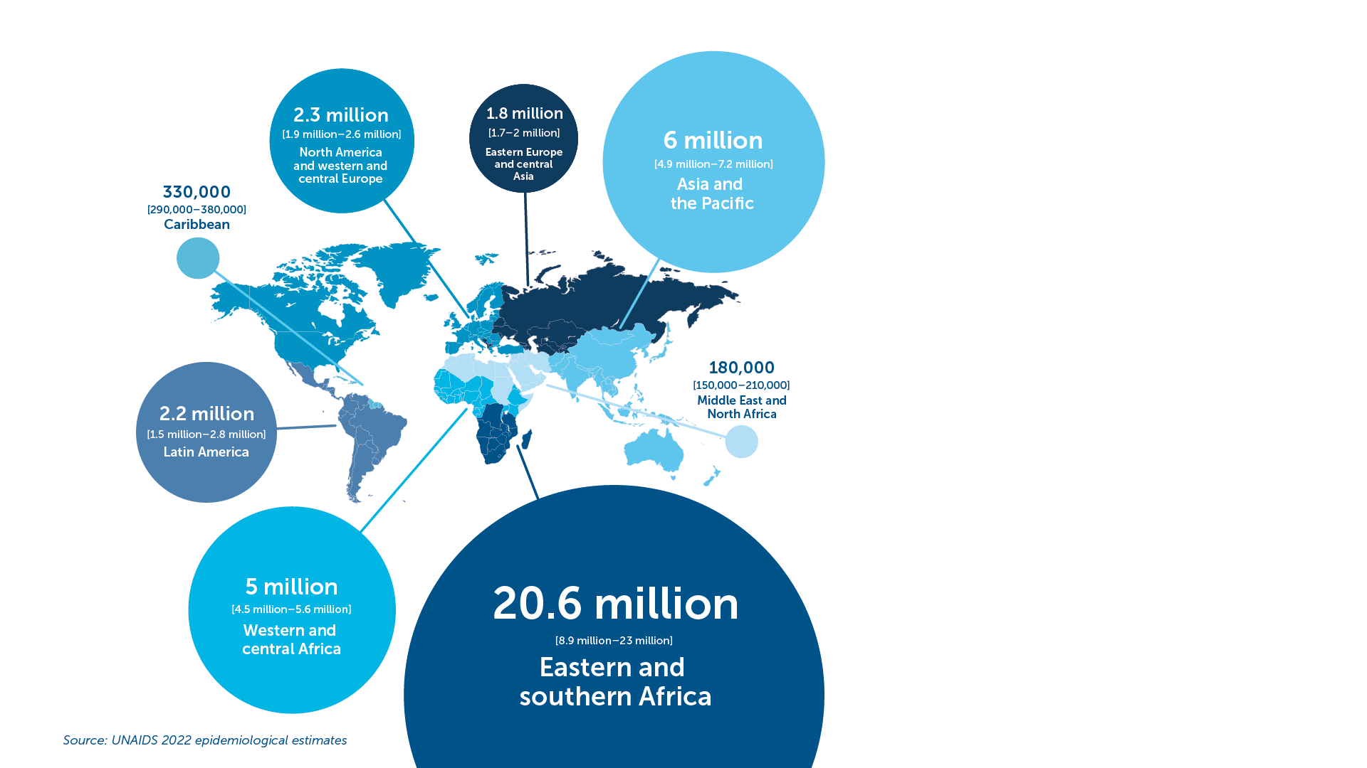
HIV
First case of AIDS recorded in 1981.​
38.4 million people globally were living with HIV in 2021.​
1.5 million people became newly infected with HIV in 2021.​
Around 650,000 people died from AIDS-related illnesses worldwide in 2021 compared to 1.9 million people in 2004 and 1.3 million people in 2010 thanks to effective treatment and progress with prevention.​
HIV transmission:​
  Blood​
  Semen and pre-seminal fluid​
  Rectal fluids​
  Vaginal fluids​
  Breast milk​
IAVI VACCINE LITERACY LIBRARY | MODULE 2

Slide 17
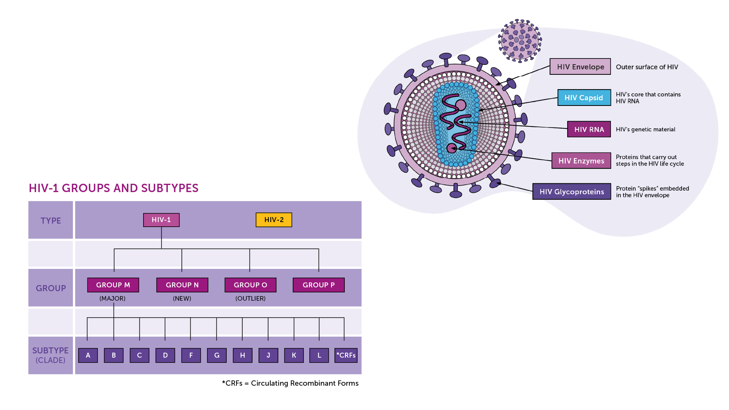
The Human Immunodeficiency
Virus​
Diversity is a challenge for vaccine development​
Retrovirus: a virus that uses RNA as its genetic material. ​
HIV-1: the most common virus found all over the world.​
HIV-2: much less common and less infectious and harmful, found mostly in West Africa.​
Four Groups (M, N, O, and P).​
10 Subtypes in the M group.​
IAVI VACCINE LITERACY LIBRARY | MODULE 2

Slide 18
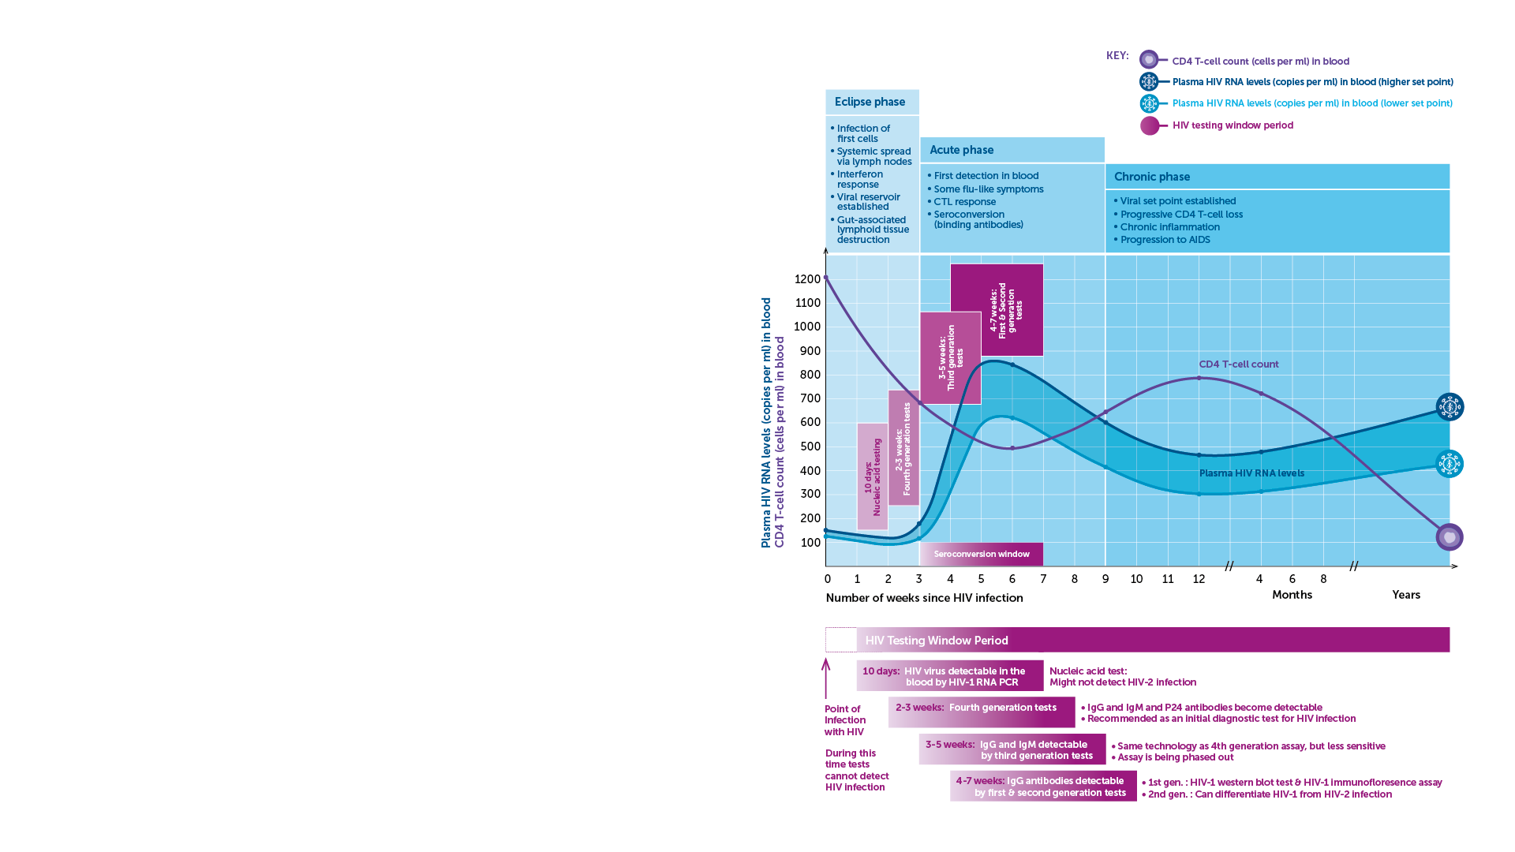
HIV Diagnosis and Disease Progression​
Diagnosis​
Nucleic acid tests (NAT) that can detect HIV RNA in the blood.​
Antigen/antibody tests to detect parts of the virus, for example the viral capsid protein (p24) along with antibodies generated in response to the infection. ​
Tests to detect antibodies generated by the body in response to the infection.​
Disease progression
Acute Infection​
Chronic Infection​
AIDS​
IAVI VACCINE LITERACY LIBRARY | MODULE 2

Slide 19
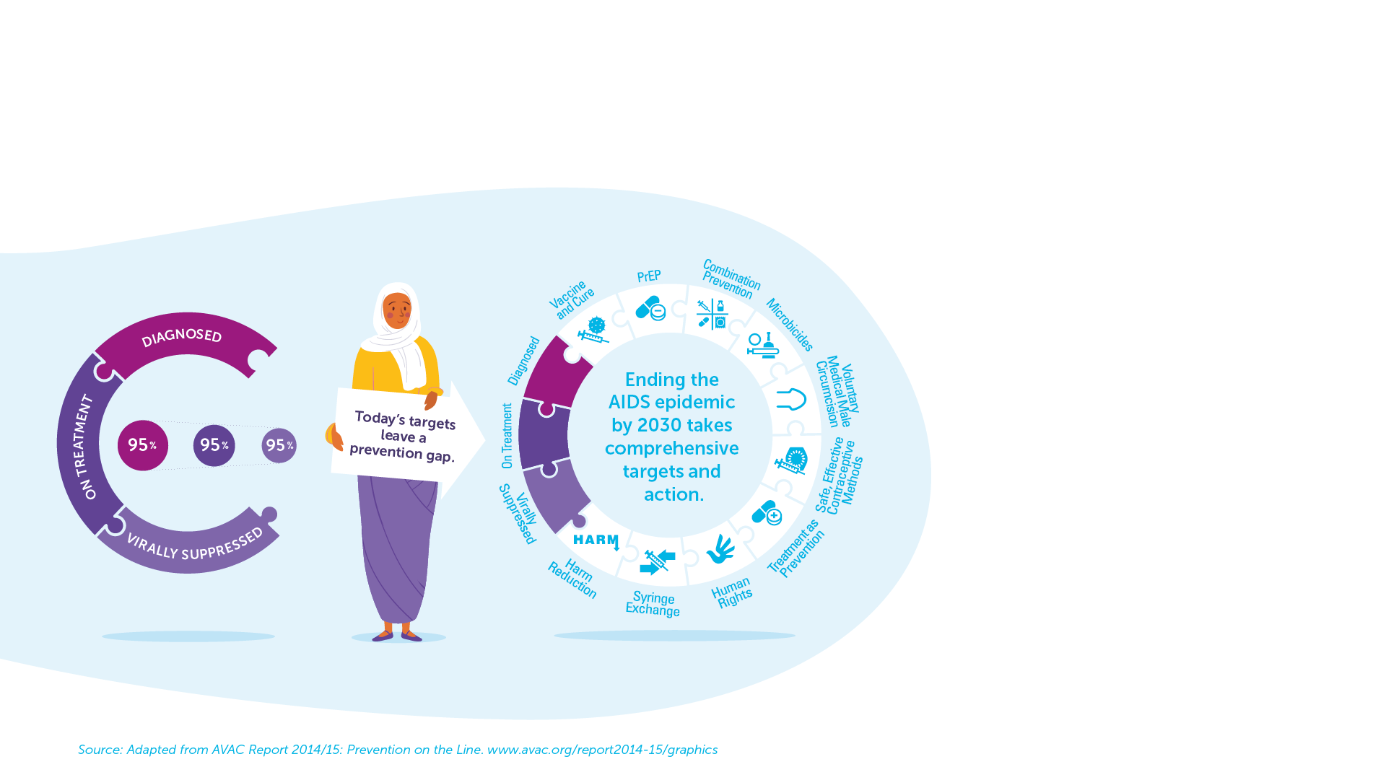
HIV Prevention and Treatment
Comprehensive prevention tools and interventions.​
To date, there is no cure and no vaccine for HIV.​
There are now more than 30 antiretrovirals (ARVs) that can be used in first, second, and third-line therapy.​
95-95-95
In 2021, 85% of people living with HIV knew their HIV status.​
Among people who knew their status, 88% were accessing treatment.​
And among people accessing treatment, 92% were virally suppressed.​
IAVI VACCINE LITERACY LIBRARY | MODULE 2

Slide 20
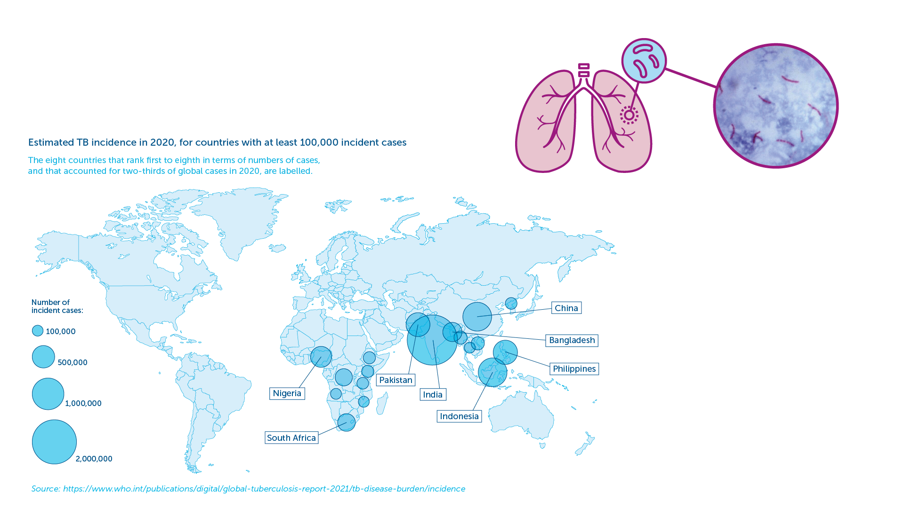
Tuberculosis (TB)
An ancient disease.​
Mycobacterium tuberculosis (M.tb) bacteria discovered in 1882.​
Over 2 billion people are infected with M.tb worldwide.​
Only 5–10% will develop TB disease during their lifetime.​
1.2 million children get sick with TB each year.​​
Spread through the air.​
IAVI VACCINE LITERACY LIBRARY | MODULE 2

Slide 21
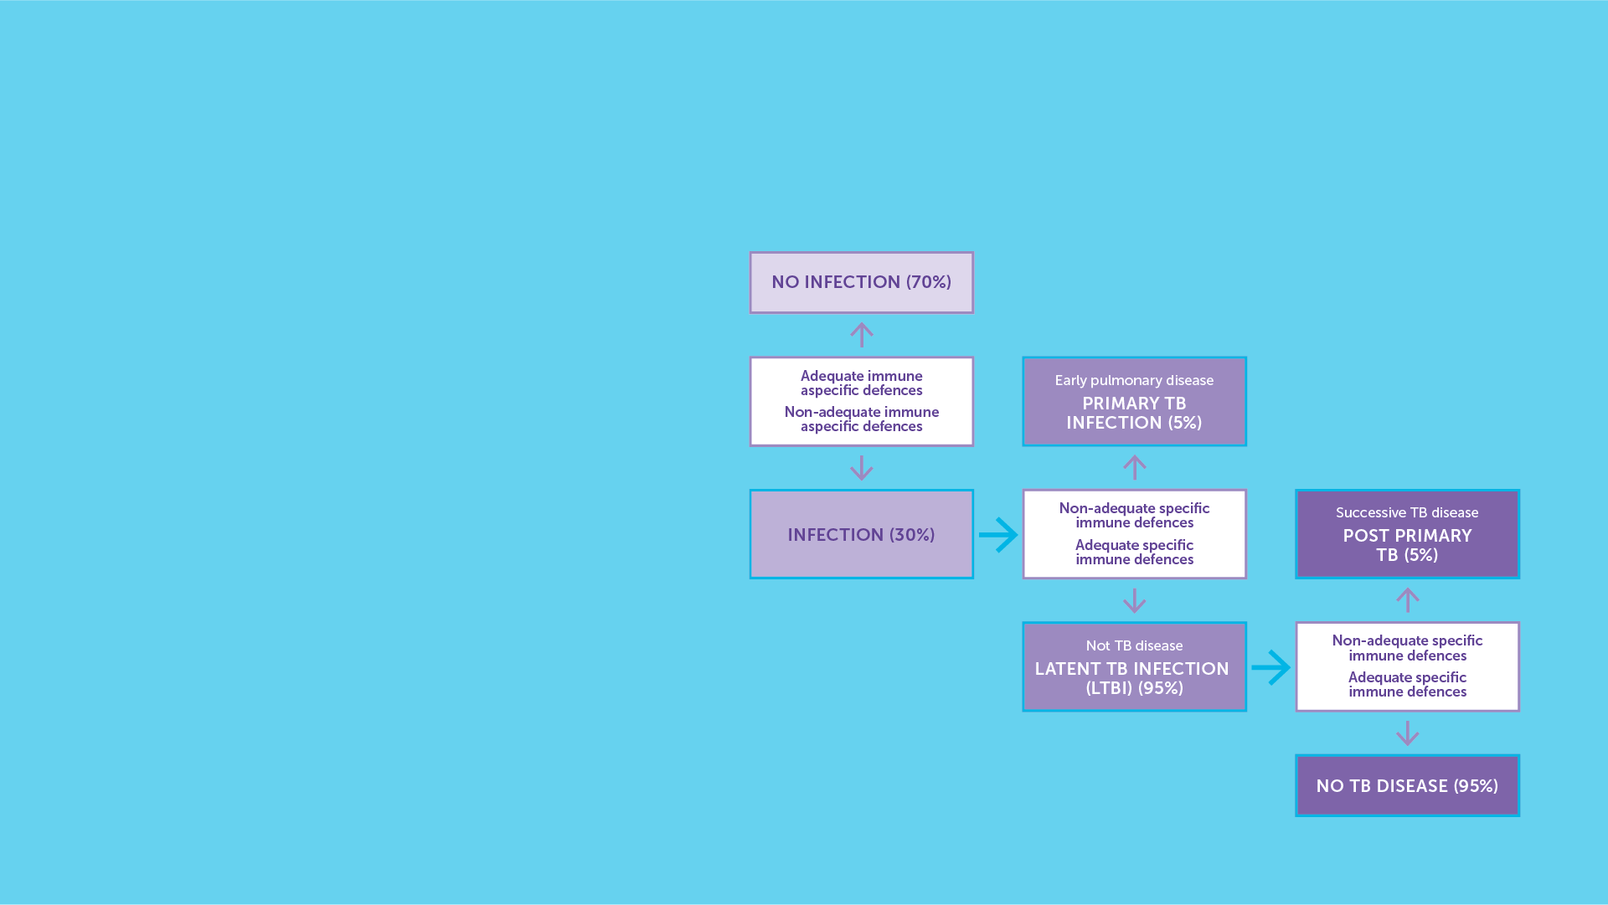
Tuberculosis – Diagnosis and Disease Progression​
The symptoms of tuberculosis infection are diverse depending on where the bacteria are in the body.​
TB presents in people in two forms: active TB disease and latent TB infection. ​
People with latent TB disease may have no symptoms.​
Diagnosing TB requires a clinical examination and confirmatory diagnostic tests.​
Disease progression.​
IAVI VACCINE LITERACY LIBRARY | MODULE 2

Slide 22
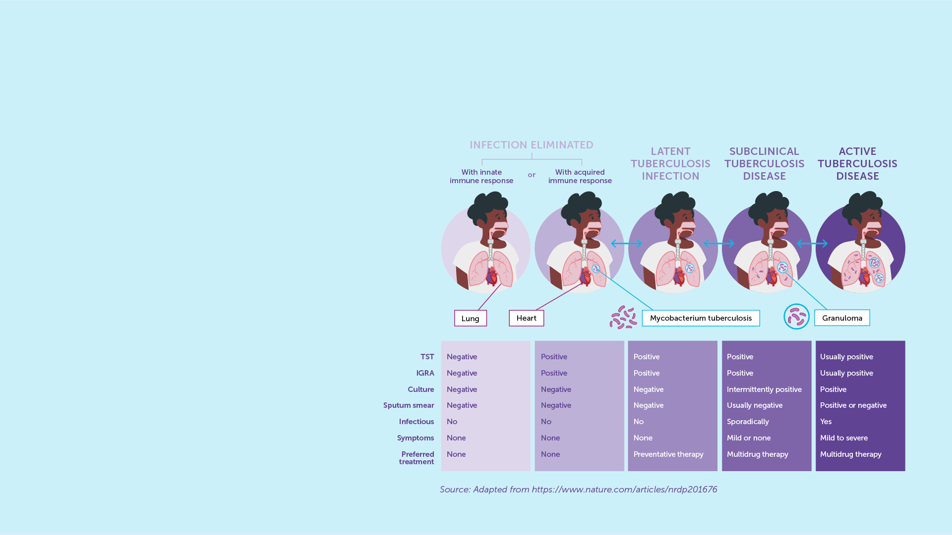
TB Prevention and Treatment​
Tuberculosis is preventable.​
BCG is the only approved vaccine for TB.​
Variable level of protection.​
Drug-sensitive TB is curable with a four- to six-month course of currently available TB treatment.​
Resistance to treatment can occur.​
Multidrug-resistant TB (MDR-TB) is treatable, but with a much longer course of multiple drugs that can cause many side-effects.​
Extensively drug-resistant TB (XDR-TB) is more difficult, and sometimes impossible, to treat successfully.​
IAVI VACCINE LITERACY LIBRARY | MODULE 2

Slide 23
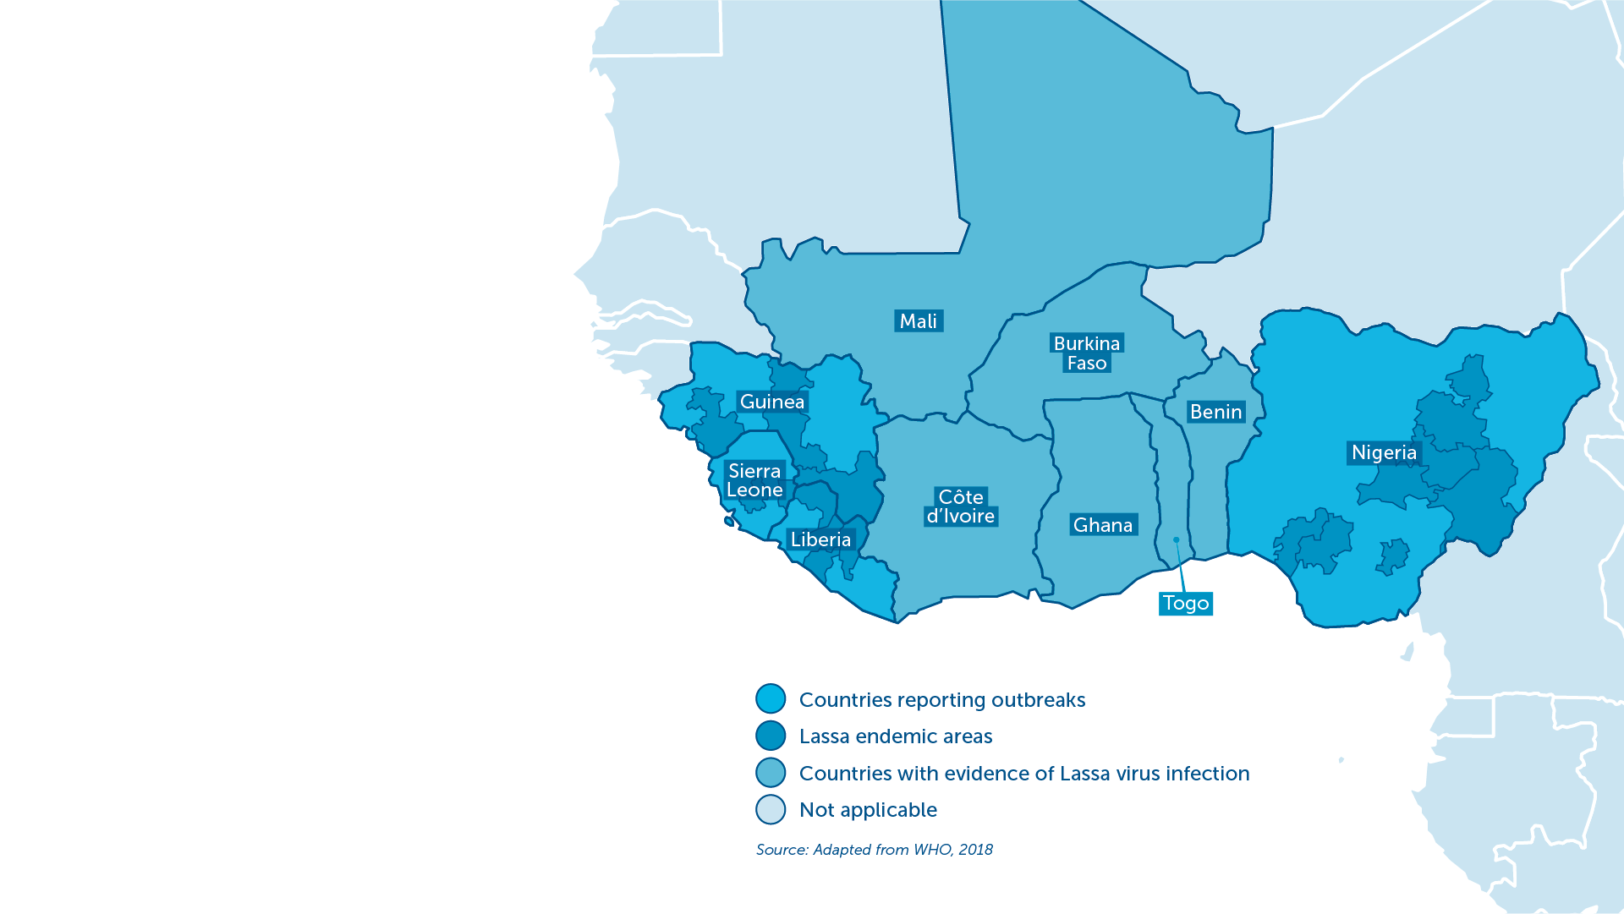
Lassa Fever
First described in the 1950s.​
Acute viral haemorrhagic illness endemic in some parts of West Africa.​
An estimated 100,000–300,000 cases and 5,000 related deaths each year. ​
Particularly dangerous to pregnant women and small children.​
Neurological problems have also been described, including various degrees of deafness, which occur in approximately one-third of infections, and in many cases hearing loss is permanent.​
WHO has identified Lassa fever as one of the top emerging pathogens likely to cause severe outbreaks in the near future.​
IAVI VACCINE LITERACY LIBRARY | MODULE 2

Slide 24
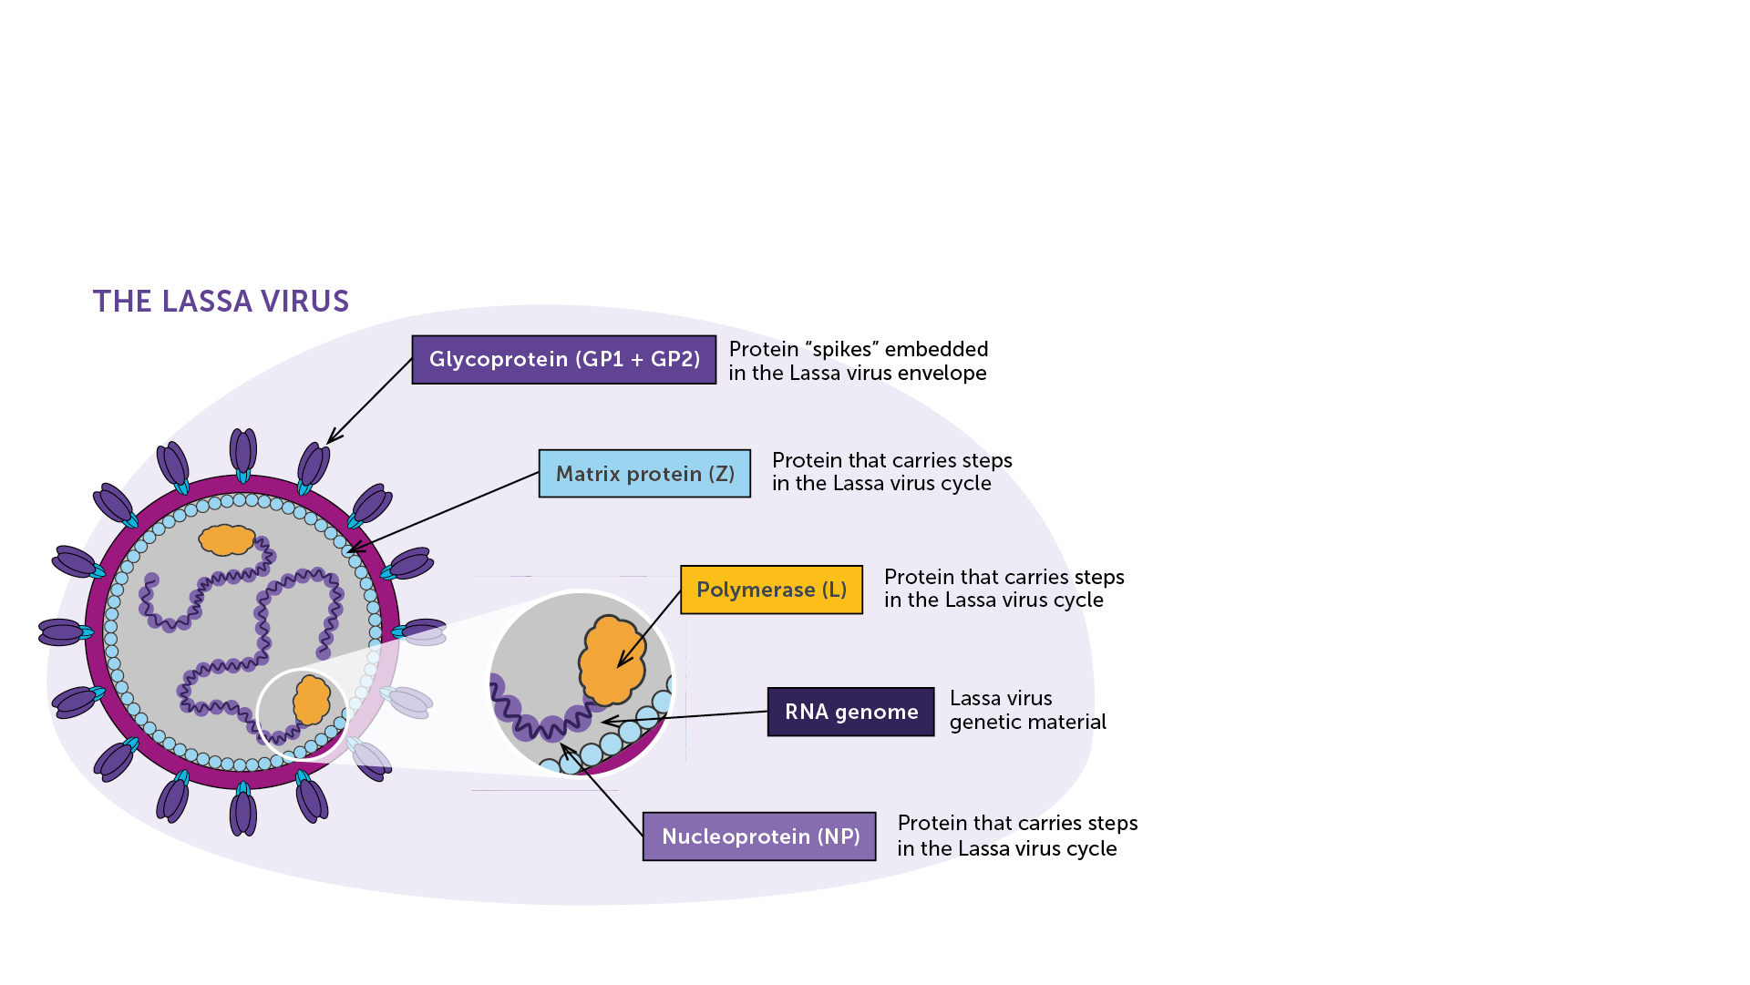
Lassa Mammarenavirus (LASV)
LASV responsible for the disease identified in 1969.​
Retrovirus: a virus that uses RNA as its genetic material. ​
Six types of LASV.​
Ingestion of food or inhalation of air contaminated with urine or faeces from infected rodents that spread the disease.​
Not spread through direct contact (hugging, shaking hands, or sitting near someone).​
Person-to-person transmission may occur after exposure to Lassa virus in the blood, tissue, secretions, or excretions of a Lassa-infected individual.​
IAVI VACCINE LITERACY LIBRARY | MODULE 2

Slide 25
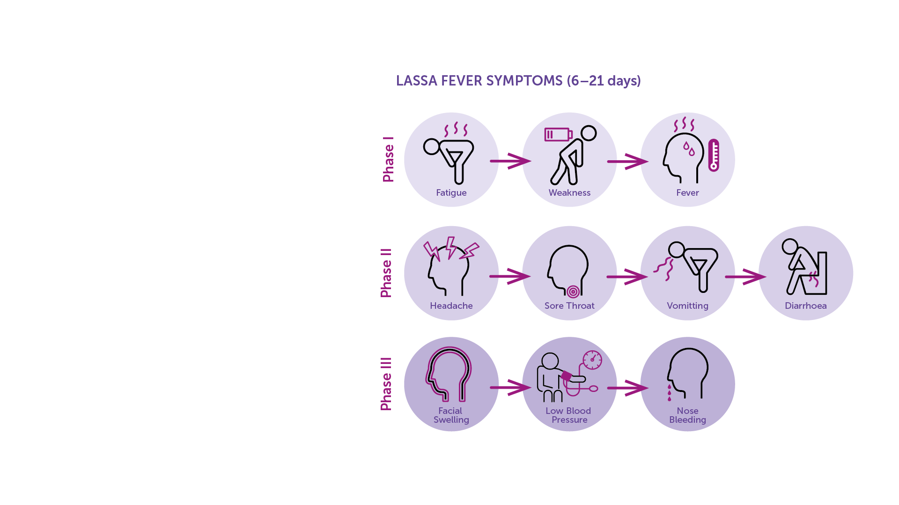
Lassa Fever Diagnosis​
Clinical diagnosis of Lassa fever is often difficult due to the variety of non-specific symptoms.​
Diagnosis​
Nucleic acid tests (NAT) that detect RNA from the virus in the blood.​
Tests to detect antibodies generated by the body in response to the infection.​
Antigenic tests to detect parts of the virus.​
Virus isolation by cell culture.​
IAVI VACCINE LITERACY LIBRARY | MODULE 2

Slide 26
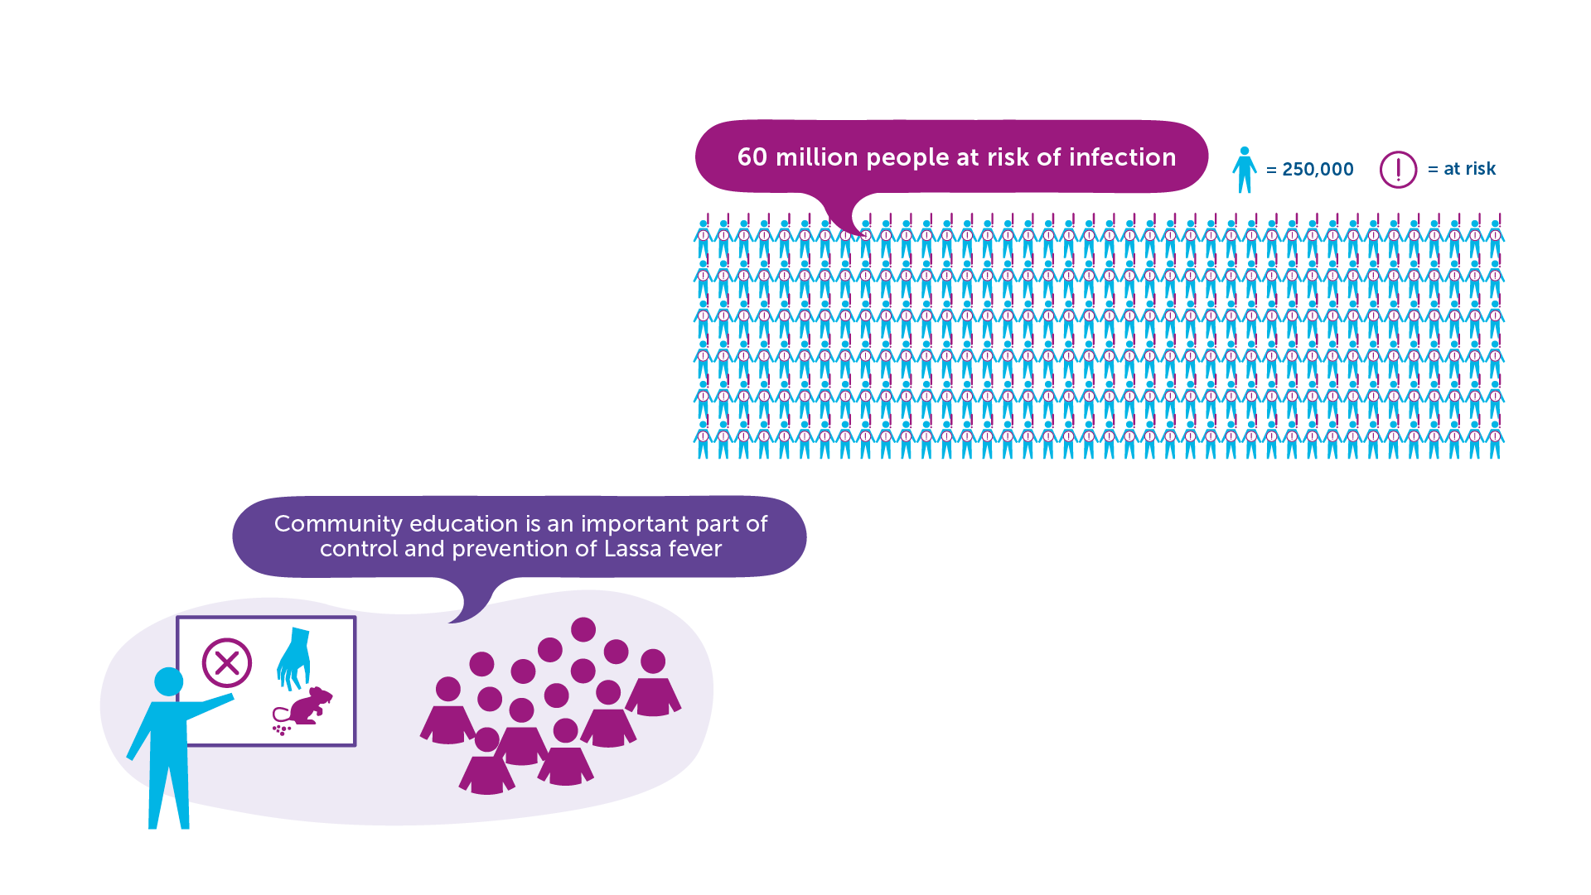
Lassa Fever Prevention and Treatment​
Nearly 60 million people are estimated at risk of infection.​
Community education in areas affected is an important part of the control and prevention of Lassa fever.​
No vaccine.​
No approved treatment for Lassa fever.​
IAVI VACCINE LITERACY LIBRARY | MODULE 2

Slide 28
Acknowledgements
IAVI would like to acknowledge the contribution of Doreen Asio, Monica Bagaya, Vincent Basajja, Kundai Chinyenze, William Dekker, Evanson Gichuru, Nyokabi Jacinta, Sarah Joseph, Dagna Laufer, Sharon Lipesa, Shelly Malhotra, Miliswa Magongo, Blossom Makhubalo, Roselyn Malogo, John Mdluli, Ireen Mosweu, Juliet Mpendo, Gaudensia Mutua, Vincent Muturi-Kioi, Conwell Mwakoi, Jauhara Nanyondo, Gertrude Nanyonjo, Jacinta Nyakobi, Faith Ochieng, Fred Otieno, Daisy Ouya, Gayle Patenaude, Hilda Phiri, Nicole Sender, Lewis Schrager, Elana Van Brakel, Kelvin Vollenhoven, Jeffery Walimbwa, Mathias Wambuzi, Anja Van der Westhuizen for reviewing the content of the IAVI Vaccine Literacy Library.
Lead Consultants: Roger Tatoud and Rebekah Webb.
Design and Illustration: Anthea Duce.
© International AIDS Vaccine Initiative, Inc. 2022

Slide 29

MODULE 3:
THE IMMUNE
SYSTEM
HIV
TB
Lassa Virus
Vaccines

Slide 31
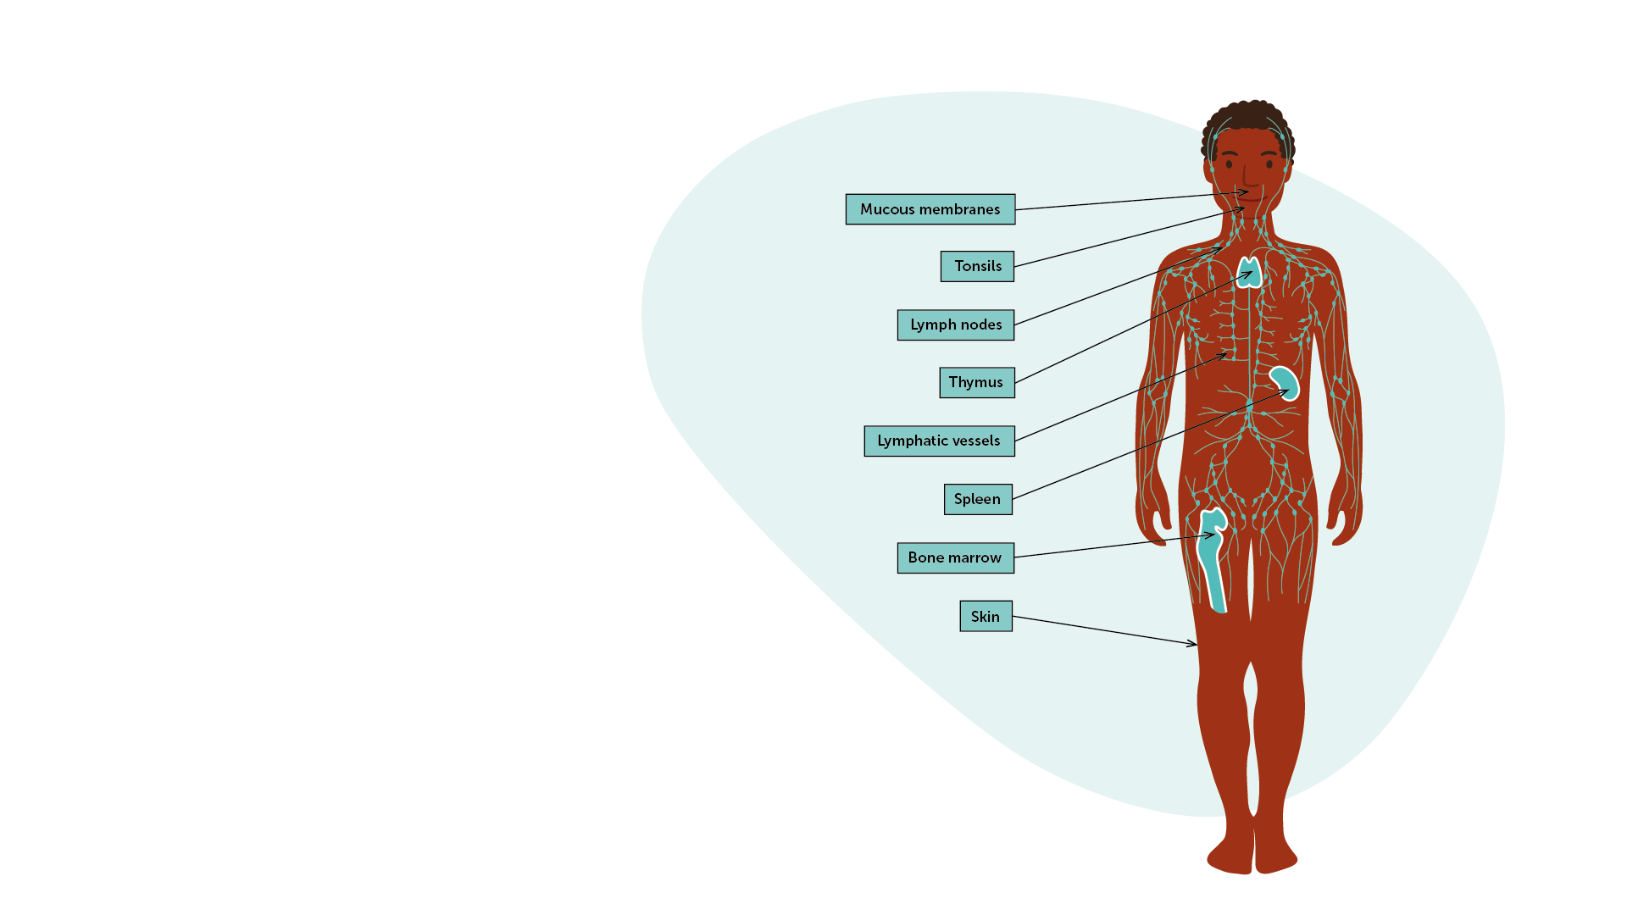
The Immune System
IAVI VACCINE LITERACY LIBRARY | MODULE 3
A complex system of organs, tissues, cells, and processes that protect us from disease.​
Enables the body to recognise anything that is different from itself (i.e. “foreign”) and that is potentially harmful.​
Creates defences against these invaders, which are called pathogens.​
Divided into two broad categories: ‘innate immunity’ and ‘acquired immunity.’​

Slide 32
Immunity and Immune Responses​
Type of immunity​
Innate immune defences​
  First to respond to any pathogen.​
  Not specific to one pathogen.​
  Cannot usually be “taught” to respond better by a vaccine.​
  Often not enough to get rid of pathogens as the first line of defence and a second line of defence kicks in.​
Acquired immunity
  Second line of defence of the body.​
  Activated only after our immune system has “seen” and “recognised” a pathogen.​
  Directed towards a single, specific pathogen.​
  The acquired immune responses are those involved in the function of a vaccine.​
Arms of the acquired immune response
Antibody-mediated or humoral immune response
  Includes antibodies and ‘B-cell’ responses.​
Cell-mediated or cellular immune response
  Coordinated by ‘T cells’ which targets cells that have already been infected with a pathogen.​
IAVI VACCINE LITERACY LIBRARY | MODULE 3

Slide 33
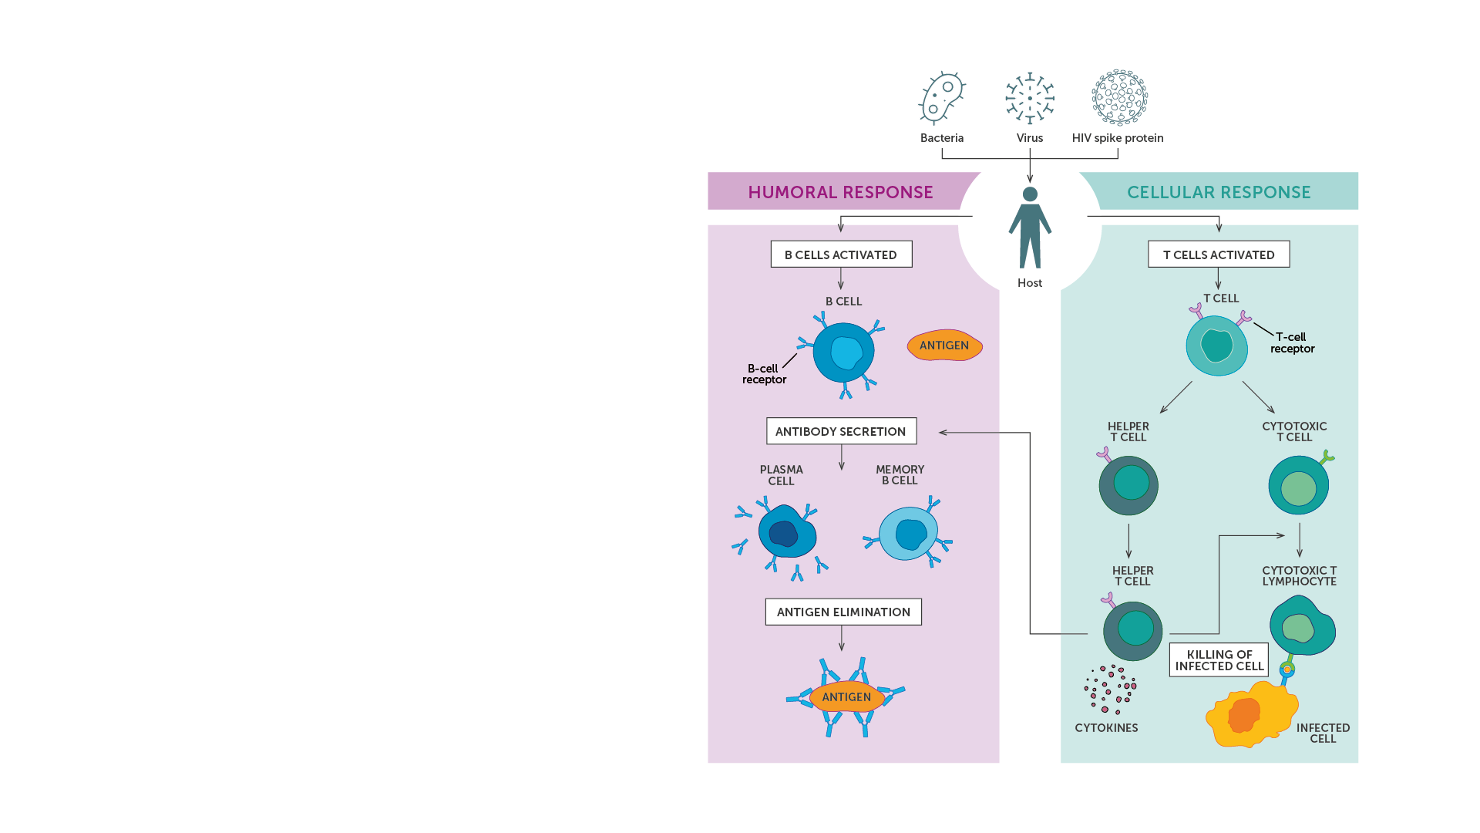
Cells of the Immune System​
Macrophages/dendritic cells/phagocytes​
Antigen-presenting cells (APCs)​
  B cells​
  Macrophages​
  Dendritic cells​
Lymphocytes​
T cells​
  CD4+ cells​
  CD8+ cells​
B cells​
Memory B cells and memory T cells​
Natural killer (NK) cells​
IAVI VACCINE LITERACY LIBRARY | MODULE 3

Slide 34
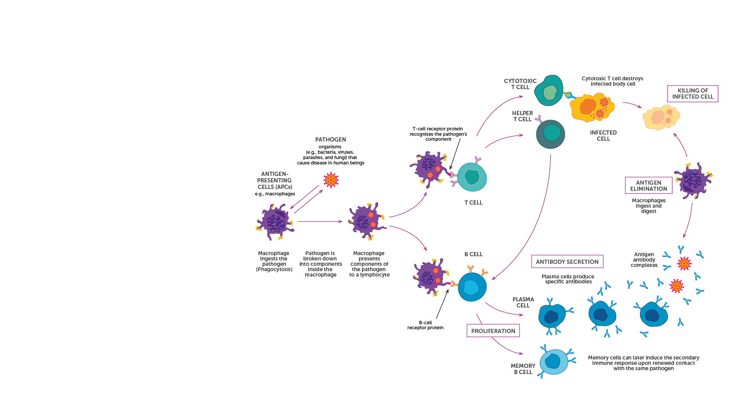
The Immune Response
The immune system comprises many cells located in different organs. Each plays a role in recognising pathogens and mounting a response.​
B-cell receptors and T-cell receptors are key proteins responsible for specific antigen recognition in acquired immunity.​
They are found at the surface of the T and B cells of the immune system, and they can recognise antigens or part of the antigens presented by the antigen-presenting cells (APCs).​
There is a vast diversity of B- and T- cell receptors allowing the human immune system to recognise a very large number of pathogens.​
IAVI VACCINE LITERACY LIBRARY | MODULE 3

Slide 35
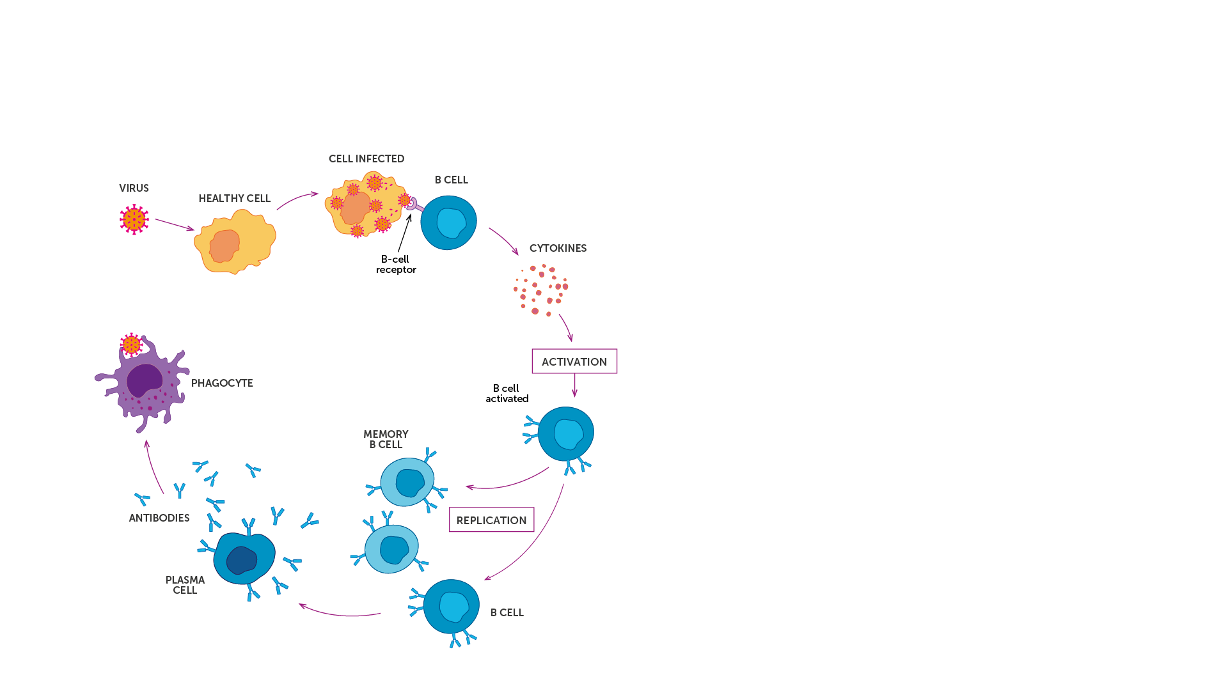
Humoral Immune Response
Binding antibody​
Produced in large quantities following infection.​
Recognises and binds to parts of a foreign body but cannot directly prevent infections or destroy the pathogen.​
Requires the involvement of other immune mechanisms to destroy the foreign agent.​
Neutralising antibody​
Recognises and binds to a pathogen.​
Can neutralise pathogens by blocking the pathogen from entering its host cell.​
Neutralisation can result in loss of infectivity.​
Broadly neutralising antibody (bnAb)​
Can recognise a wide range of viruses even if they are different from the virus that initially infected the individual.​
IAVI VACCINE LITERACY LIBRARY | MODULE 3

Slide 36
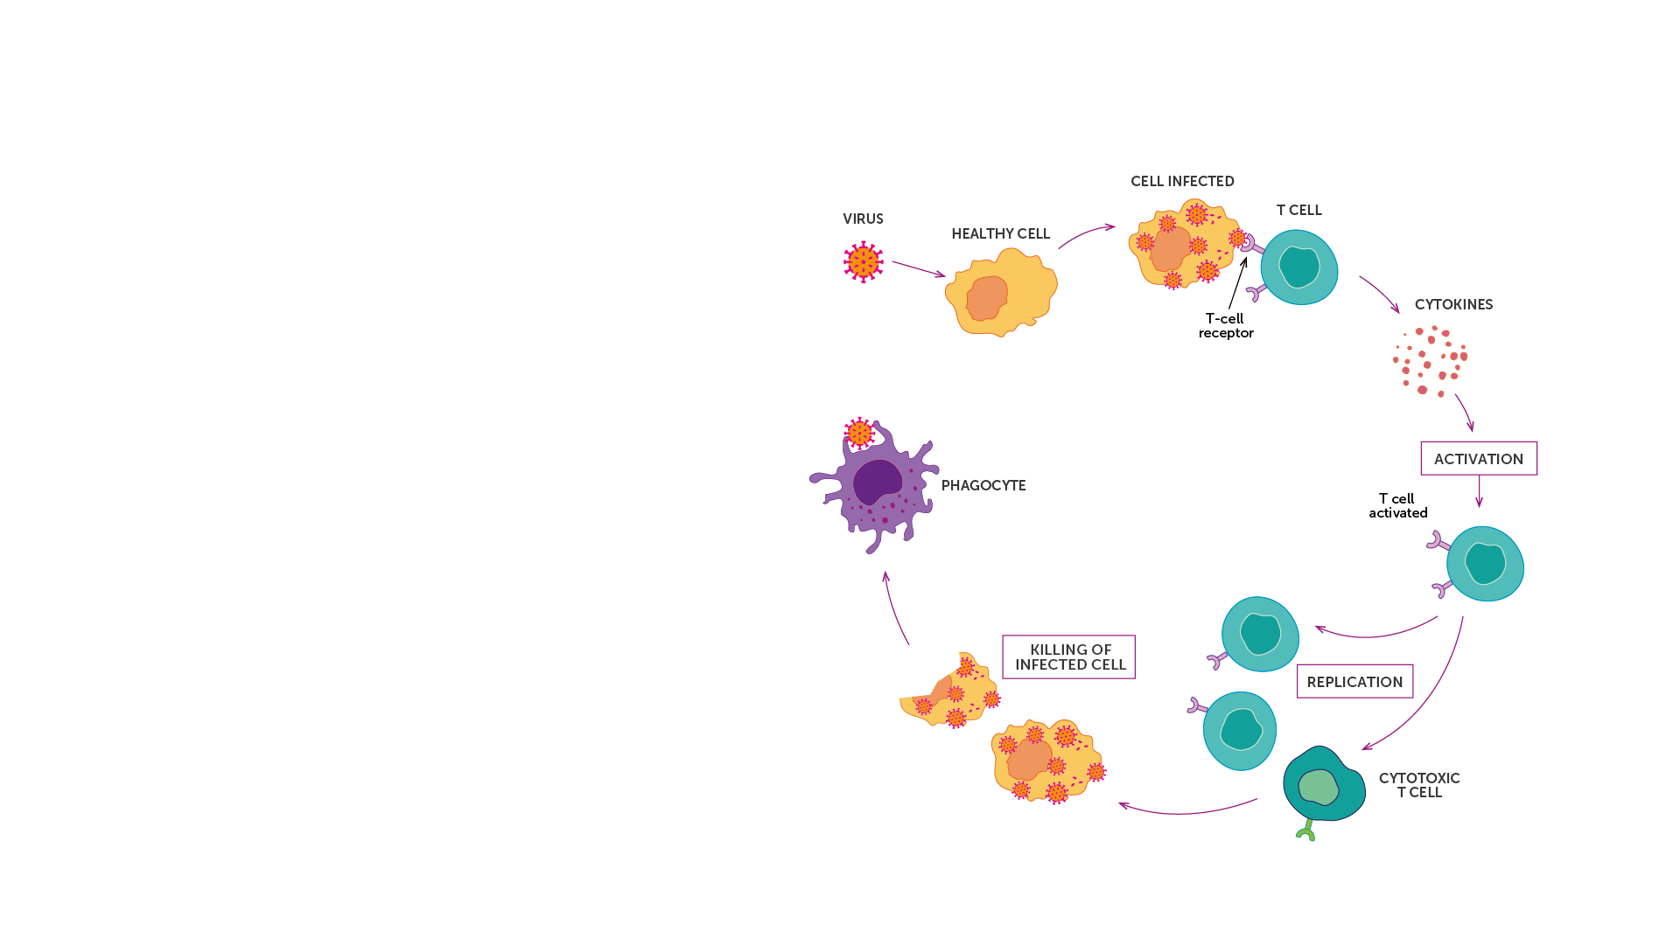
Cellular Immune Response
The cellular response is the arm of the immune response mediated by cells from the immune system and the production of cytokines.​
Cellular immunity is most effective in destroying virus-infected cells, and bacteria within cells.​
Cytokines are proteins that act as messengers between cells to regulate and coordinate the immune responses.​
Cellular immunity works by activating antigen-specific cytotoxic T lymphocytes (CTLs), macrophages and natural killer cells that can destroy cells displaying antigens of foreign antigen on their surface.​
IAVI VACCINE LITERACY LIBRARY | MODULE 3

Slide 37
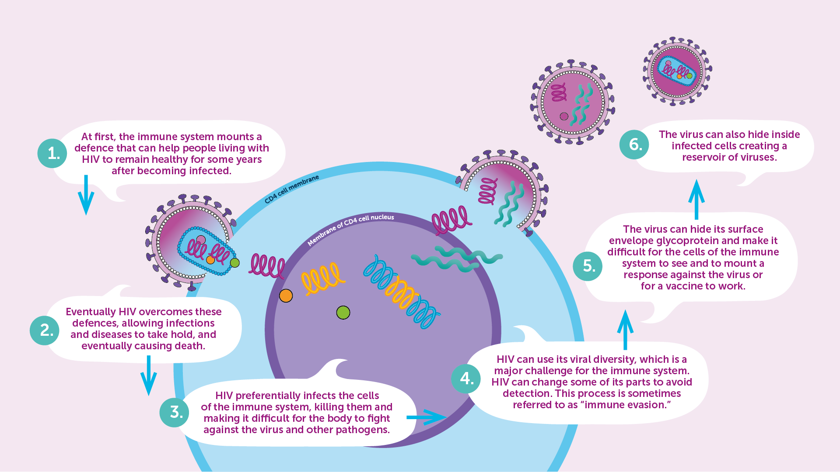
HIV and the Immune System
IAVI VACCINE LITERACY LIBRARY | MODULE 3

Slide 38
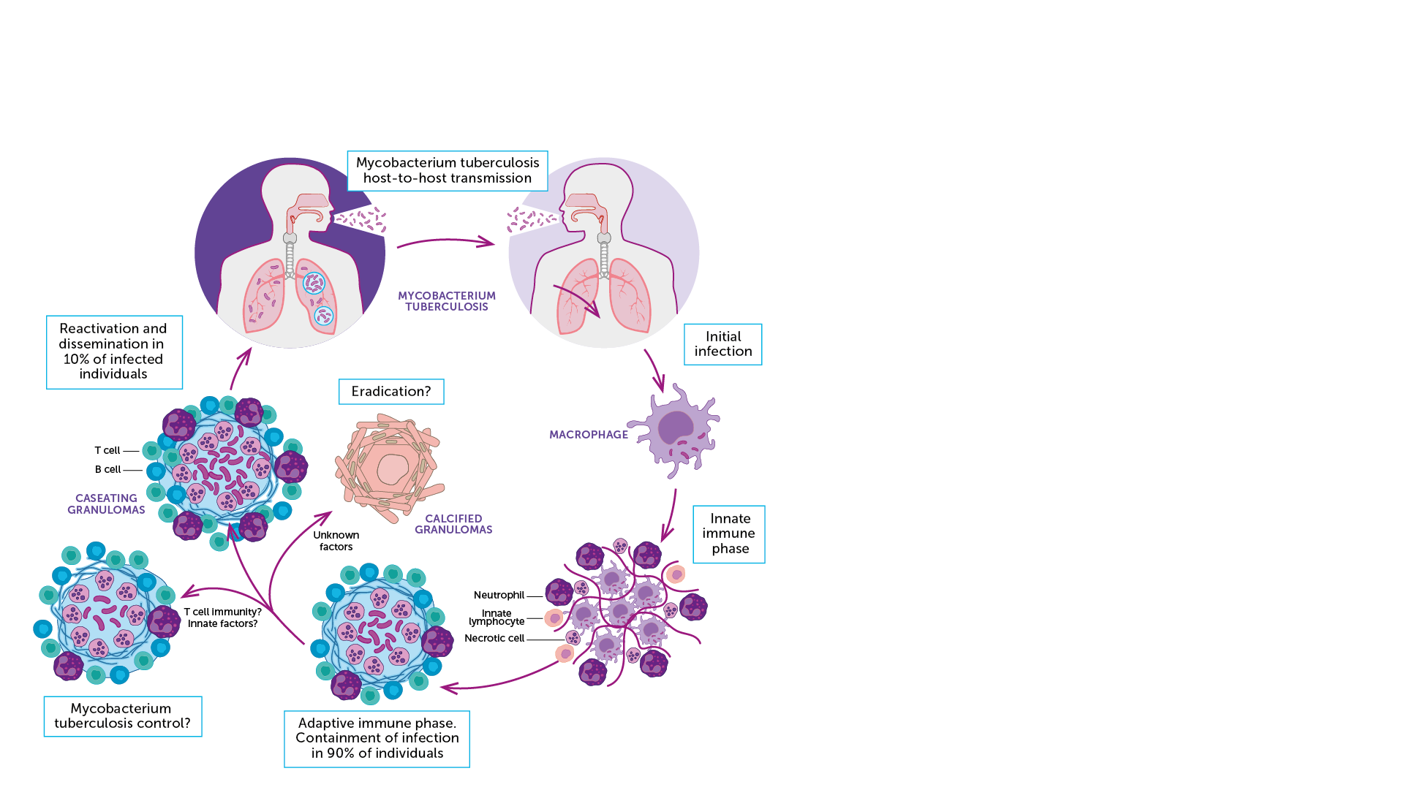
TB and the Immune System
The interaction between the immune system and Mycobacterium tuberculosis are complex and either lead to:​
  Clearance of the bacteria​
  Latent TB infection​
  Active TB disease ​​
M.tb can prevent the activation of pathogen destruction systems within macrophages where it can hide, reproduce slowly, and modify the cell to its advantage.​
M.tb can affect the function of dendritic cells by altering the production of various cytokines involved in the immune responses and the suppression of T lymphocyte activity.​
M.tb can also interfere with the interactions between the different cells of the immune system and hamper their ability to work together and kill or constrain the organism.​
IAVI VACCINE LITERACY LIBRARY | MODULE 3

Slide 39

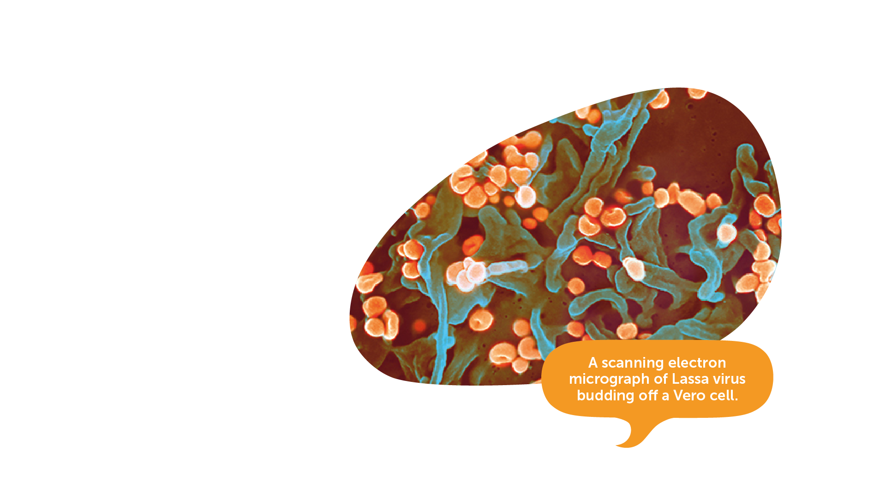
Lassa and the Immune System​
The immune response to natural Lassa virus infection (LASV) has yet to be fully explained by scientists.​
Outbreaks of the disease are typically sporadic and often in remote locations.
The virus needs to be handled in a special high safety laboratory​.
LASV results in immunosuppression and is able to evade and undermine effective immune response.​
Image credit: National Institute of Allergy and Infectious Diseases, NIH.
IAVI VACCINE LITERACY LIBRARY | MODULE 3
Notes:
https://www.iavi.org/news-resources/press-releases/2021/edctp-and-cepi-funding-moves-iavi-s-lassa-fever-vaccine-candidate-into-advanced-clinical-development

Slide 40

Key Messages
The immune system is the set of organs, tissues, and cells that defend the body against infections.​
It is very sophisticated and is designed to recognise common pathogens that enter the body, such as viruses, bacteria, or parasites.​
The immune system develops defence responses to invading organisms and usually will ‘remember’ and respond more rapidly during future encounters.​
Some pathogens such as HIV can disrupt or evade immune responses.​
IAVI VACCINE LITERACY LIBRARY | MODULE 3

Slide 42
Acknowledgements
IAVI would like to acknowledge the contribution of Doreen Asio, Monica Bagaya, Vincent Basajja, Kundai Chinyenze, William Dekker, Evanson Gichuru, Nyokabi Jacinta, Sarah Joseph, Dagna Laufer, Sharon Lipesa, Shelly Malhotra, Miliswa Magongo, Blossom Makhubalo, Roselyn Malogo, John Mdluli, Ireen Mosweu, Juliet Mpendo, Gaudensia Mutua, Vincent Muturi-Kioi, Conwell Mwakoi, Jauhara Nanyondo, Gertrude Nanyonjo, Jacinta Nyakobi, Faith Ochieng, Fred Otieno, Daisy Ouya, Gayle Patenaude, Hilda Phiri, Nicole Sender, Lewis Schrager, Elana Van Brakel, Kelvin Vollenhoven, Jeffery Walimbwa, Mathias Wambuzi, Anja Van der Westhuizen for reviewing the content of the IAVI Vaccine Literacy Library.
Lead Consultants: Roger Tatoud and Rebekah Webb.
Design and Illustration: Anthea Duce.
© International AIDS Vaccine Initiative, Inc. 2022

Slide 43

MODULE 4:
INTRODUCTION
TO VACCINES
HIV
TB
Lassa Virus
Vaccines

Slide 45

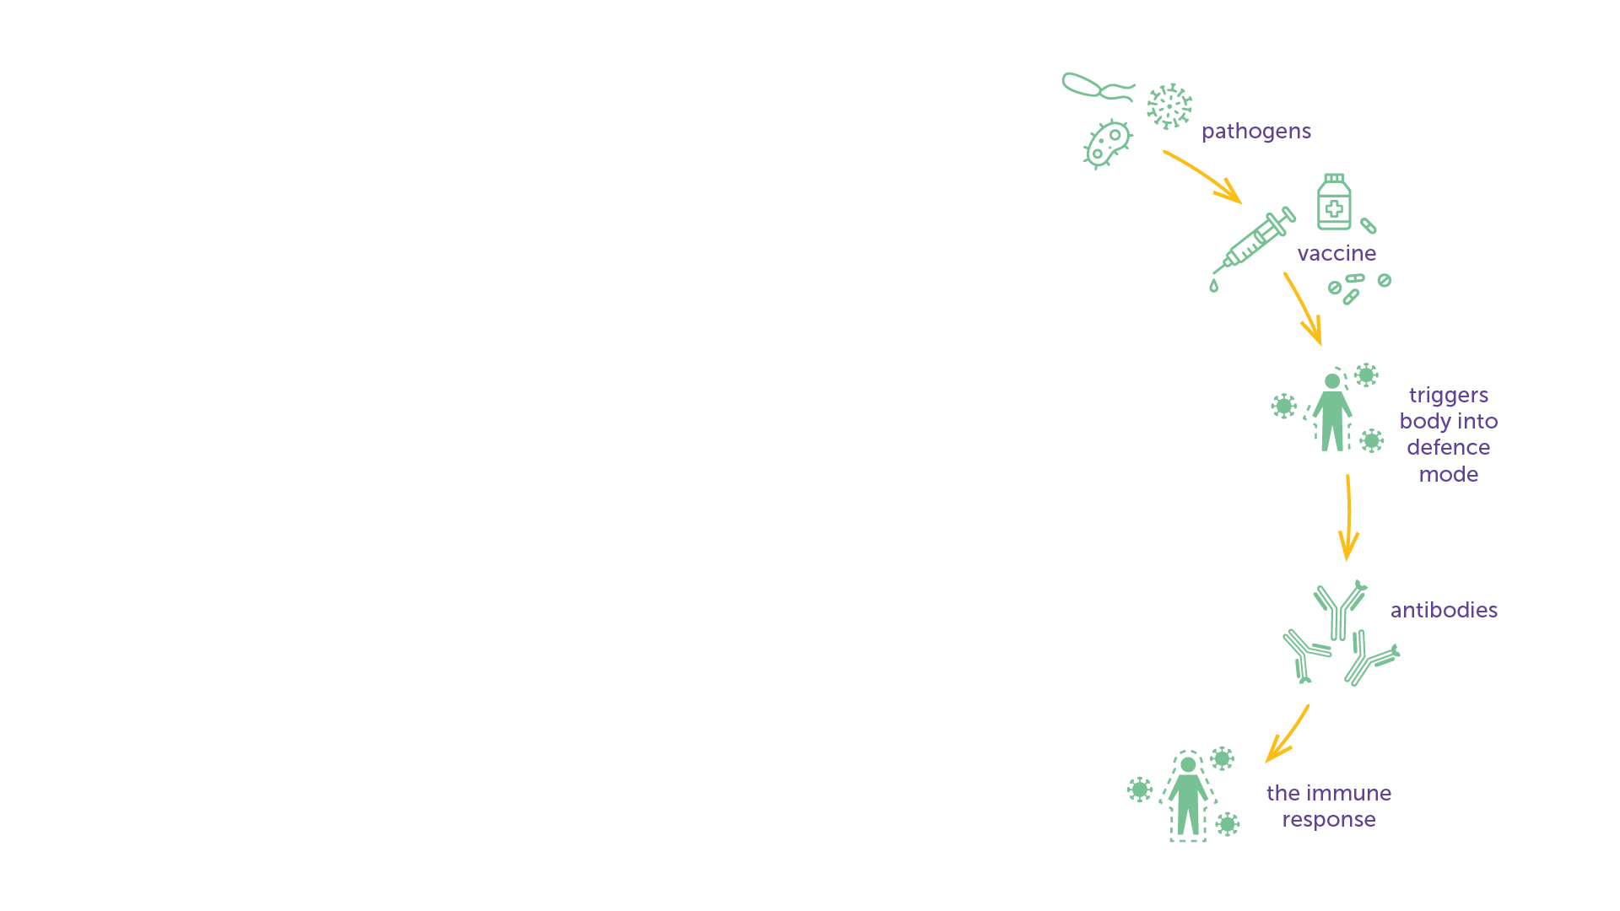
What is a Vaccine?
A vaccine is a biological product that is introduced into the body to trigger an immune response to prevent infection or to control a disease caused by a virus, bacteria or parasite (these are called ‘pathogens’).​
A vaccine ‘teaches’ the body how to defend itself against a pathogen.​
A vaccine can contain all or a part of the pathogen, produced synthetically, or derived from the pathogen and known as an ‘antigen.’​
Vaccines can be introduced into the body by different ways, such as injection into the muscle (intramuscular); into or under the skin (intradermal or subcutaneous); application to the skin (transdermal); application to the inside of the nose (nasal); or by being swallowed (oral).​
Each vaccine is designed to protect against a specific disease, but can be combined into one jab with other vaccines, for example the vaccine for diphtheria, pertussis (whooping cough), and tetanus (called DTP).​
A vaccine typically contains only a small part of the pathogen it is designed to fight. To ensure a strong immune response is triggered, an adjuvant can be added to the vaccine to increase the body’s immune response.​
IAVI VACCINE LITERACY LIBRARY | MODULE 4

Slide 46
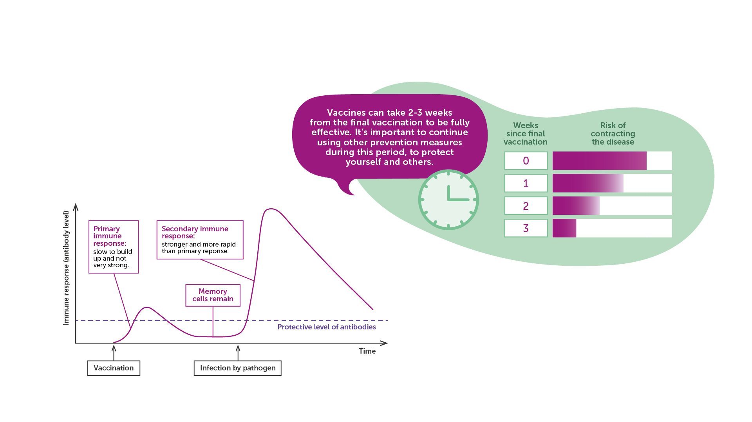
How a Vaccine Works
Source: Adapted from WHO
IAVI VACCINE LITERACY LIBRARY | MODULE 4

Slide 47
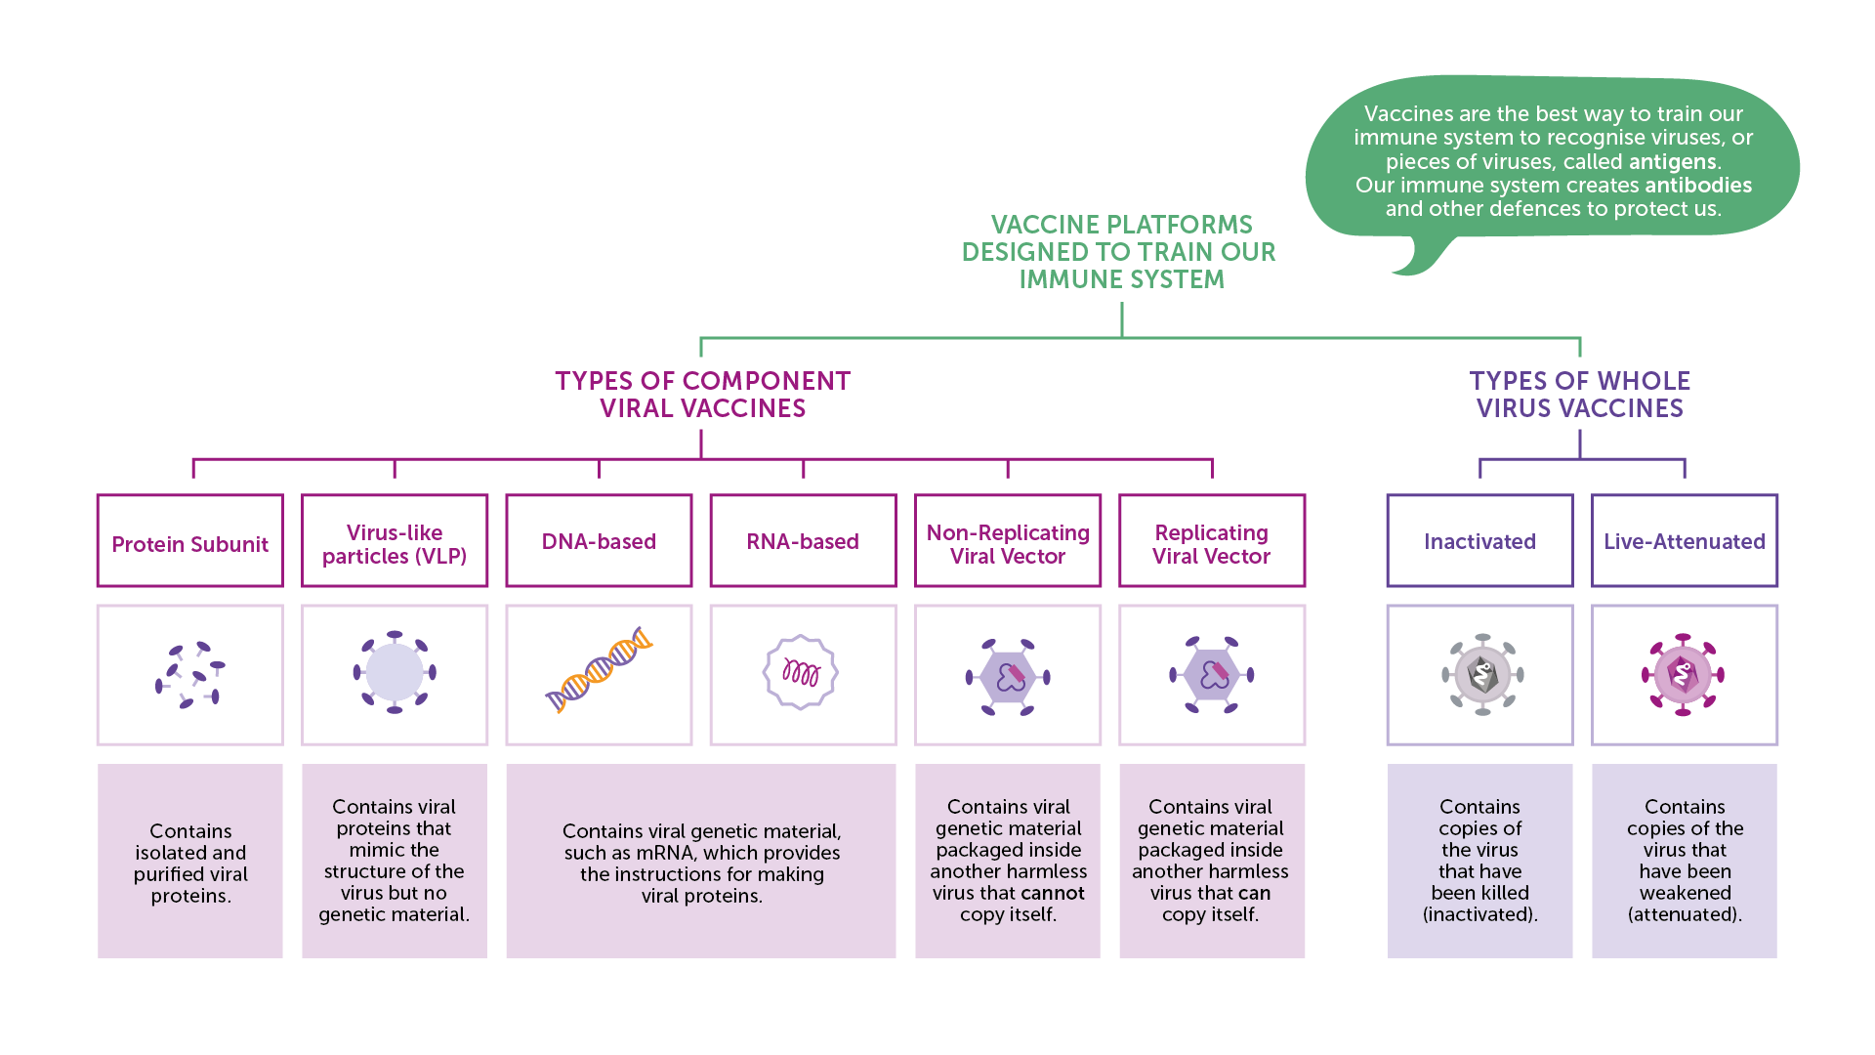
Vaccine Platforms
IAVI VACCINE LITERACY LIBRARY | MODULE 4

Slide 48
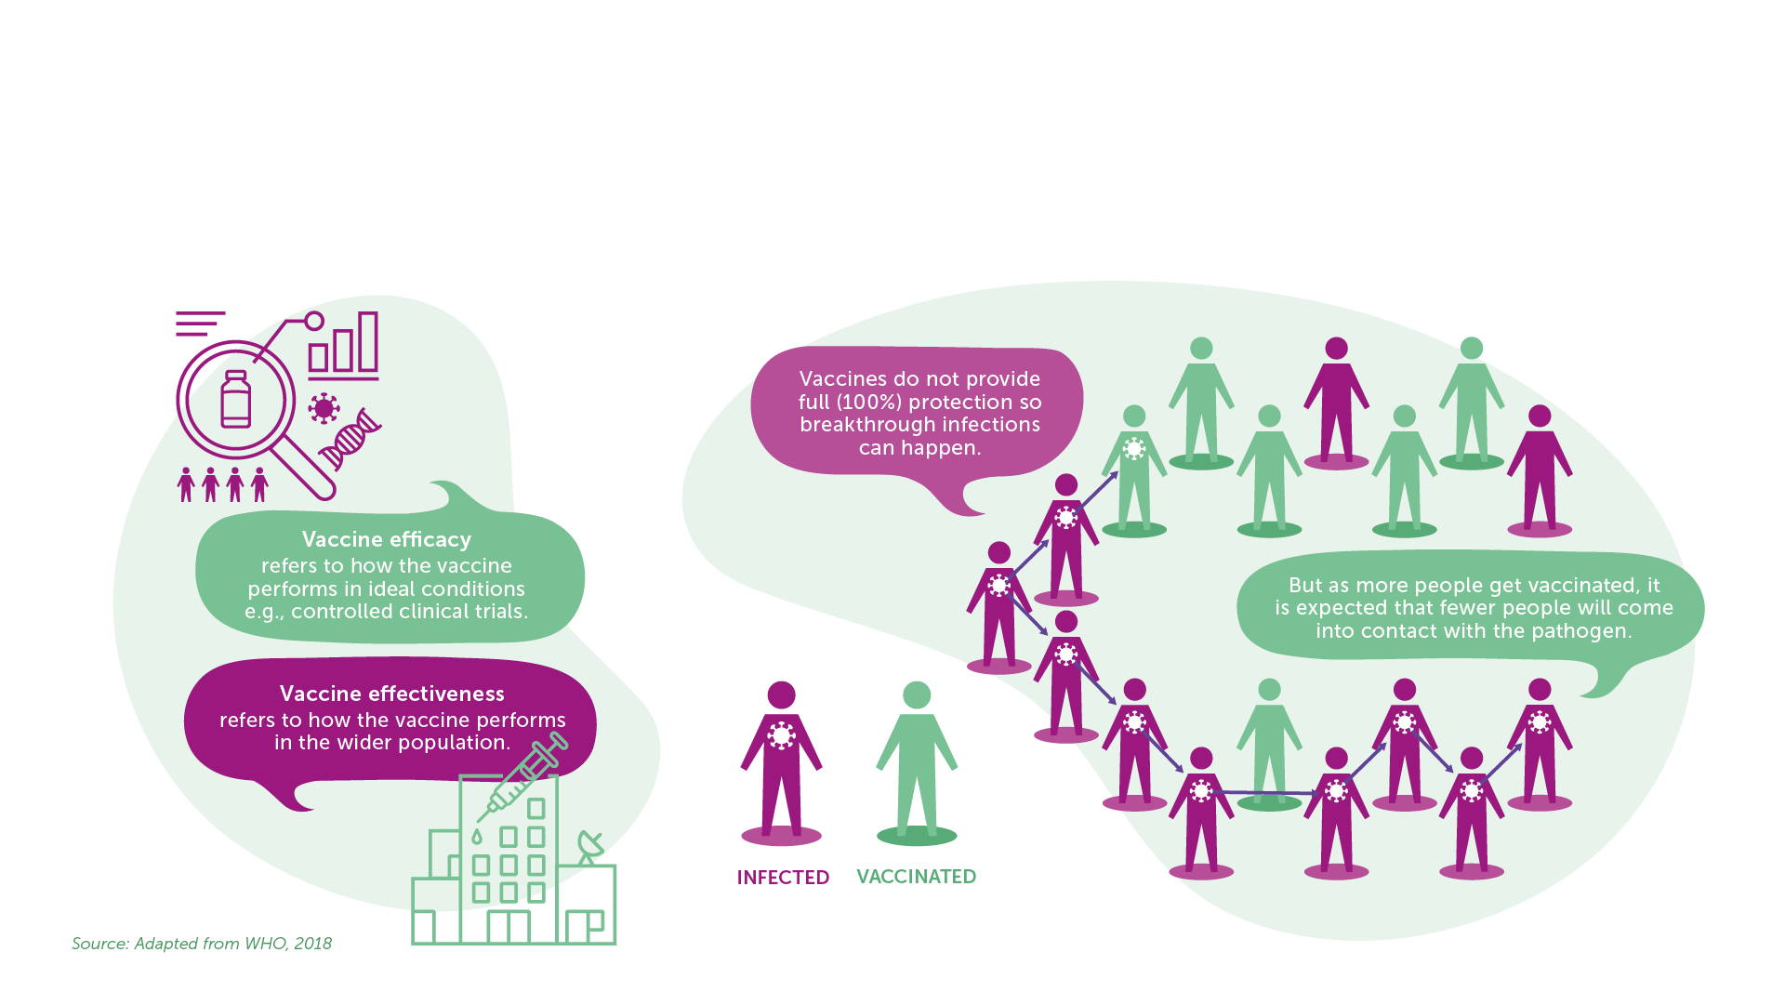
Efficacy, Effectiveness, Herd Immunity
Efficacy and Effectiveness
Herd Immunity
IAVI VACCINE LITERACY LIBRARY | MODULE 4

Slide 49
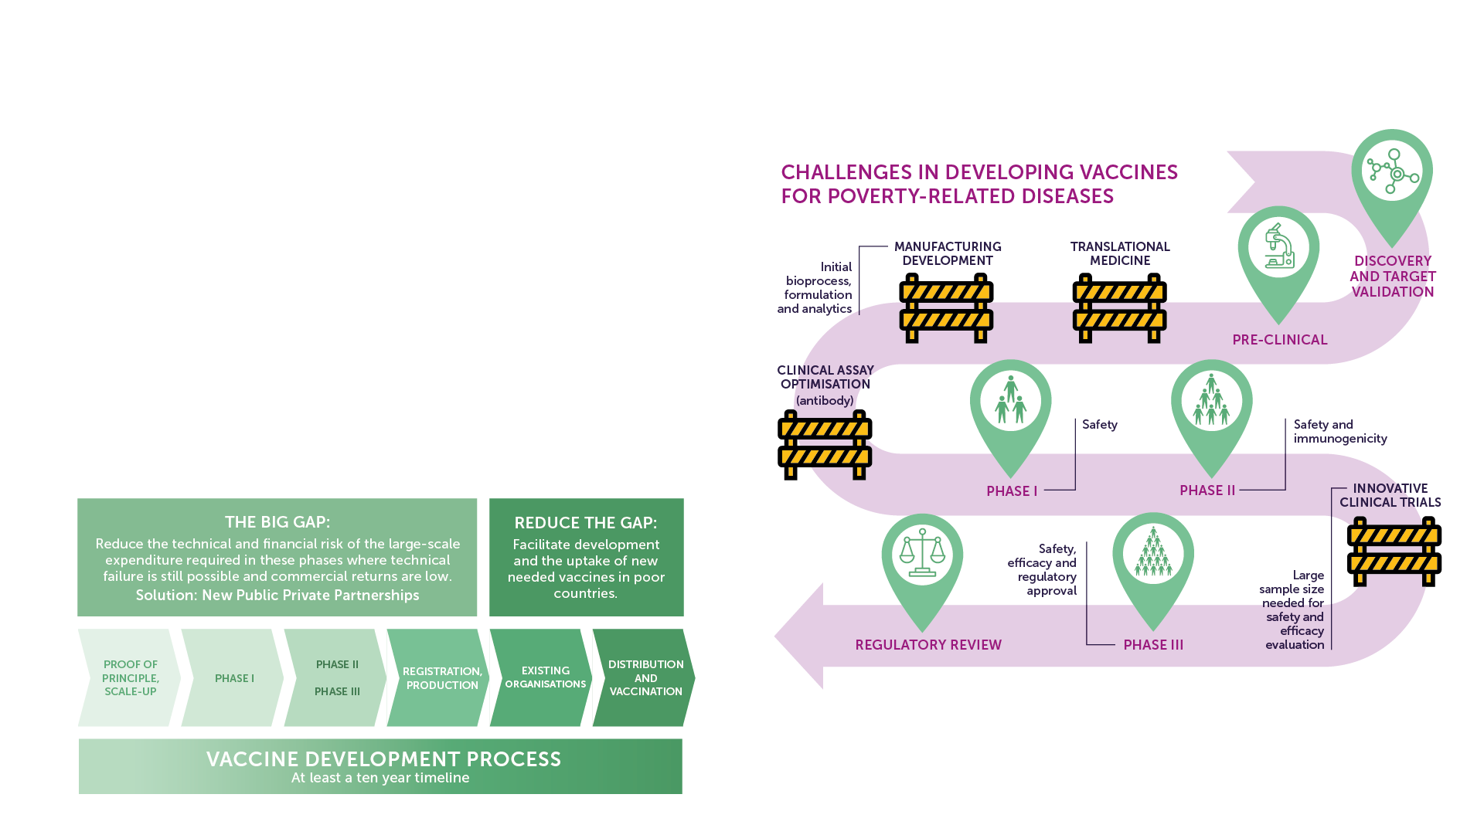
Vaccine Development Challenges
The pathogen is complex and diverse.​
Immune responses are still poorly understood.​
Animal models are limited.​
Large clinical trials are needed to show efficacy.​
Limited engagement from industry (neglected diseases).​
IAVI VACCINE LITERACY LIBRARY | MODULE 4

Slide 50
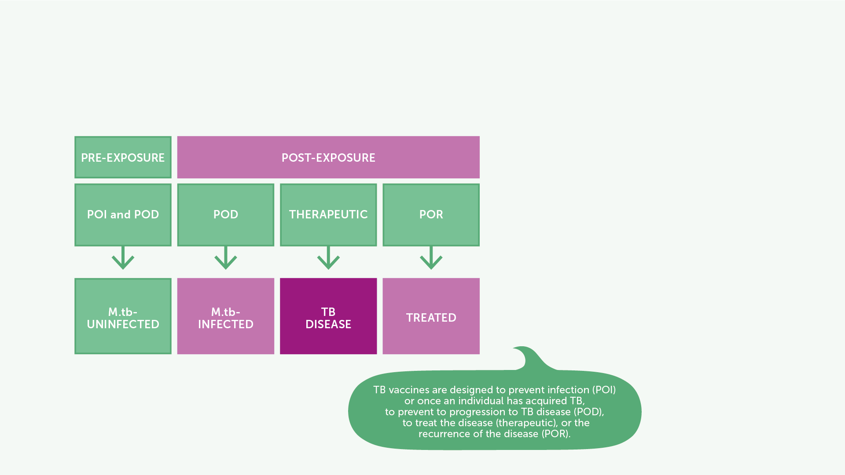
TB Vaccine Research and Development
BCG, developed in 1921 and the only licensed vaccine for the prevention of TB.​
Different vaccines being researched to address different aspects of TB.​
In 2019, M72/AS01 candidate vaccine showed 49.7% protective efficacy against pulmonary TB in HIV negative adults with latent TB infection living in high TB burden countries. ​
IAVI VACCINE LITERACY LIBRARY | MODULE 4

Slide 51
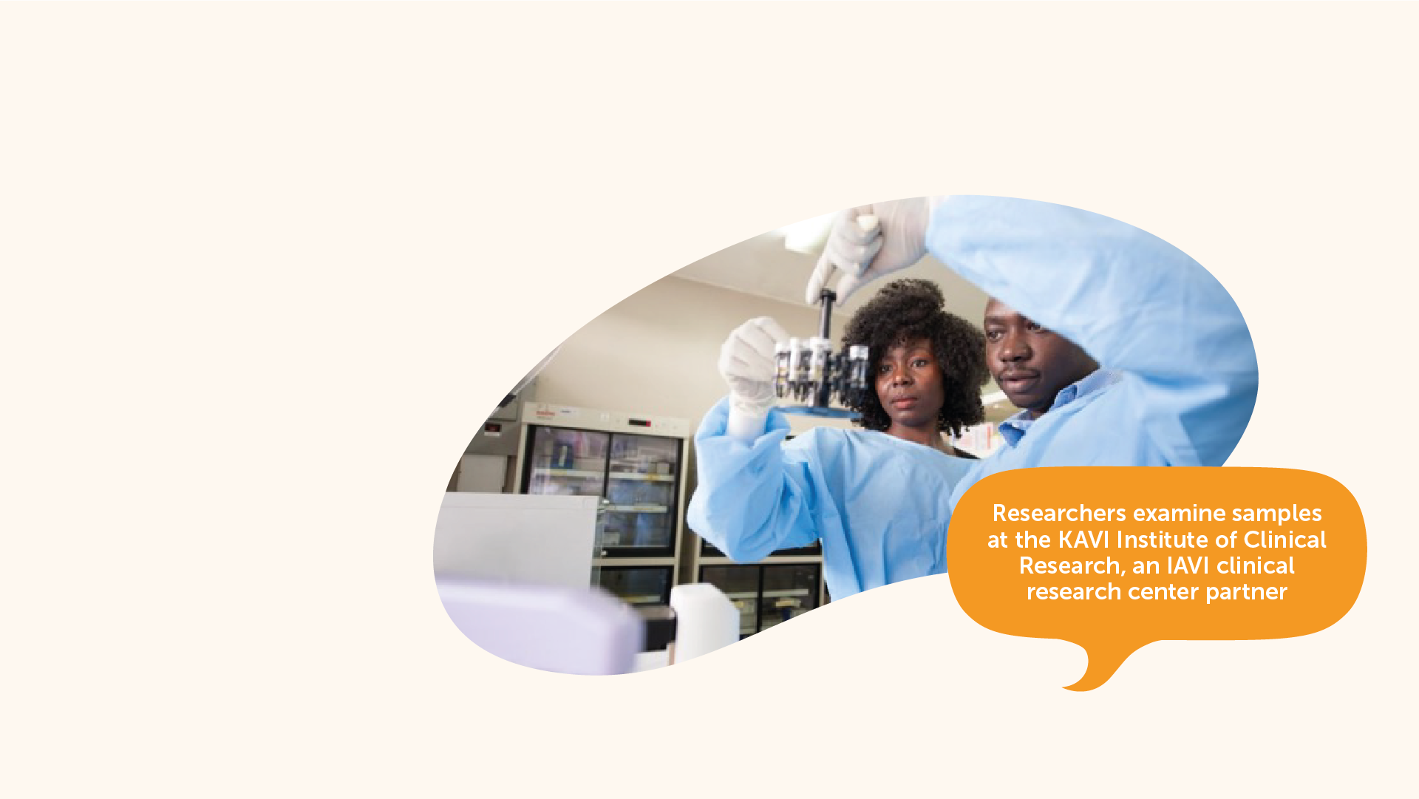
Lassa Fever Vaccine Research and Development​
No vaccine approved.​
Several candidates tested in animal studies.​
CEPI is supporting the development of six Lassa vaccine candidates based on DNA or recombinant vectors.​
Three of these have entered Phase I trials in humans as of 2022.​
IAVI VACCINE LITERACY LIBRARY | MODULE 4

Slide 52
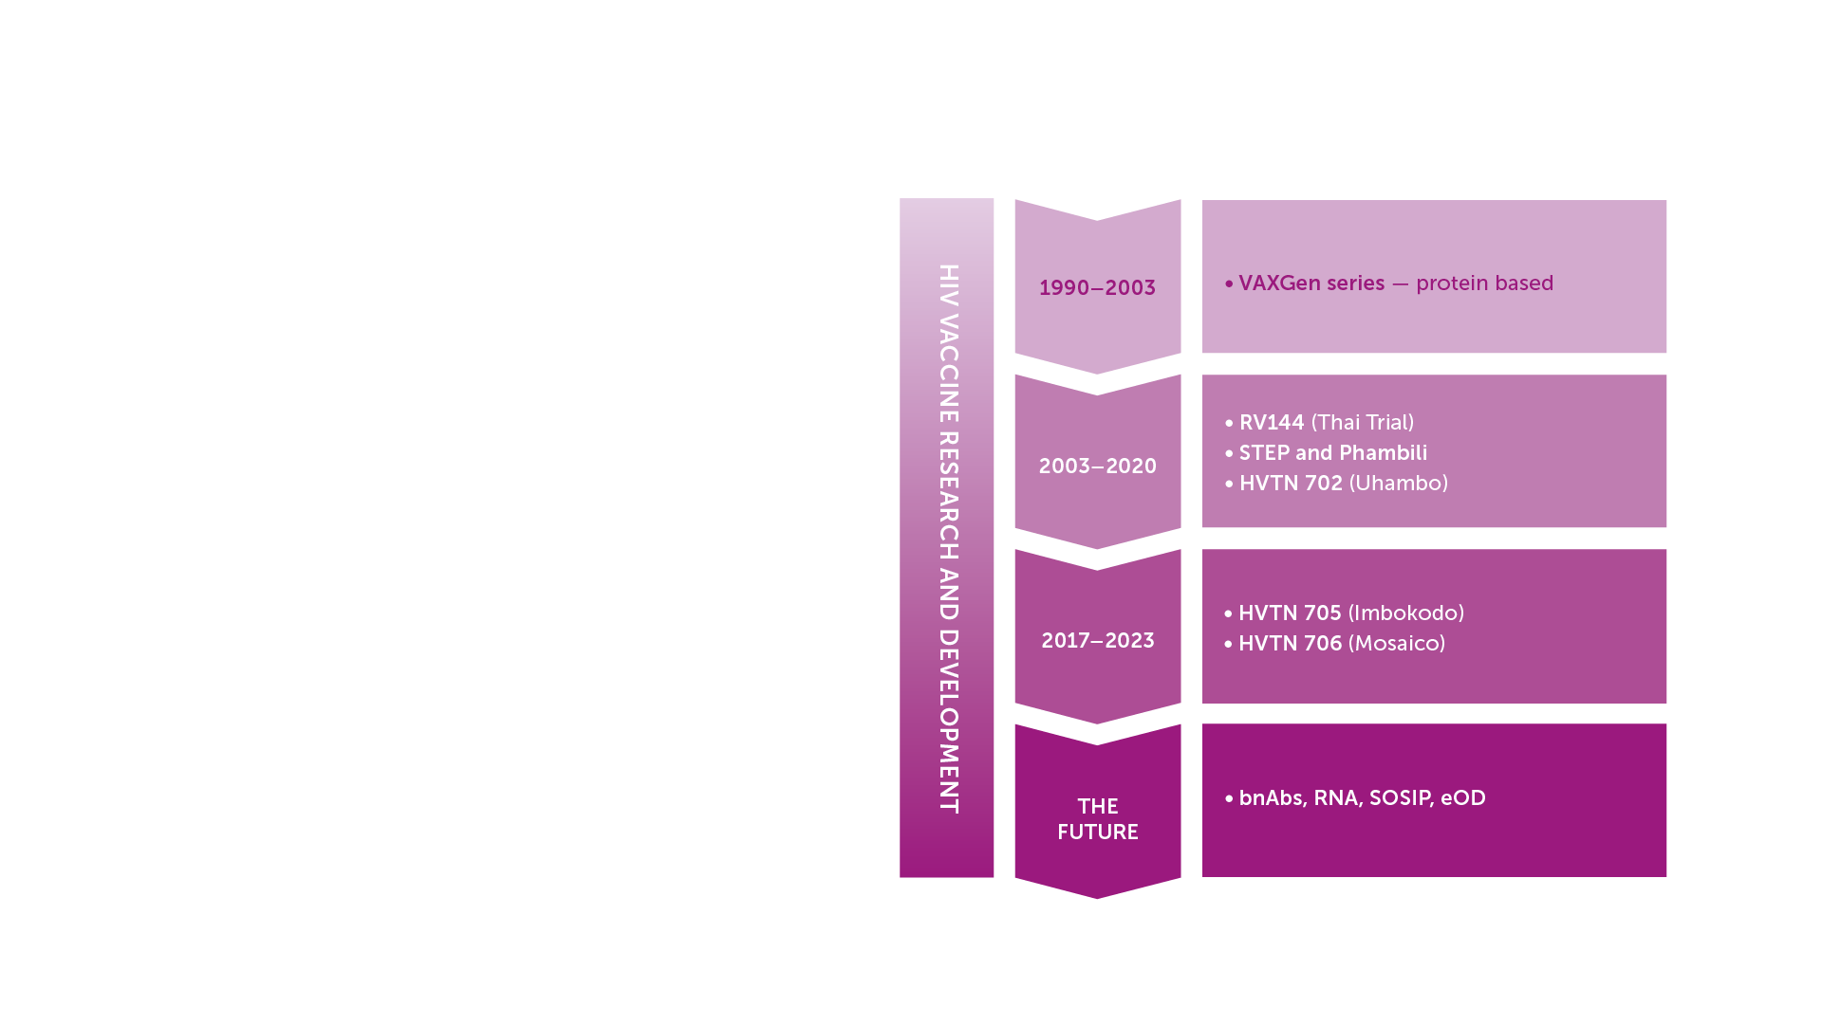
HIV Vaccine Research and Development​
A preventive HIV vaccine could work in one of two ways:​
Blocking infection, so the vaccinated person does not become infected with HIV in the future.​
Modifying the course of HIV infection so that even if it were not successful in preventing HIV infection, the vaccinated person would have a mild course of disease and AIDS would develop more slowly or not at all.​
IAVI VACCINE LITERACY LIBRARY | MODULE 4

Slide 53
Key Messages
Vaccines work and save lives.​
Vaccines ‘teach’ the immune system how to defend itself against a disease-causing agent, known as a pathogen.​
Vaccine efficacy refers to how well it protects against disease or infection when it is tested in a large trial in humans; vaccine effectiveness refers to how well it reduces the risk of infection once it is used in the overall population.​
No existing vaccine works on all people 100% of the time. It is possible for a vaccine to be less than 100% effective and therefore it will not eliminate the risk of infection. However, this vaccine may still be beneficial in reducing the burden of an epidemic at population level.​
Traditionally, vaccines are used to prevent illness, but therapeutic vaccines are also being developed that can fight disease after infection has taken hold.​
IAVI VACCINE LITERACY LIBRARY | MODULE 4

Slide 55
Acknowledgements
IAVI would like to acknowledge the contribution of Doreen Asio, Monica Bagaya, Vincent Basajja, Kundai Chinyenze, William Dekker, Evanson Gichuru, Nyokabi Jacinta, Sarah Joseph, Dagna Laufer, Sharon Lipesa, Shelly Malhotra, Miliswa Magongo, Blossom Makhubalo, Roselyn Malogo, John Mdluli, Ireen Mosweu, Juliet Mpendo, Gaudensia Mutua, Vincent Muturi-Kioi, Conwell Mwakoi, Jauhara Nanyondo, Gertrude Nanyonjo, Jacinta Nyakobi, Faith Ochieng, Fred Otieno, Daisy Ouya, Gayle Patenaude, Hilda Phiri, Nicole Sender, Lewis Schrager, Elana Van Brakel, Kelvin Vollenhoven, Jeffery Walimbwa, Mathias Wambuzi, Anja Van der Westhuizen for reviewing the content of the IAVI Vaccine Literacy Library.
Lead Consultants: Roger Tatoud and Rebekah Webb.
Design and Illustration: Anthea Duce.
© International AIDS Vaccine Initiative, Inc. 2022

Slide 56

MODULE 5:
WHAT IS A VACCINE
CLINICAL TRIAL?
HIV
TB
Lassa Virus
Vaccines

Slide 58

What is a Vaccine Clinical Trial?
A type of research that studies new medicines, treatments, or prevention tools to evaluate their effect on human health.​
Clinical trials evaluate whether candidate vaccines are effective at preventing or controlling infections and diseases.​
A sequential series of trials are required to determine whether the candidate vaccine is both safe and efficacious.​
Clinical trials are necessary for licensing new vaccines and medicines.​
IAVI VACCINE LITERACY LIBRARY | MODULE 5

Slide 59
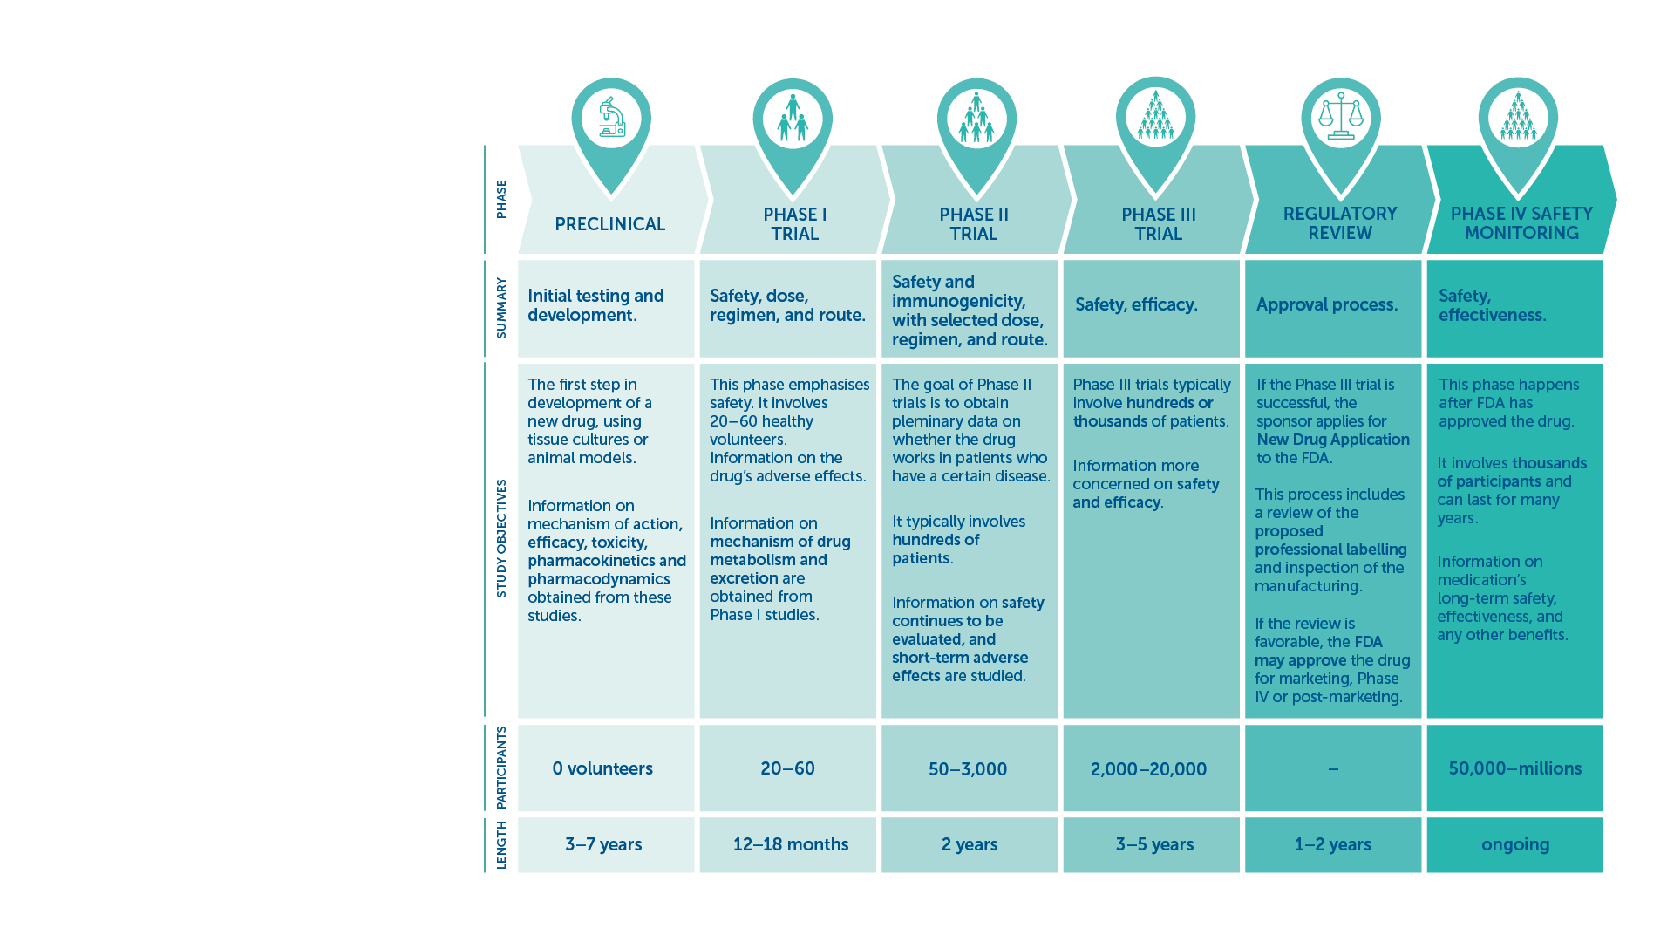
Phases of Clinical Trials
Highlights:​
Safety​
Efficacy​
Effectiveness​
IAVI VACCINE LITERACY LIBRARY | MODULE 5

Slide 60

Safety
To make sure that all possible side-effects are recorded, even rare or uncommon ones.​
‘Adverse events’ can be mild, moderate, or severe.​
Common reactions that are expected for vaccines include fever, headache, tiredness, or body aches.​
Serious reactions to vaccines are very rare.​
Safety monitoring continues through the reporting of side effects even after a vaccine has been approved for use.​
Safety is evaluated in the different clinical trial phases of a candidate vaccine to establish the product(s) does not cause serious reactions, or side effects that would prevent its use.​
IAVI VACCINE LITERACY LIBRARY | MODULE 5

Slide 61
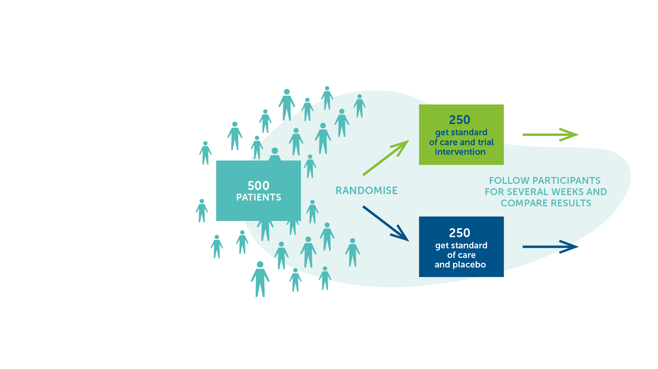
Placebo
A harmless, inactive substance.​
Given to one group of participants in a clinical trial, while the candidate vaccine is given to another group.​
The group receiving the placebo is usually called the control group. ​
In this way researchers have a comparator to tell if the vaccine candidate is safe and effective.​
IAVI VACCINE LITERACY LIBRARY | MODULE 5

Slide 62
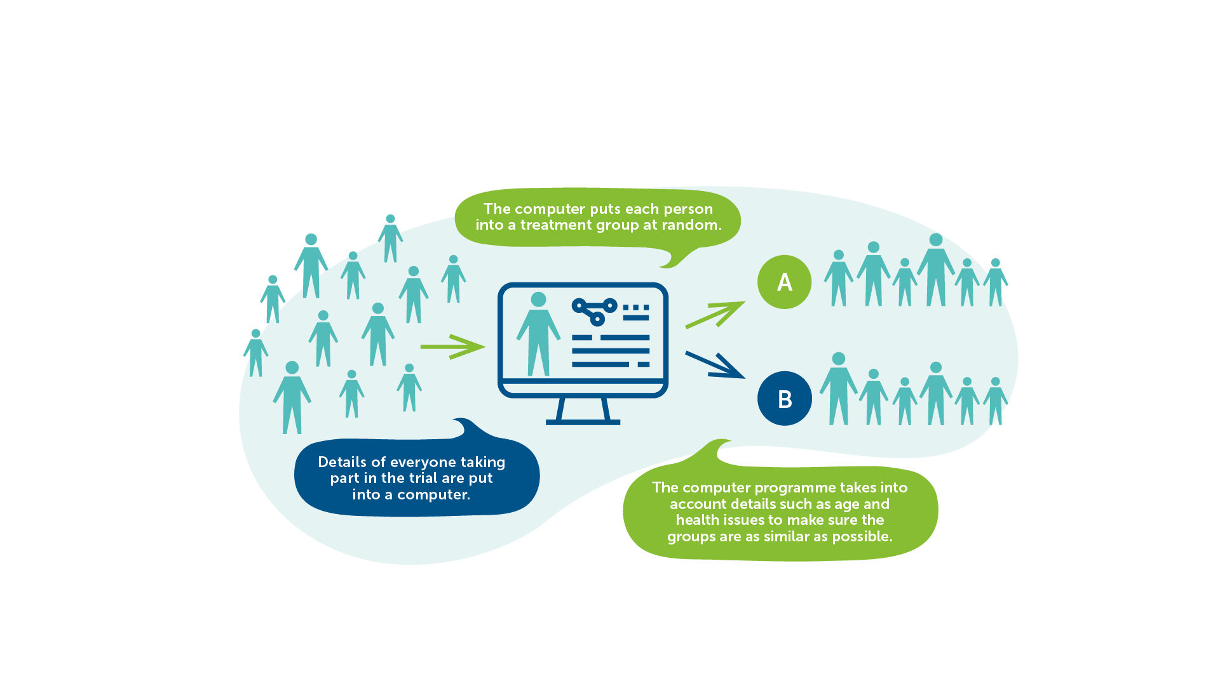
Randomisation
IAVI VACCINE LITERACY LIBRARY | MODULE 5

Slide 63
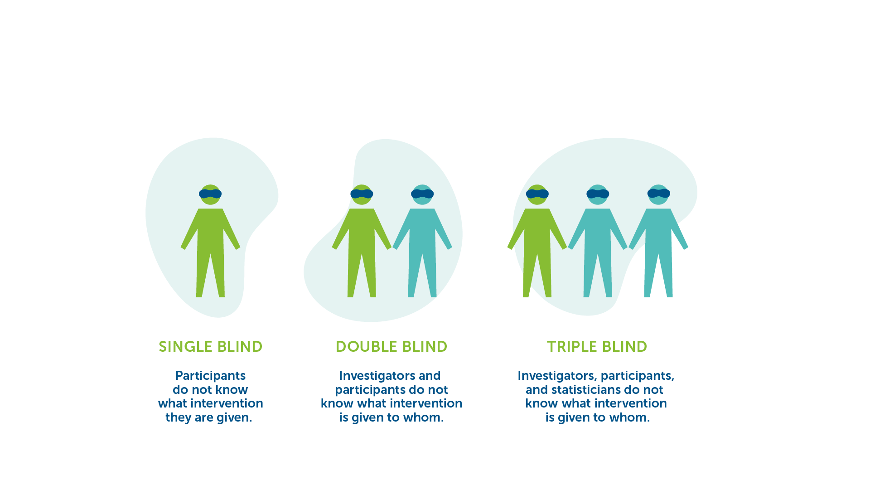
Blinding
Having a blind trial helps prevent any bias.​
IAVI VACCINE LITERACY LIBRARY | MODULE 5

Slide 64
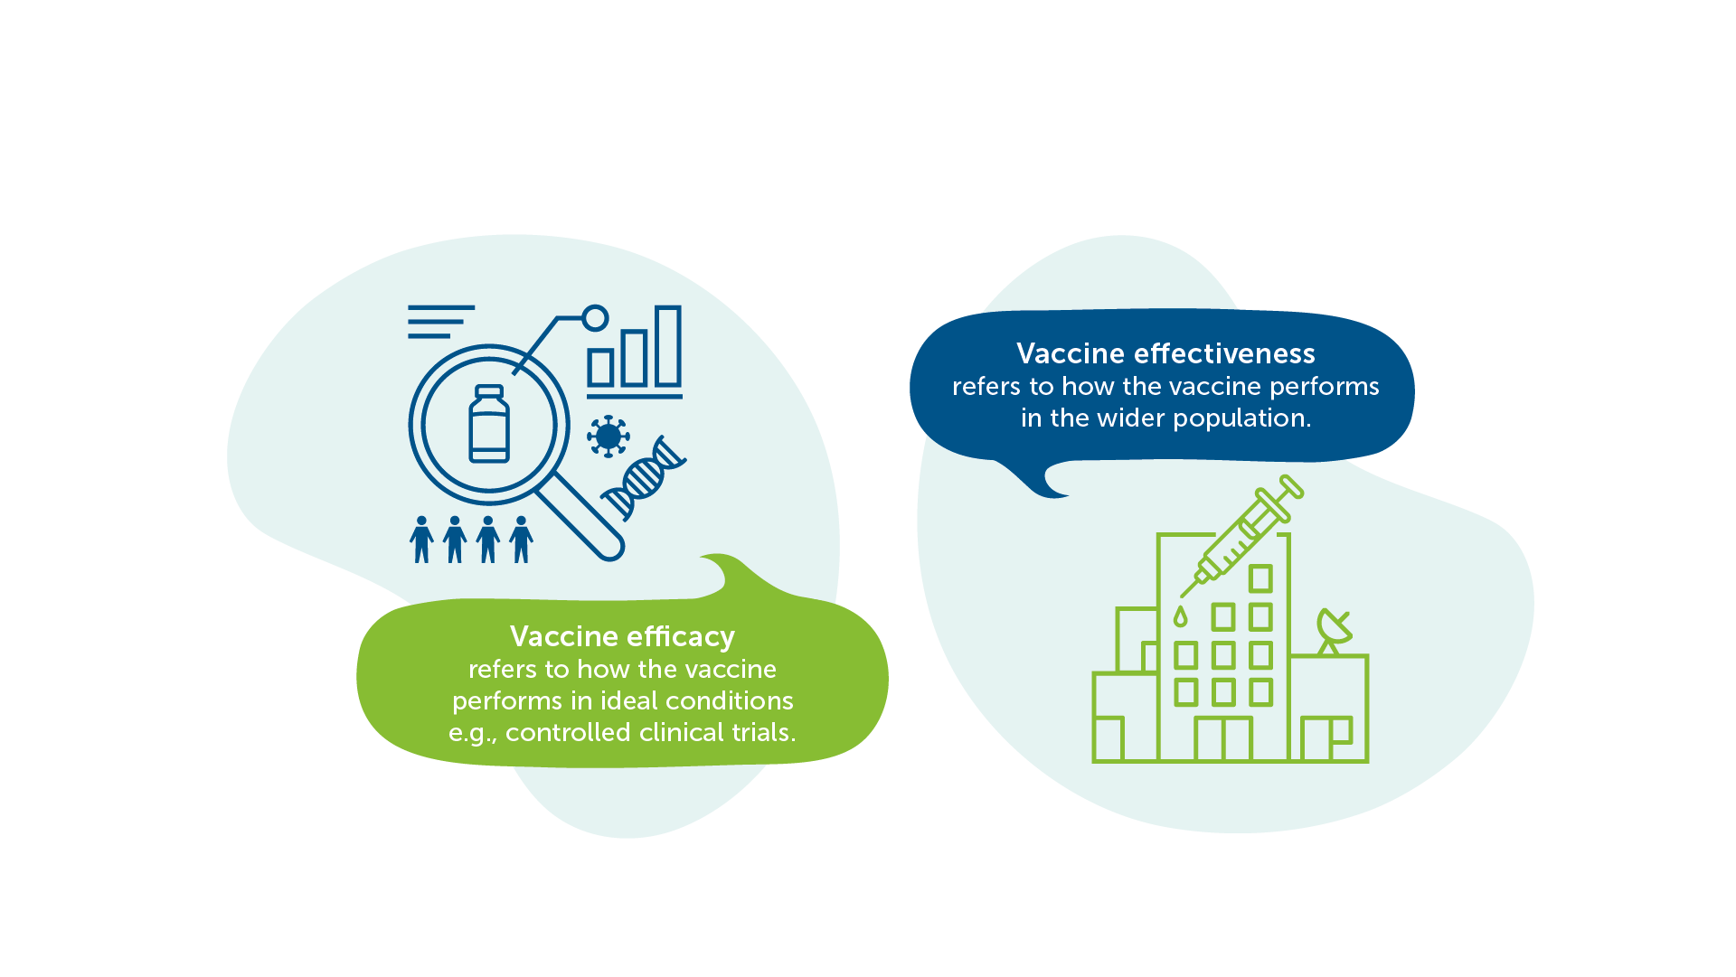
Efficacy vs Effectiveness
Source: Adapted from WHO
IAVI VACCINE LITERACY LIBRARY | MODULE 5

Slide 65
Clinical Trials in Low- and Middle- Income Countries
To ensure that vaccines are safe and effective for those populations where vaccines are needed most.​
Demonstrates whether or not the vaccine can be delivered effectively in the local conditions.​
Provide the evidence needed to speed approval and access.​
Raises knowledge and awareness of vaccine research among key stakeholders and communities, which will help ready communities for a vaccine when one is available.​
IAVI VACCINE LITERACY LIBRARY | MODULE 5

Slide 66
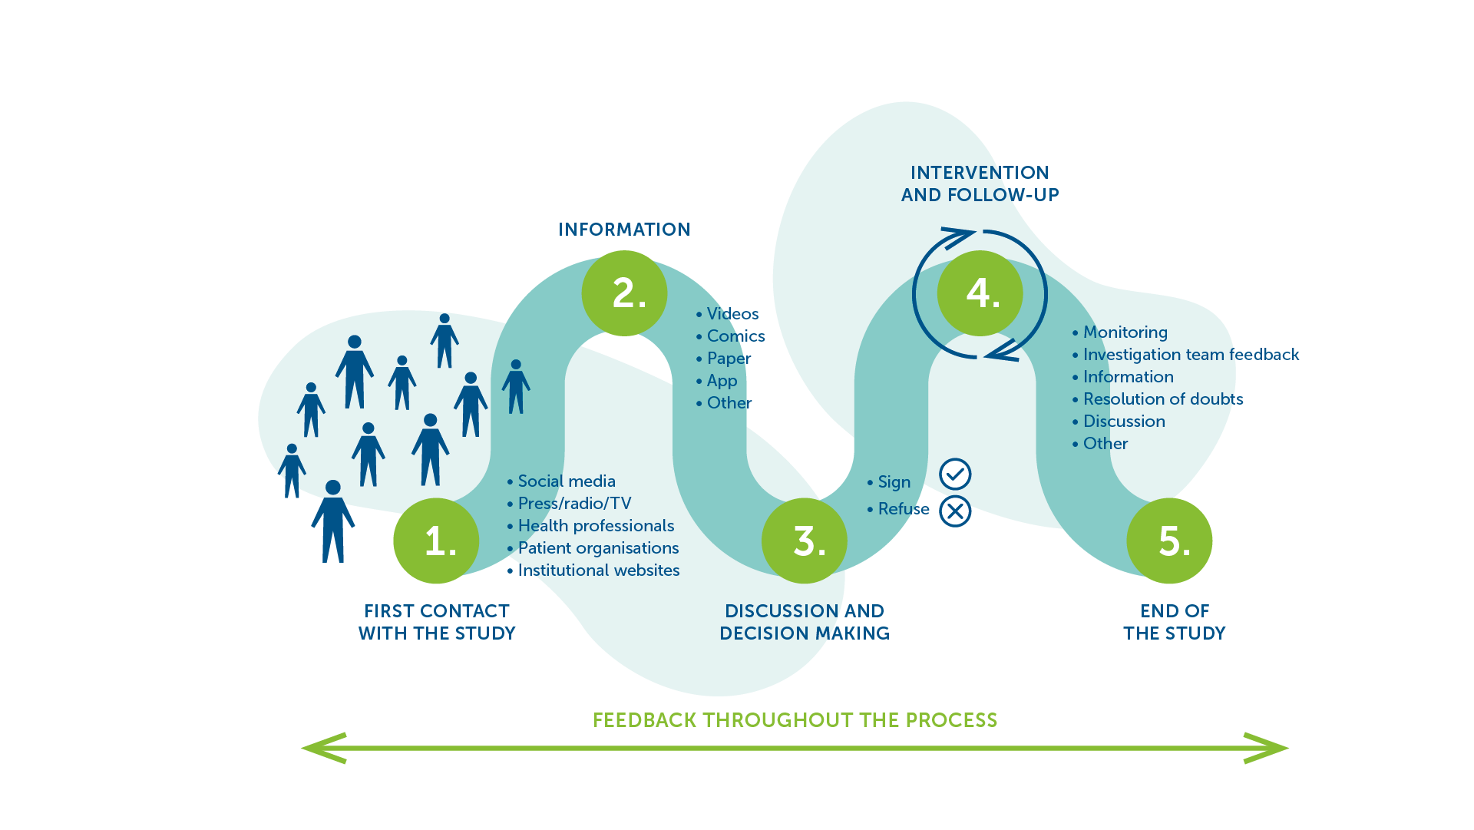
Participation in Clinical Trials​
IAVI VACCINE LITERACY LIBRARY | MODULE 5

Slide 68
Acknowledgements
IAVI would like to acknowledge the contribution of Doreen Asio, Monica Bagaya, Vincent Basajja, Kundai Chinyenze, William Dekker, Evanson Gichuru, Nyokabi Jacinta, Sarah Joseph, Dagna Laufer, Sharon Lipesa, Shelly Malhotra, Miliswa Magongo, Blossom Makhubalo, Roselyn Malogo, John Mdluli, Ireen Mosweu, Juliet Mpendo, Gaudensia Mutua, Vincent Muturi-Kioi, Conwell Mwakoi, Jauhara Nanyondo, Gertrude Nanyonjo, Jacinta Nyakobi, Faith Ochieng, Fred Otieno, Daisy Ouya, Gayle Patenaude, Hilda Phiri, Nicole Sender, Lewis Schrager, Elana Van Brakel, Kelvin Vollenhoven, Jeffery Walimbwa, Mathias Wambuzi, Anja Van der Westhuizen for reviewing the content of the IAVI Vaccine Literacy Library.
Lead Consultants: Roger Tatoud and Rebekah Webb.
Design and Illustration: Anthea Duce.
© International AIDS Vaccine Initiative, Inc. 2022

Slide 69
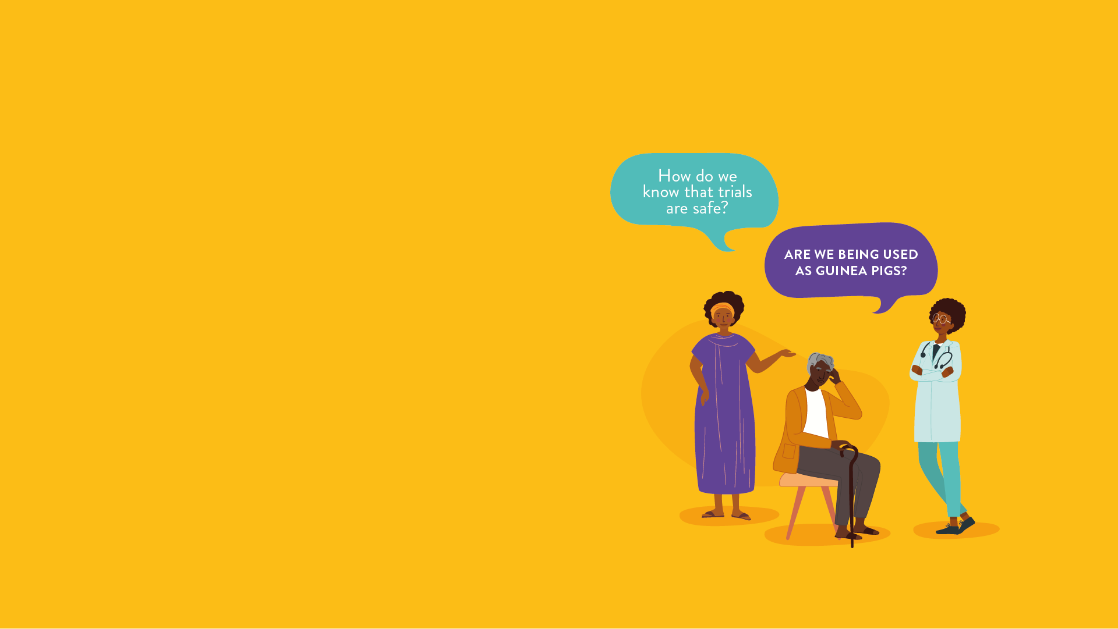
MODULE 6:
THE ETHICS AND
REGULATION OF
CLINICAL TRIALS
HIV
TB
Lassa Virus
Vaccines

Slide 71
Ethics of Medical Research​
All medical research is governed by principles of ethics​.
All trials follow the same set of international ethical guidelines to ensure that each participant’s health, dignity, and well-being is protected​.
It is the duty of researchers to make sure that local standards of health and human rights of participants are also upheld​.
All clinical trials are carefully evaluated before they can start:​
  Scientifically and ethically sound​.
  Candidate vaccines are safe for participants​.
Legal and ethical standards apply to clinical trials, no matter in which country they are conducted.
IAVI VACCINE LITERACY LIBRARY | MODULE 6

Slide 72
Principles of Ethical Research​
Seven primary principles form a basis for ethical conduct of all clinical trials:​​
Value – should answer a question that will enhance health or provide useful knowledge in the health field.​
Validity – should have an appropriate, careful, practical design and methodology.​
Fair participant selection – participants should be selected in a fair manner, based on scientifically and ethically sound factors.​
Favourable risk/benefit ratio – risks of participating should be kept to a minimum and should be justified by benefits of participating and of knowledge gained by the study.​
Independent review – independent ethical and regulatory committees must review and give approval for the study.​
Informed consent – every participant must understand the process, risks, and benefits of trial participation so she or he can make an educated and independent decision to participate.​
Respect for participants – rights and welfare of participants must be protected throughout the entire trial, conclusion, and follow-up.​
IAVI VACCINE LITERACY LIBRARY | MODULE 6

Slide 73
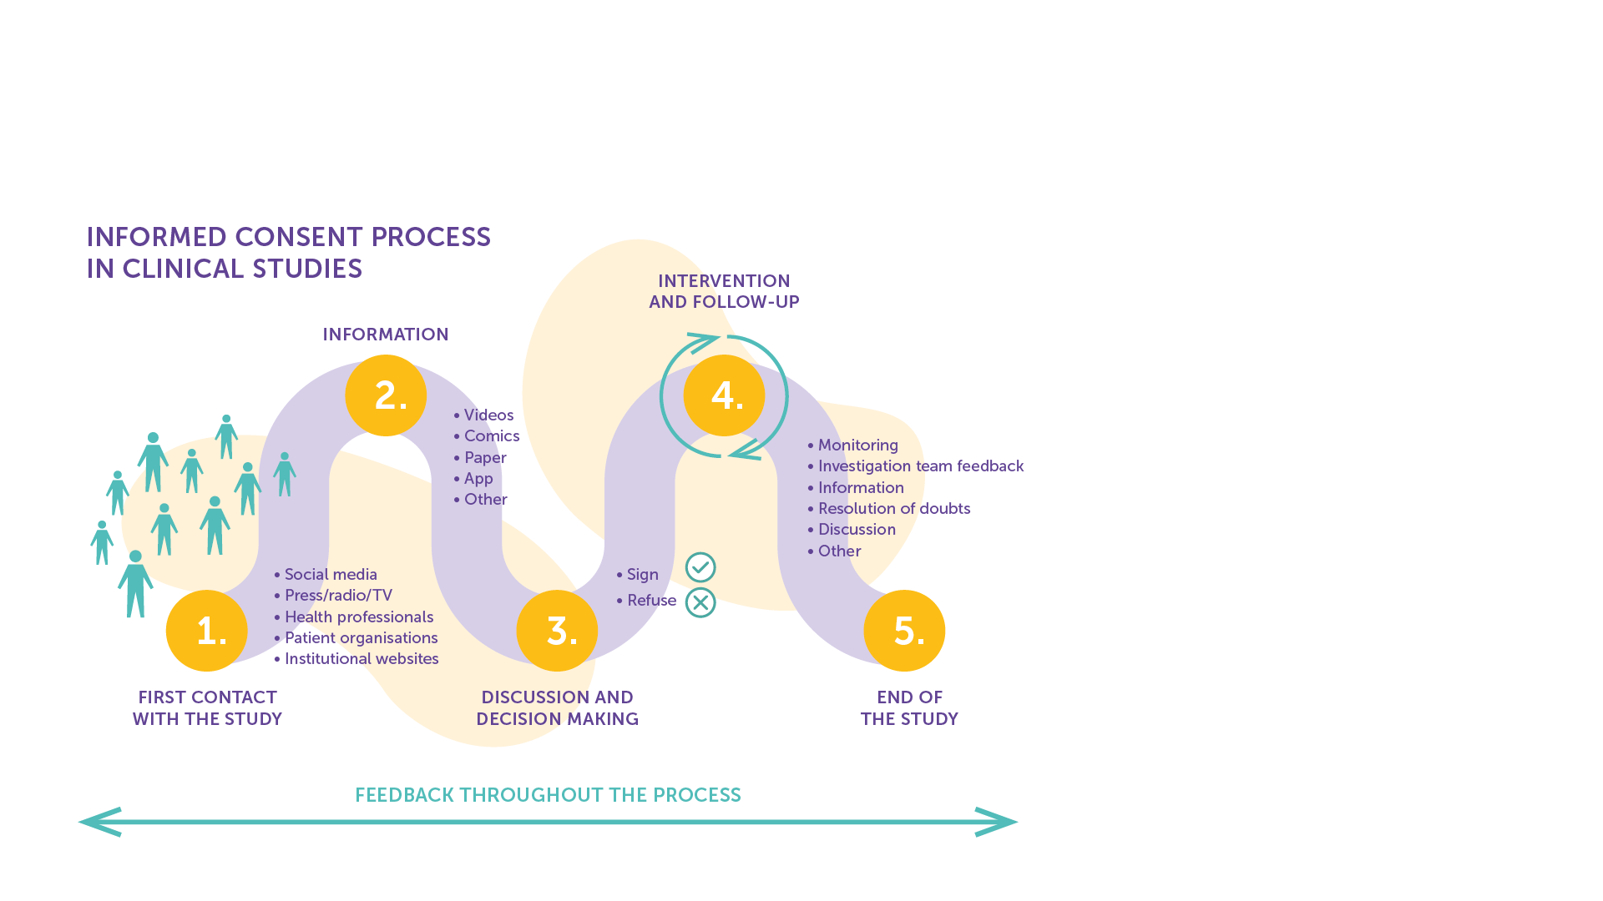
Informed Consent
Informed consent is the cornerstone of all medical research.
It ensures that participants fully understand key information about the trial and that they are not unfairly influenced to participate.​
Researchers must be sure that the participant’s decision is free from inducement or coercion of any kind.​
It includes the right to withdraw from the research.​
It is not a one-off event but an ongoing process to ensure that the person understands all relevant facts associated with their participation in a clinical trial.​
IAVI VACCINE LITERACY LIBRARY | MODULE 6

Slide 74
The Informed Consent Form
The informed consent form is signed by anyone who decides to participant in a trial to indicates his or her understanding of, and agreement to, the following:​​
Why the research is being done.​
What researchers want to accomplish and who is responsible for the trial.​
What will be done during the trial and for how long.​
What risks are involved.​
What is expected of trial participants.​
What, if any, benefits can be expected from the trial.​
The system in place for care and support of participants.​
What other interventions are available.​
The participant’s right to leave the trial at any time.​
IAVI VACCINE LITERACY LIBRARY | MODULE 6

Slide 75
Vulnerable Groups​
Communicating complete information and ensuring understanding can be complex and difficult, particularly for vulnerable groups, including women and adolescents.​
Women may be vulnerable to unfair influence and coercion from husbands, family, community members and healthcare providers.​
Young people under the age of 18 are minors in the eyes of the law, and therefore are usually unable to give consent without parental permission. ​
People from vulnerable groups may not fully understand their personal risk, posing challenges for informed consent as well as prevention counselling during the trial.​
IAVI VACCINE LITERACY LIBRARY | MODULE 6

Slide 76
Confidentiality
The study team must keep all information about participants confidential.​
Information collected about the participant during the trial should not be disclosed to anyone except study staff without the consent of the participant.​
While confidentiality is critical for all trial participants, women may be particularly vulnerable if confidentiality is broken, as disclosure of participation in trials itself may lead to stigma, discrimination, and violence.​
This is particularly relevant to HIV vaccine trials: if a woman is known to be participating in such a trial, people may assume she is engaging in risky behaviour or that she is protecting herself from the risky behaviour of her partner.​
All trial staff must be trained in handling confidentiality in a gender-sensitive manner.​
IAVI VACCINE LITERACY LIBRARY | MODULE 6

Slide 77
Risks and Benefits
Participating in any clinical trial involves both risks and benefits. When researchers plan a study, they must make sure that the risks and benefits of participation balance.​
If there are many risks, it is unfair to ask people to participate. If there are many benefits, people will participate for the wrong reasons and the study may be considered coercive.​
When someone is deciding whether or not to participate in a trial, that person must fully understand the risks and benefits involved to make an informed choice of whether they feel that the benefits outweigh the risks of participation.​
An ethical review board determines the balance of risks and benefits. Every study plan, or protocol, must be reviewed by such a board​.
IAVI VACCINE LITERACY LIBRARY | MODULE 6

Slide 78
Independent Review
Before a trial can be conducted anywhere in the world, it must go through an independent scientific and ethics review.​
All clinical trials are conducted according to a protocol for how the trial will be carried out.​
All protocols must be carried out according to strict international standards, such as guidelines set by the International Council on Harmonisation (ICH) on Good Clinical Practices (GCP), and Good Clinical Laboratory Practices (GCLP).​
Before any protocol can begin, it must be reviewed and approved by an ethics committee and relevant regulatory committees at the national level.​
IAVI VACCINE LITERACY LIBRARY | MODULE 6

Slide 79
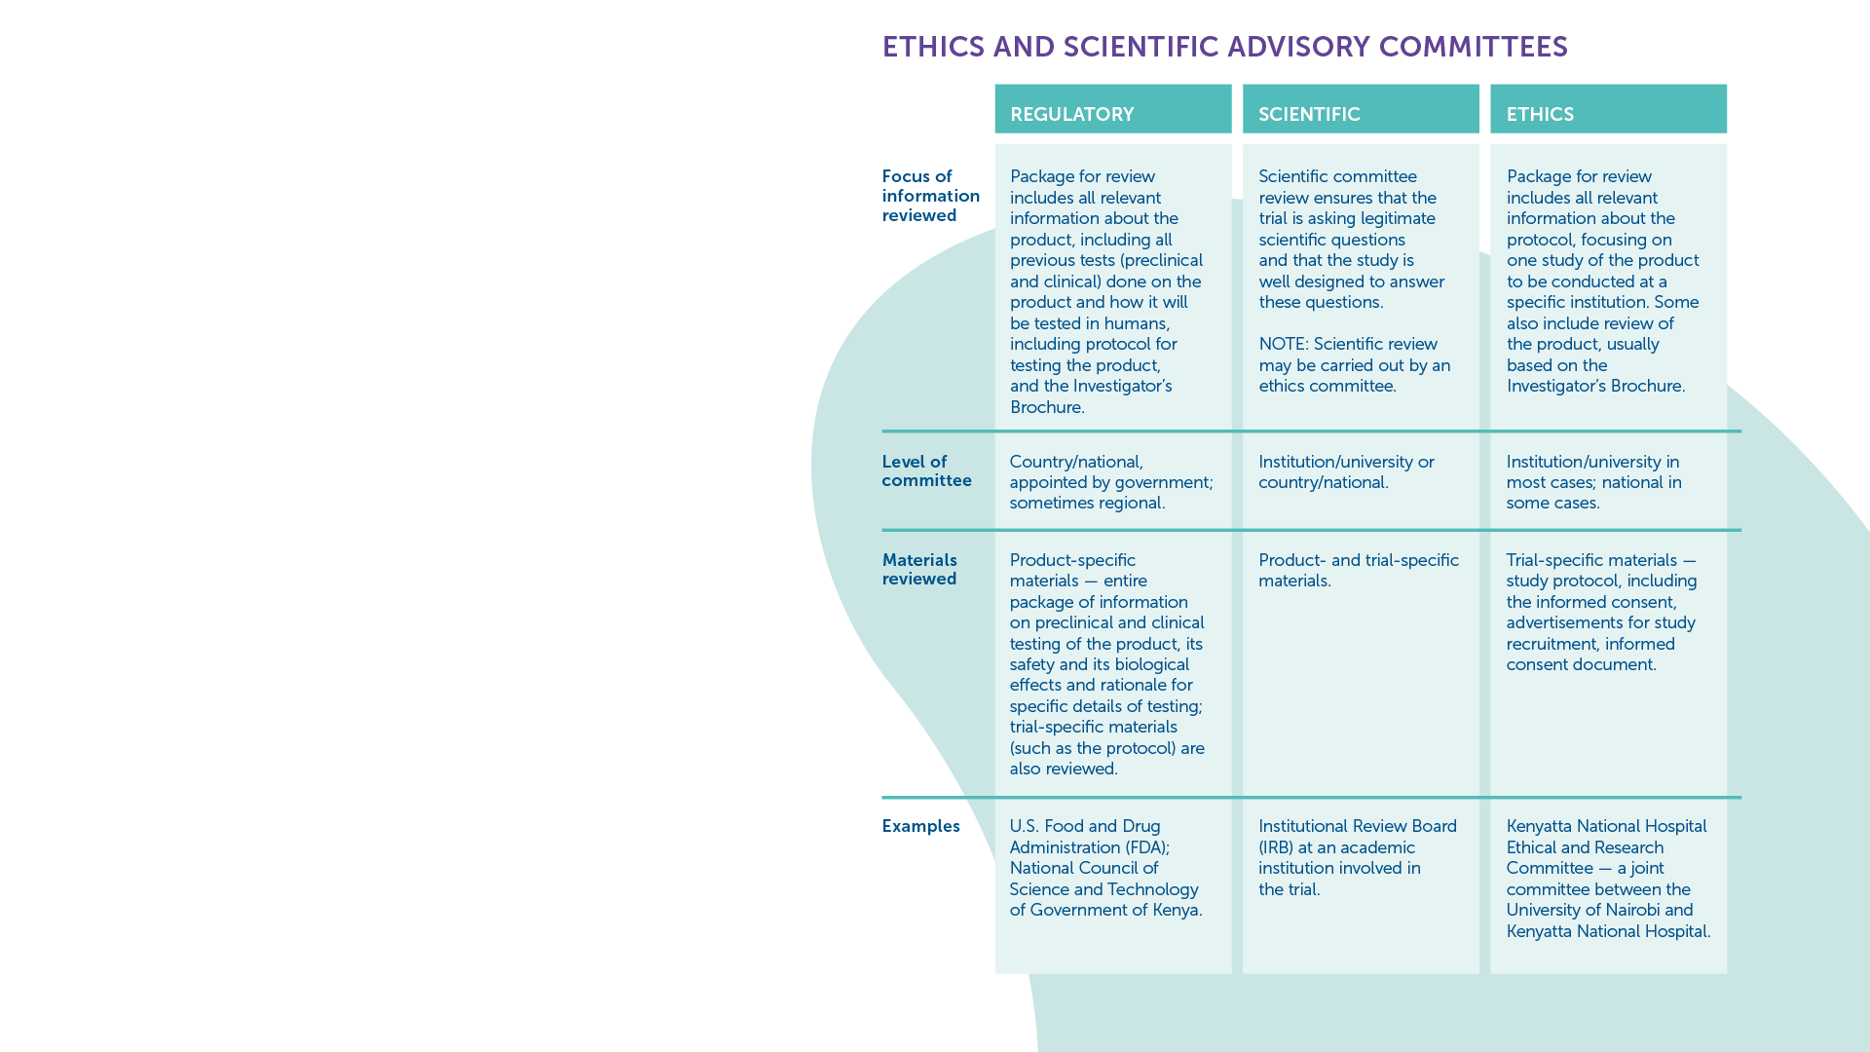
Ethics and Advisory Committees​
Both national and international authorities that are independent of trial researchers and sponsors conduct ongoing monitoring of research projects to ensure that they meet ethical standards.​
These include:
National Regulatory Authorities​
Independent Ethical Committees​
Ethics Review Committees​
Institutional Review Boards​
Local Ethics Committees​
Community Advisory Boards​
IAVI VACCINE LITERACY LIBRARY | MODULE 6

Slide 80
Trial Guidelines
All review committees follow internationally agreed-upon guidelines that provide detailed definitions of the requirements for ethical research. ​
The following guidelines create uniform ethical and scientific standards for all trials with human participants, wherever they take place:
  International Council on Harmonisation (ICH) – these guidelines are set by regulatory authorities and the pharmaceutical industry.​
  Good Clinical Practice (GCP) - these guidelines establish the requirements needed for effective review and approval of proposed clinical studies.​
  Good Participatory Practice (GPP) – these guidelines provide clinical trial funders, sponsors, and implementers with systematic guidance on how to effectively engage with all stakeholders in the design and conduct of HIV and TB vaccine research. Guidelines also exist for emerging infectious diseases.​
  Disease-Specific Guidance is also available for HIV, TB and emerging infectious diseases.​
IAVI VACCINE LITERACY LIBRARY | MODULE 6

Slide 81
Community Engagement
Outreach to the broader community extends beyond the scope of trial recruitment – it involves informing the leaders in a community well in advance of the trial as an important channel for building understanding and support among the community at large.​
Most vaccine trial sites have active community advisory boards (CABs) that act as liaisons between the trial researchers and the community.​
For outreach to the individual, a trial site will sometimes offer general information sessions, where anyone interested can learn about vaccine research.​
There may also be one-on-one counselling sessions where potential participants learn about the trial in more detail.​
IAVI VACCINE LITERACY LIBRARY | MODULE 6

Slide 83
Acknowledgements
IAVI would like to acknowledge the contribution of Doreen Asio, Monica Bagaya, Vincent Basajja, Kundai Chinyenze, William Dekker, Evanson Gichuru, Nyokabi Jacinta, Sarah Joseph, Dagna Laufer, Sharon Lipesa, Shelly Malhotra, Miliswa Magongo, Blossom Makhubalo, Roselyn Malogo, John Mdluli, Ireen Mosweu, Juliet Mpendo, Gaudensia Mutua, Vincent Muturi-Kioi, Conwell Mwakoi, Jauhara Nanyondo, Gertrude Nanyonjo, Jacinta Nyakobi, Faith Ochieng, Fred Otieno, Daisy Ouya, Gayle Patenaude, Hilda Phiri, Nicole Sender, Lewis Schrager, Elana Van Brakel, Kelvin Vollenhoven, Jeffery Walimbwa, Mathias Wambuzi, Anja Van der Westhuizen for reviewing the content of the IAVI Vaccine Literacy Library.
Lead Consultants: Roger Tatoud and Rebekah Webb.
Design and Illustration: Anthea Duce.
© International AIDS Vaccine Initiative, Inc. 2022

Slide 84

MODULE 7:
PREPARING FOR FUTURE ACCESS
HIV
TB
Lassa Virus
Vaccines

Slide 86

Overview
Making a vaccine available to the world requires much more than proving that it is safe and efficacious in clinical trials.​
There can be many barriers that prevent wide uptake and use of vaccines, including funding, regulatory issues, manufacturing, supply chain, affordability, and acceptability.​
Reluctance or refusal to be vaccinated (vaccine hesitancy) may be influenced by a complex mix of historical, political, social, and behavioural factors.​
IAVI VACCINE LITERACY LIBRARY | MODULE 7

Slide 87
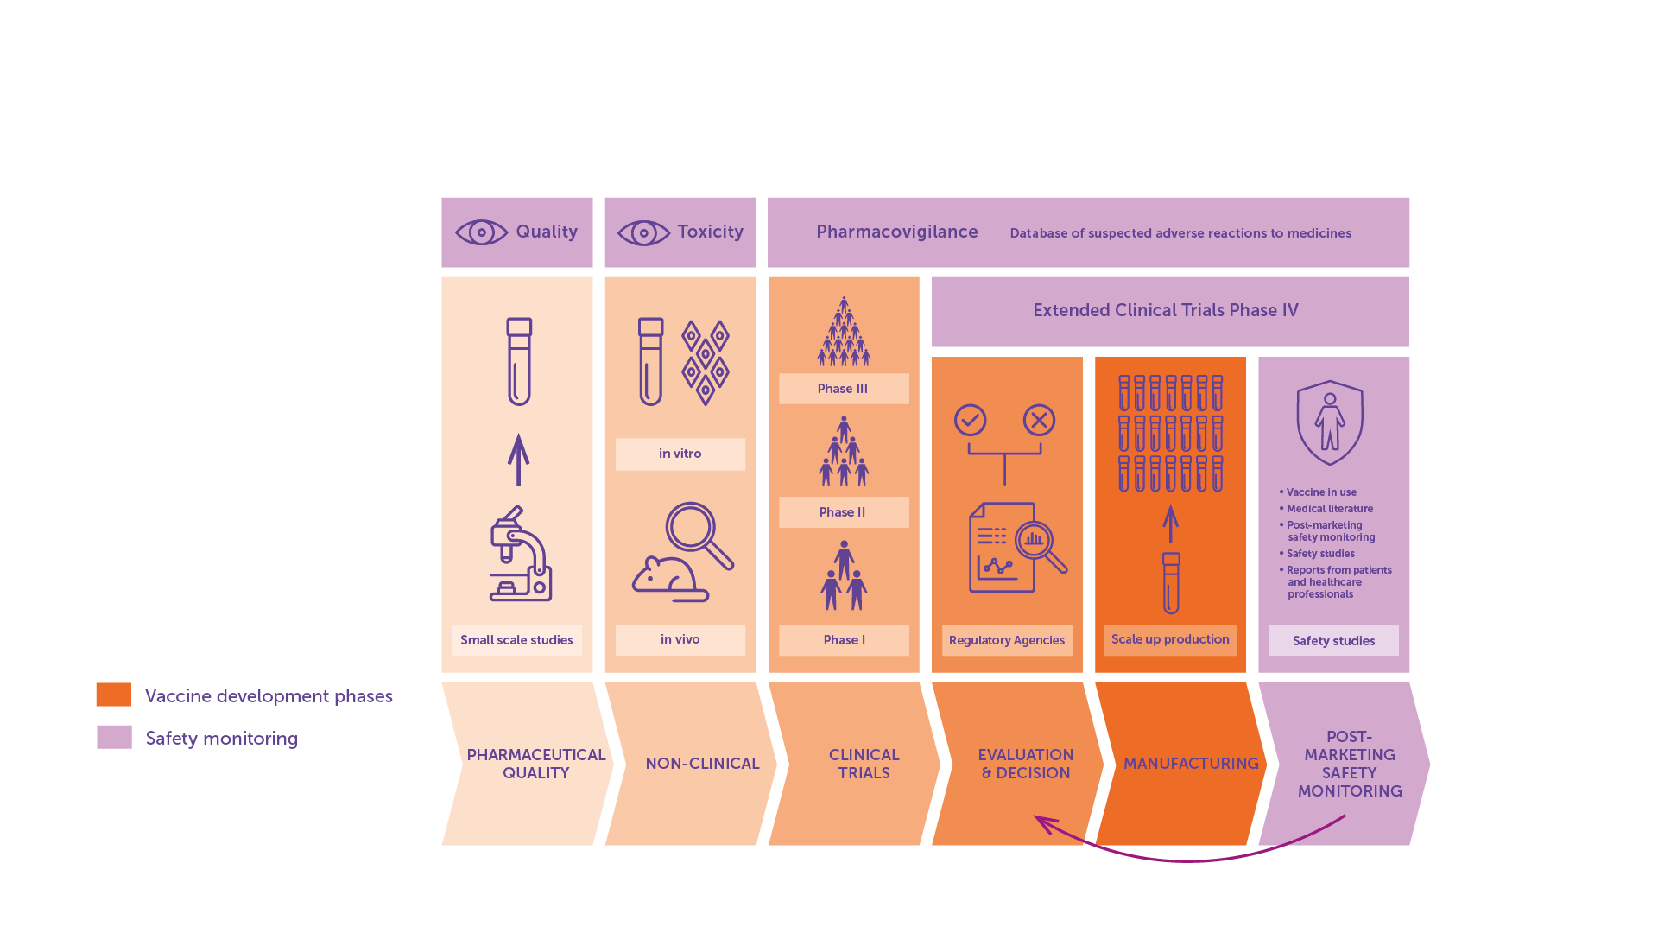
Access Journey
IAVI VACCINE LITERACY LIBRARY | MODULE 7

Slide 88

Regulatory Bodies in Africa
The African Medicines Agency (AMA) sets common standards and regulations for the region and coordinates joint reviews of clinical trial applications for vaccines.​
The East African Community’s Medicines Regulatory Harmonisation initiative supports a joint regional assessment process that harmonises technical documents, combines inspections and review processes, and accelerates approvals among member states.​
The African Vaccine Regulatory Forum (AVAREF) assists national regulatory authorities, ethics committees, and sponsors to achieve consensus on ethical and regulatory questions surrounding the research and development of medical products.​
The South African Health Products Regulatory Authority (SAHPRA) regulates all health products in the country through monitoring, evaluation, investigation, inspection, and registration. This includes clinical trials, complementary medicines, medical devices and diagnostics.​
IAVI VACCINE LITERACY LIBRARY | MODULE 7

Slide 89

Manufacturing
Two costly elements: building large-scale manufacturing facilities and developing biological processes (‘bioprocesses’) to produce large quantities of the vaccine.​
Manufacturing of vaccines is largely carried out by the private (pharmaceutical) sector.​
It can take years to build sufficient capacity for manufacturing – advance market commitments can reduce the risk for companies.​
Policy action and advocacy are needed at both the global and local level to create additional incentives for large pharmaceuticals to work on scale-up for manufacturing or to transfer their technology to other companies to do this work.​
Technology transfer to enable scaling up manufacturing by additional companies is often held back by issues of intellectual property.​
Approaches such as voluntary licensing and early technology transfer to manufacturers with strong commercial reach in high prevalence settings could help support the scale-up of manufacturing.​
IAVI VACCINE LITERACY LIBRARY | MODULE 7

Slide 90
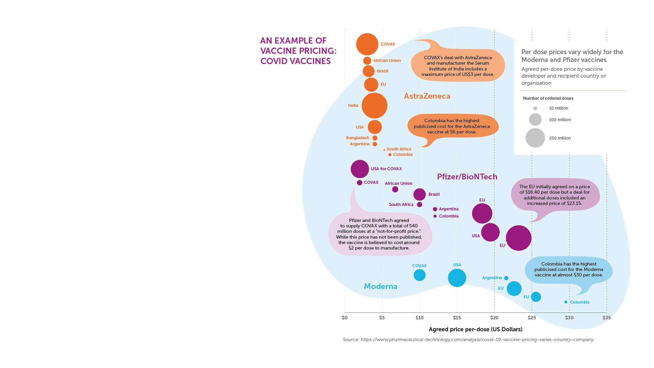
Pricing
The pricing of vaccines is driven by a combination of factors but is ultimately set by the manufacturer.​
Some vaccines are more expensive than others to develop or produce due to their ingredients or mechanism of action.​
For vaccines that are procured directly from companies, the actual price that a government pays for a vaccine is negotiated with the company that produces the vaccine, depending on the number of doses ordered and the urgency of the need.​
International agreement may be used to manufacture a vaccine at reduced cost (for example the WTO Agreement on Trade-Related Aspects of Intellectual Property Rights – TRIPS).​
IAVI VACCINE LITERACY LIBRARY | MODULE 7

Slide 91

Funding
Billions of dollars are needed to manufacture and deliver vaccines globally.​
Most of this funding must come from national governments, especially in wealthy countries, as well as multinational funding bodies like Gavi, the Vaccine Alliance; the Global Fund; and the World Bank.​
To help guarantee sufficient funding, other mechanisms for purchase and delivery can be put into place including, for example, ‘advance market commitments’ from funders.​
If such commitments are made, governments will likely be more willing and able to create systems for delivery.​
IAVI VACCINE LITERACY LIBRARY | MODULE 7

Slide 92
Delivery and Roll-out​
Delivery strategies need to address:​
Transportation​.
Storage facilities​.
Storage conditions​.
Appropriate venues for delivering vaccines (e.g., clinics, community settings)​.
Education and social marketing appropriate to specific populations​.
Human resources​.
Linkages to the wider health system​.
IAVI VACCINE LITERACY LIBRARY | MODULE 7

Slide 93
Vaccine Hesitancy
In 2019, WHO listed vaccine hesitancy among the ‘Top 10’ threats to global health.
Common concerns include:​
Worry that the vaccine may cause infection.​
Concern that any illness following vaccination is due to the vaccine.​
Fear that the vaccine could cause sterility.​
Misinformation spread by social networks.​
Fear that the vaccine was developed too quickly.​
Concern that long-term side effects could appear in years to come.​
IAVI VACCINE LITERACY LIBRARY | MODULE 7

Slide 94

Vaccine Advocacy
Knowledge of vaccines and their potential benefit will have an impact on whether governments make vaccines a public health priority.​
Policymakers must weigh up vaccine effectiveness against its cost compared with other interventions.​
Even a vaccine with relatively low efficacy would have a significant impact on the epidemic in high-incidence countries if given to a large segment of the population.​
It is important that advocates, community groups, and vaccine developers increase awareness and support among government officials to help ensure vaccine access.​
IAVI VACCINE LITERACY LIBRARY | MODULE 7

Slide 96
Acknowledgements
IAVI would like to acknowledge the contribution of Doreen Asio, Monica Bagaya, Vincent Basajja, Kundai Chinyenze, William Dekker, Evanson Gichuru, Nyokabi Jacinta, Sarah Joseph, Dagna Laufer, Sharon Lipesa, Shelly Malhotra, Miliswa Magongo, Blossom Makhubalo, Roselyn Malogo, John Mdluli, Ireen Mosweu, Juliet Mpendo, Gaudensia Mutua, Vincent Muturi-Kioi, Conwell Mwakoi, Jauhara Nanyondo, Gertrude Nanyonjo, Jacinta Nyakobi, Faith Ochieng, Fred Otieno, Daisy Ouya, Gayle Patenaude, Hilda Phiri, Nicole Sender, Lewis Schrager, Elana Van Brakel, Kelvin Vollenhoven, Jeffery Walimbwa, Mathias Wambuzi, Anja Van der Westhuizen for reviewing the content of the IAVI Vaccine Literacy Library.
Lead Consultants: Roger Tatoud and Rebekah Webb.
Design and Illustration: Anthea Duce.
© International AIDS Vaccine Initiative, Inc. 2022

Slide 97


