Slide 1



2022

Slide 3





MODULE 7:
PREPARING FOR FUTURE ACCESS
HIV
TB
Lassa Virus
Vaccines

Slide 4

Overview
Making a vaccine available to the world requires much more than proving that it is safe and efficacious in clinical trials.​
There can be many barriers that prevent wide uptake and use of vaccines, including funding, regulatory issues, manufacturing, supply chain, affordability, and acceptability.​
Reluctance or refusal to be vaccinated (vaccine hesitancy) may be influenced by a complex mix of historical, political, social, and behavioural factors.​
IAVI VACCINE LITERACY LIBRARY | MODULE 7

Slide 5
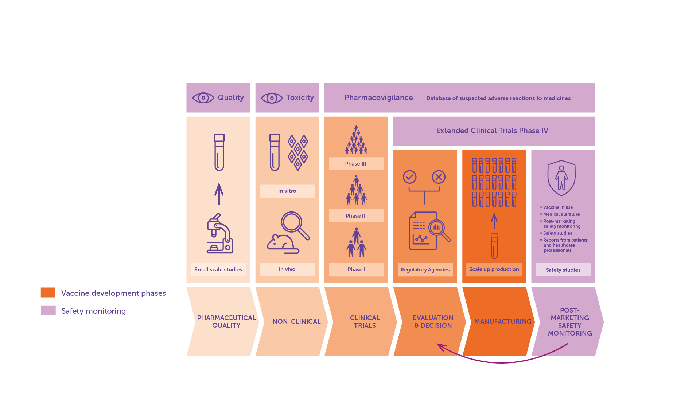
Access Journey
IAVI VACCINE LITERACY LIBRARY | MODULE 7

Slide 6

Regulatory Bodies in Africa
The African Medicines Agency (AMA) sets common standards and regulations for the region and coordinates joint reviews of clinical trial applications for vaccines.​
The East African Community’s Medicines Regulatory Harmonisation initiative supports a joint regional assessment process that harmonises technical documents, combines inspections and review processes, and accelerates approvals among member states.​
The African Vaccine Regulatory Forum (AVAREF) assists national regulatory authorities, ethics committees, and sponsors to achieve consensus on ethical and regulatory questions surrounding the research and development of medical products.​
The South African Health Products Regulatory Authority (SAHPRA) regulates all health products in the country through monitoring, evaluation, investigation, inspection, and registration. This includes clinical trials, complementary medicines, medical devices and diagnostics.​
IAVI VACCINE LITERACY LIBRARY | MODULE 7

Slide 7

Manufacturing
Two costly elements: building large-scale manufacturing facilities and developing biological processes (‘bioprocesses’) to produce large quantities of the vaccine.​
Manufacturing of vaccines is largely carried out by the private (pharmaceutical) sector.​
It can take years to build sufficient capacity for manufacturing – advance market commitments can reduce the risk for companies.​
Policy action and advocacy are needed at both the global and local level to create additional incentives for large pharmaceuticals to work on scale-up for manufacturing or to transfer their technology to other companies to do this work.​
Technology transfer to enable scaling up manufacturing by additional companies is often held back by issues of intellectual property.​
Approaches such as voluntary licensing and early technology transfer to manufacturers with strong commercial reach in high prevalence settings could help support the scale-up of manufacturing.​
IAVI VACCINE LITERACY LIBRARY | MODULE 7

Slide 8
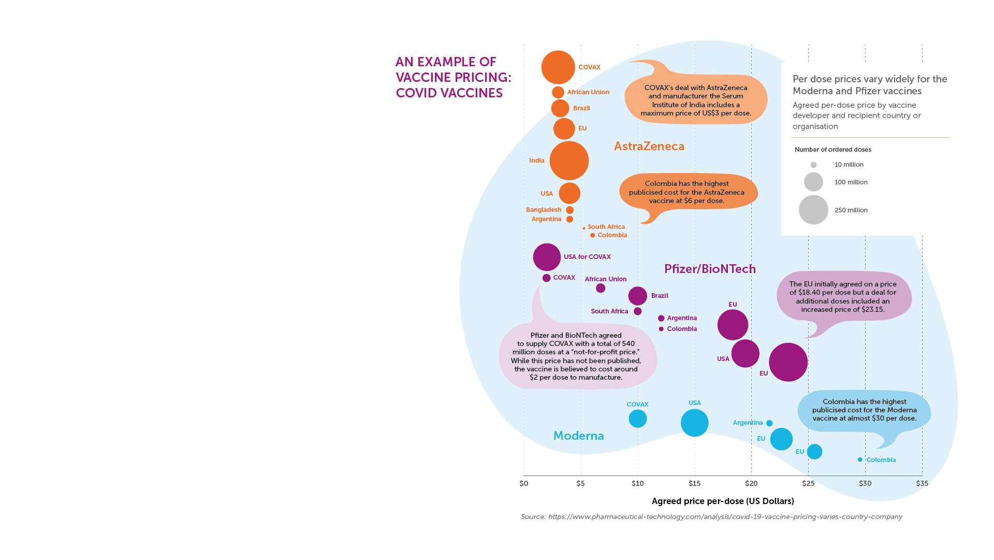
Pricing
The pricing of vaccines is driven by a combination of factors but is ultimately set by the manufacturer.​
Some vaccines are more expensive than others to develop or produce due to their ingredients or mechanism of action.​
For vaccines that are procured directly from companies, the actual price that a government pays for a vaccine is negotiated with the company that produces the vaccine, depending on the number of doses ordered and the urgency of the need.​
International agreement may be used to manufacture a vaccine at reduced cost (for example the WTO Agreement on Trade-Related Aspects of Intellectual Property Rights – TRIPS).​
IAVI VACCINE LITERACY LIBRARY | MODULE 7

Slide 9

Funding
Billions of dollars are needed to manufacture and deliver vaccines globally.​
Most of this funding must come from national governments, especially in wealthy countries, as well as multinational funding bodies like Gavi, the Vaccine Alliance; the Global Fund; and the World Bank.​
To help guarantee sufficient funding, other mechanisms for purchase and delivery can be put into place including, for example, ‘advance market commitments’ from funders.​
If such commitments are made, governments will likely be more willing and able to create systems for delivery.​
IAVI VACCINE LITERACY LIBRARY | MODULE 7

Slide 10
Delivery and Roll-out​
Delivery strategies need to address:​
Transportation​.
Storage facilities​.
Storage conditions​.
Appropriate venues for delivering vaccines (e.g., clinics, community settings)​.
Education and social marketing appropriate to specific populations​.
Human resources​.
Linkages to the wider health system​.
IAVI VACCINE LITERACY LIBRARY | MODULE 7

Slide 11
Vaccine Hesitancy
In 2019, WHO listed vaccine hesitancy among the ‘Top 10’ threats to global health.
Common concerns include:​
Worry that the vaccine may cause infection.​
Concern that any illness following vaccination is due to the vaccine.​
Fear that the vaccine could cause sterility.​
Misinformation spread by social networks.​
Fear that the vaccine was developed too quickly.​
Concern that long-term side effects could appear in years to come.​
IAVI VACCINE LITERACY LIBRARY | MODULE 7

Slide 12

Vaccine Advocacy
Knowledge of vaccines and their potential benefit will have an impact on whether governments make vaccines a public health priority.​
Policymakers must weigh up vaccine effectiveness against its cost compared with other interventions.​
Even a vaccine with relatively low efficacy would have a significant impact on the epidemic in high-incidence countries if given to a large segment of the population.​
It is important that advocates, community groups, and vaccine developers increase awareness and support among government officials to help ensure vaccine access.​
IAVI VACCINE LITERACY LIBRARY | MODULE 7

Slide 14
Acknowledgements
IAVI would like to acknowledge the contribution of Doreen Asio, Monica Bagaya, Vincent Basajja, Kundai Chinyenze, William Dekker, Evanson Gichuru, Nyokabi Jacinta, Sarah Joseph, Dagna Laufer, Sharon Lipesa, Shelly Malhotra, Miliswa Magongo, Blossom Makhubalo, Roselyn Malogo, John Mdluli, Ireen Mosweu, Juliet Mpendo, Gaudensia Mutua, Vincent Muturi-Kioi, Conwell Mwakoi, Jauhara Nanyondo, Gertrude Nanyonjo, Jacinta Nyakobi, Faith Ochieng, Fred Otieno, Daisy Ouya, Gayle Patenaude, Hilda Phiri, Nicole Sender, Lewis Schrager, Elana Van Brakel, Kelvin Vollenhoven, Jeffery Walimbwa, Mathias Wambuzi, Anja Van der Westhuizen for reviewing the content of the IAVI Vaccine Literacy Library.
Lead Consultants: Roger Tatoud and Rebekah Webb.
Design and Illustration: Anthea Duce.
© International AIDS Vaccine Initiative, Inc. 2022

Slide 15


