Slide 1



2022

Slide 3





MODULE 6:
THE ETHICS AND
REGULATION OF
CLINICAL TRIALS
HIV
TB
Lassa Virus
Vaccines

Slide 4

Ethics of Medical Research​
All medical research is governed by principles of ethics​.
All trials follow the same set of international ethical guidelines to ensure that each participant’s health, dignity, and well-being is protected​.
It is the duty of researchers to make sure that local standards of health and human rights of participants are also upheld​.
All clinical trials are carefully evaluated before they can start:​
  Scientifically and ethically sound​.
  Candidate vaccines are safe for participants​.
Legal and ethical standards apply to clinical trials, no matter in which country they are conducted.
IAVI VACCINE LITERACY LIBRARY | MODULE 6

Slide 5

Principles of Ethical Research​
Seven primary principles form a basis for ethical conduct of all clinical trials:​​
Value – should answer a question that will enhance health or provide useful knowledge in the health field.​
Validity – should have an appropriate, careful, practical design and methodology.​
Fair participant selection – participants should be selected in a fair manner, based on scientifically and ethically sound factors.​
Favourable risk/benefit ratio – risks of participating should be kept to a minimum and should be justified by benefits of participating and of knowledge gained by the study.​
Independent review – independent ethical and regulatory committees must review and give approval for the study.​
Informed consent – every participant must understand the process, risks, and benefits of trial participation so she or he can make an educated and independent decision to participate.​
Respect for participants – rights and welfare of participants must be protected throughout the entire trial, conclusion, and follow-up.​
IAVI VACCINE LITERACY LIBRARY | MODULE 6

Slide 6
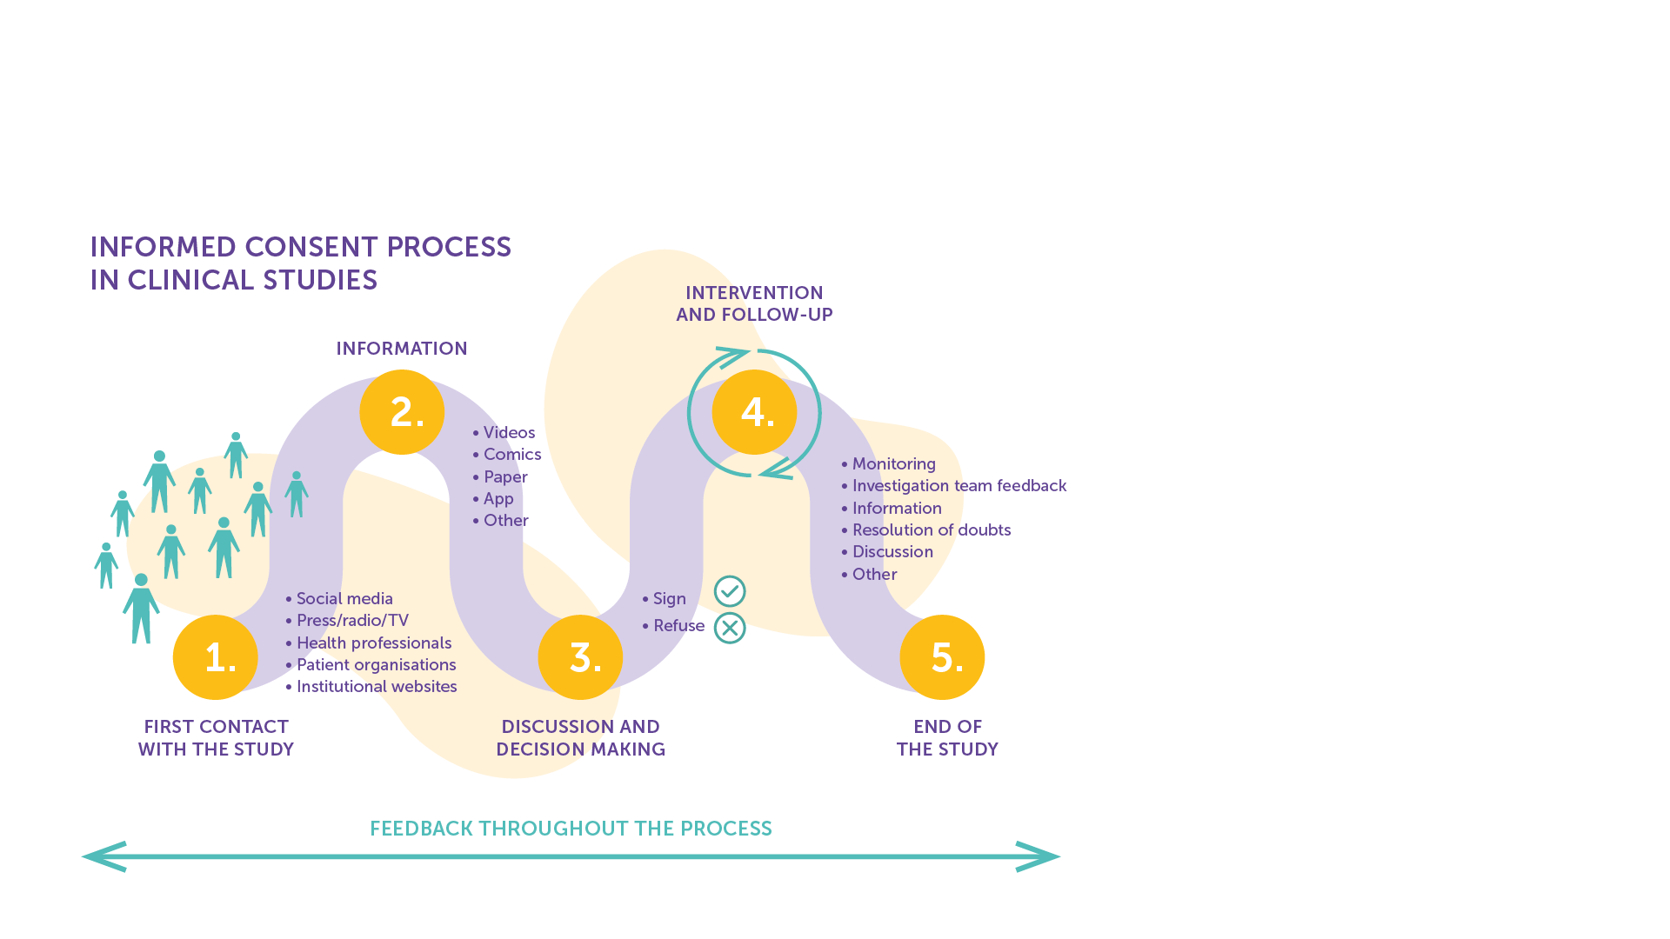
Informed Consent
Informed consent is the cornerstone of all medical research.
It ensures that participants fully understand key information about the trial and that they are not unfairly influenced to participate.​
Researchers must be sure that the participant’s decision is free from inducement or coercion of any kind.​
It includes the right to withdraw from the research.​
It is not a one-off event but an ongoing process to ensure that the person understands all relevant facts associated with their participation in a clinical trial.​
IAVI VACCINE LITERACY LIBRARY | MODULE 6

Slide 7
The Informed Consent Form
The informed consent form is signed by anyone who decides to participant in a trial to indicates his or her understanding of, and agreement to, the following:​​
Why the research is being done.​
What researchers want to accomplish and who is responsible for the trial.​
What will be done during the trial and for how long.​
What risks are involved.​
What is expected of trial participants.​
What, if any, benefits can be expected from the trial.​
The system in place for care and support of participants.​
What other interventions are available.​
The participant’s right to leave the trial at any time.​
IAVI VACCINE LITERACY LIBRARY | MODULE 6

Slide 8
Vulnerable Groups​
Communicating complete information and ensuring understanding can be complex and difficult, particularly for vulnerable groups, including women and adolescents.​
Women may be vulnerable to unfair influence and coercion from husbands, family, community members and healthcare providers.​
Young people under the age of 18 are minors in the eyes of the law, and therefore are usually unable to give consent without parental permission. ​
People from vulnerable groups may not fully understand their personal risk, posing challenges for informed consent as well as prevention counselling during the trial.​
IAVI VACCINE LITERACY LIBRARY | MODULE 6

Slide 9
Confidentiality
The study team must keep all information about participants confidential.​
Information collected about the participant during the trial should not be disclosed to anyone except study staff without the consent of the participant.​
While confidentiality is critical for all trial participants, women may be particularly vulnerable if confidentiality is broken, as disclosure of participation in trials itself may lead to stigma, discrimination, and violence.​
This is particularly relevant to HIV vaccine trials: if a woman is known to be participating in such a trial, people may assume she is engaging in risky behaviour or that she is protecting herself from the risky behaviour of her partner.​
All trial staff must be trained in handling confidentiality in a gender-sensitive manner.​
IAVI VACCINE LITERACY LIBRARY | MODULE 6

Slide 10
Risks and Benefits
Participating in any clinical trial involves both risks and benefits. When researchers plan a study, they must make sure that the risks and benefits of participation balance.​
If there are many risks, it is unfair to ask people to participate. If there are many benefits, people will participate for the wrong reasons and the study may be considered coercive.​
When someone is deciding whether or not to participate in a trial, that person must fully understand the risks and benefits involved to make an informed choice of whether they feel that the benefits outweigh the risks of participation.​
An ethical review board determines the balance of risks and benefits. Every study plan, or protocol, must be reviewed by such a board​.
IAVI VACCINE LITERACY LIBRARY | MODULE 6

Slide 11

Independent Review
Before a trial can be conducted anywhere in the world, it must go through an independent scientific and ethics review.​
All clinical trials are conducted according to a protocol for how the trial will be carried out.​
All protocols must be carried out according to strict international standards, such as guidelines set by the International Council on Harmonisation (ICH) on Good Clinical Practices (GCP), and Good Clinical Laboratory Practices (GCLP).​
Before any protocol can begin, it must be reviewed and approved by an ethics committee and relevant regulatory committees at the national level.​
IAVI VACCINE LITERACY LIBRARY | MODULE 6

Slide 12
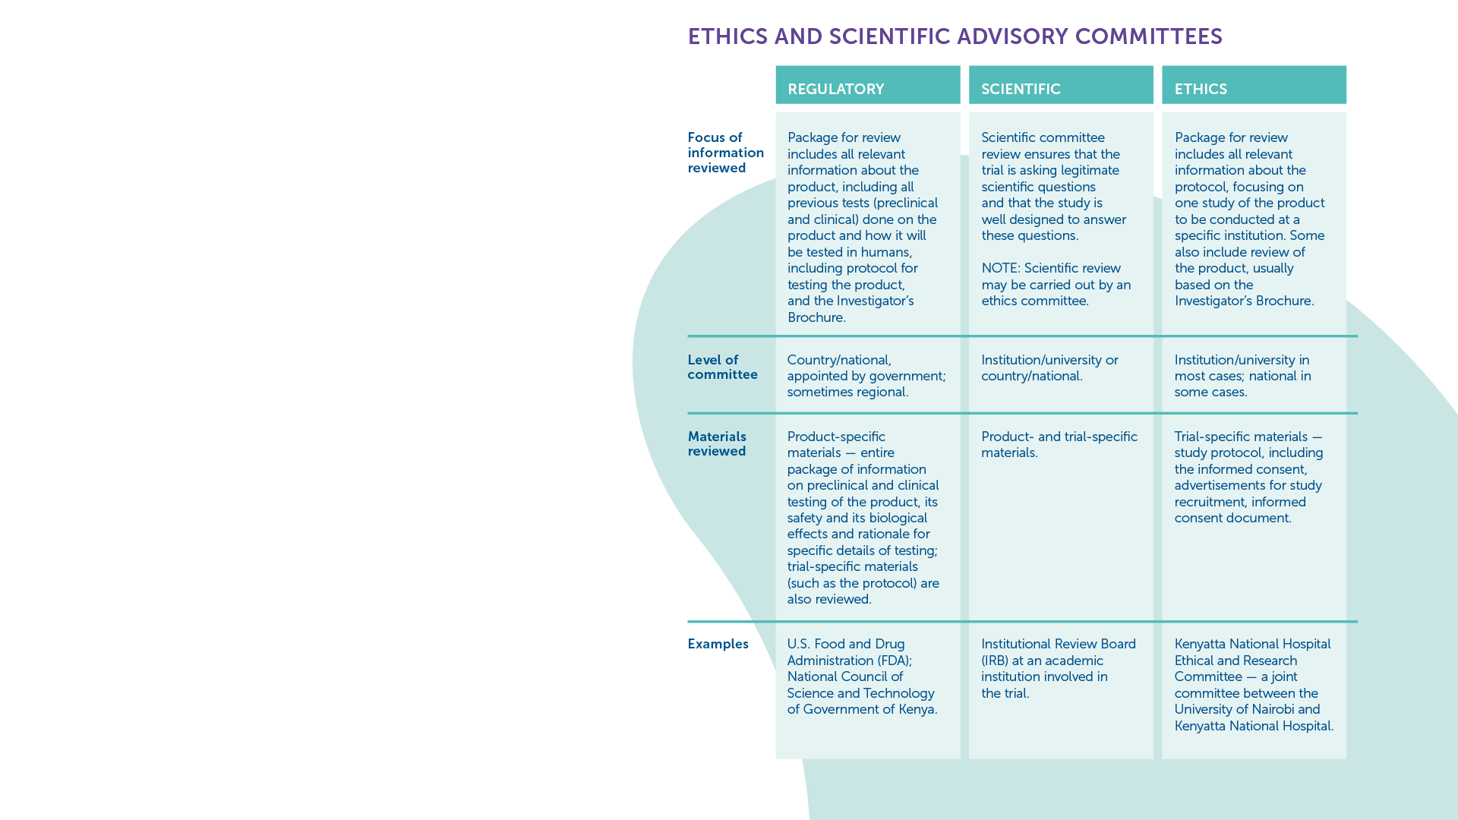
Ethics and Advisory Committees​
Both national and international authorities that are independent of trial researchers and sponsors conduct ongoing monitoring of research projects to ensure that they meet ethical standards.​
These include:
National Regulatory Authorities​
Independent Ethical Committees​
Ethics Review Committees​
Institutional Review Boards​
Local Ethics Committees​
Community Advisory Boards​
IAVI VACCINE LITERACY LIBRARY | MODULE 6

Slide 13
Trial Guidelines
All review committees follow internationally agreed-upon guidelines that provide detailed definitions of the requirements for ethical research. ​
The following guidelines create uniform ethical and scientific standards for all trials with human participants, wherever they take place:
  International Council on Harmonisation (ICH) – these guidelines are set by regulatory authorities and the pharmaceutical industry.​
  Good Clinical Practice (GCP) - these guidelines establish the requirements needed for effective review and approval of proposed clinical studies.​
  Good Participatory Practice (GPP) – these guidelines provide clinical trial funders, sponsors, and implementers with systematic guidance on how to effectively engage with all stakeholders in the design and conduct of HIV and TB vaccine research. Guidelines also exist for emerging infectious diseases.​
  Disease-Specific Guidance is also available for HIV, TB and emerging infectious diseases.​
IAVI VACCINE LITERACY LIBRARY | MODULE 6

Slide 14
Community Engagement
Outreach to the broader community extends beyond the scope of trial recruitment – it involves informing the leaders in a community well in advance of the trial as an important channel for building understanding and support among the community at large.​
Most vaccine trial sites have active community advisory boards (CABs) that act as liaisons between the trial researchers and the community.​
For outreach to the individual, a trial site will sometimes offer general information sessions, where anyone interested can learn about vaccine research.​
There may also be one-on-one counselling sessions where potential participants learn about the trial in more detail.​
IAVI VACCINE LITERACY LIBRARY | MODULE 6

Slide 16
Acknowledgements
IAVI would like to acknowledge the contribution of Doreen Asio, Monica Bagaya, Vincent Basajja, Kundai Chinyenze, William Dekker, Evanson Gichuru, Nyokabi Jacinta, Sarah Joseph, Dagna Laufer, Sharon Lipesa, Shelly Malhotra, Miliswa Magongo, Blossom Makhubalo, Roselyn Malogo, John Mdluli, Ireen Mosweu, Juliet Mpendo, Gaudensia Mutua, Vincent Muturi-Kioi, Conwell Mwakoi, Jauhara Nanyondo, Gertrude Nanyonjo, Jacinta Nyakobi, Faith Ochieng, Fred Otieno, Daisy Ouya, Gayle Patenaude, Hilda Phiri, Nicole Sender, Lewis Schrager, Elana Van Brakel, Kelvin Vollenhoven, Jeffery Walimbwa, Mathias Wambuzi, Anja Van der Westhuizen for reviewing the content of the IAVI Vaccine Literacy Library.
Lead Consultants: Roger Tatoud and Rebekah Webb.
Design and Illustration: Anthea Duce.
© International AIDS Vaccine Initiative, Inc. 2022

Slide 17


