Slide 1



2022

Slide 3




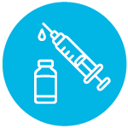
MODULE 5:
WHAT IS A VACCINE
CLINICAL TRIAL?
HIV
TB
Lassa Virus
Vaccines

Slide 4

What is a Vaccine Clinical Trial?
A type of research that studies new medicines, treatments, or prevention tools to evaluate their effect on human health.​
Clinical trials evaluate whether candidate vaccines are effective at preventing or controlling infections and diseases.​
A sequential series of trials are required to determine whether the candidate vaccine is both safe and efficacious.​
Clinical trials are necessary for licensing new vaccines and medicines.​
IAVI VACCINE LITERACY LIBRARY | MODULE 5

Slide 5
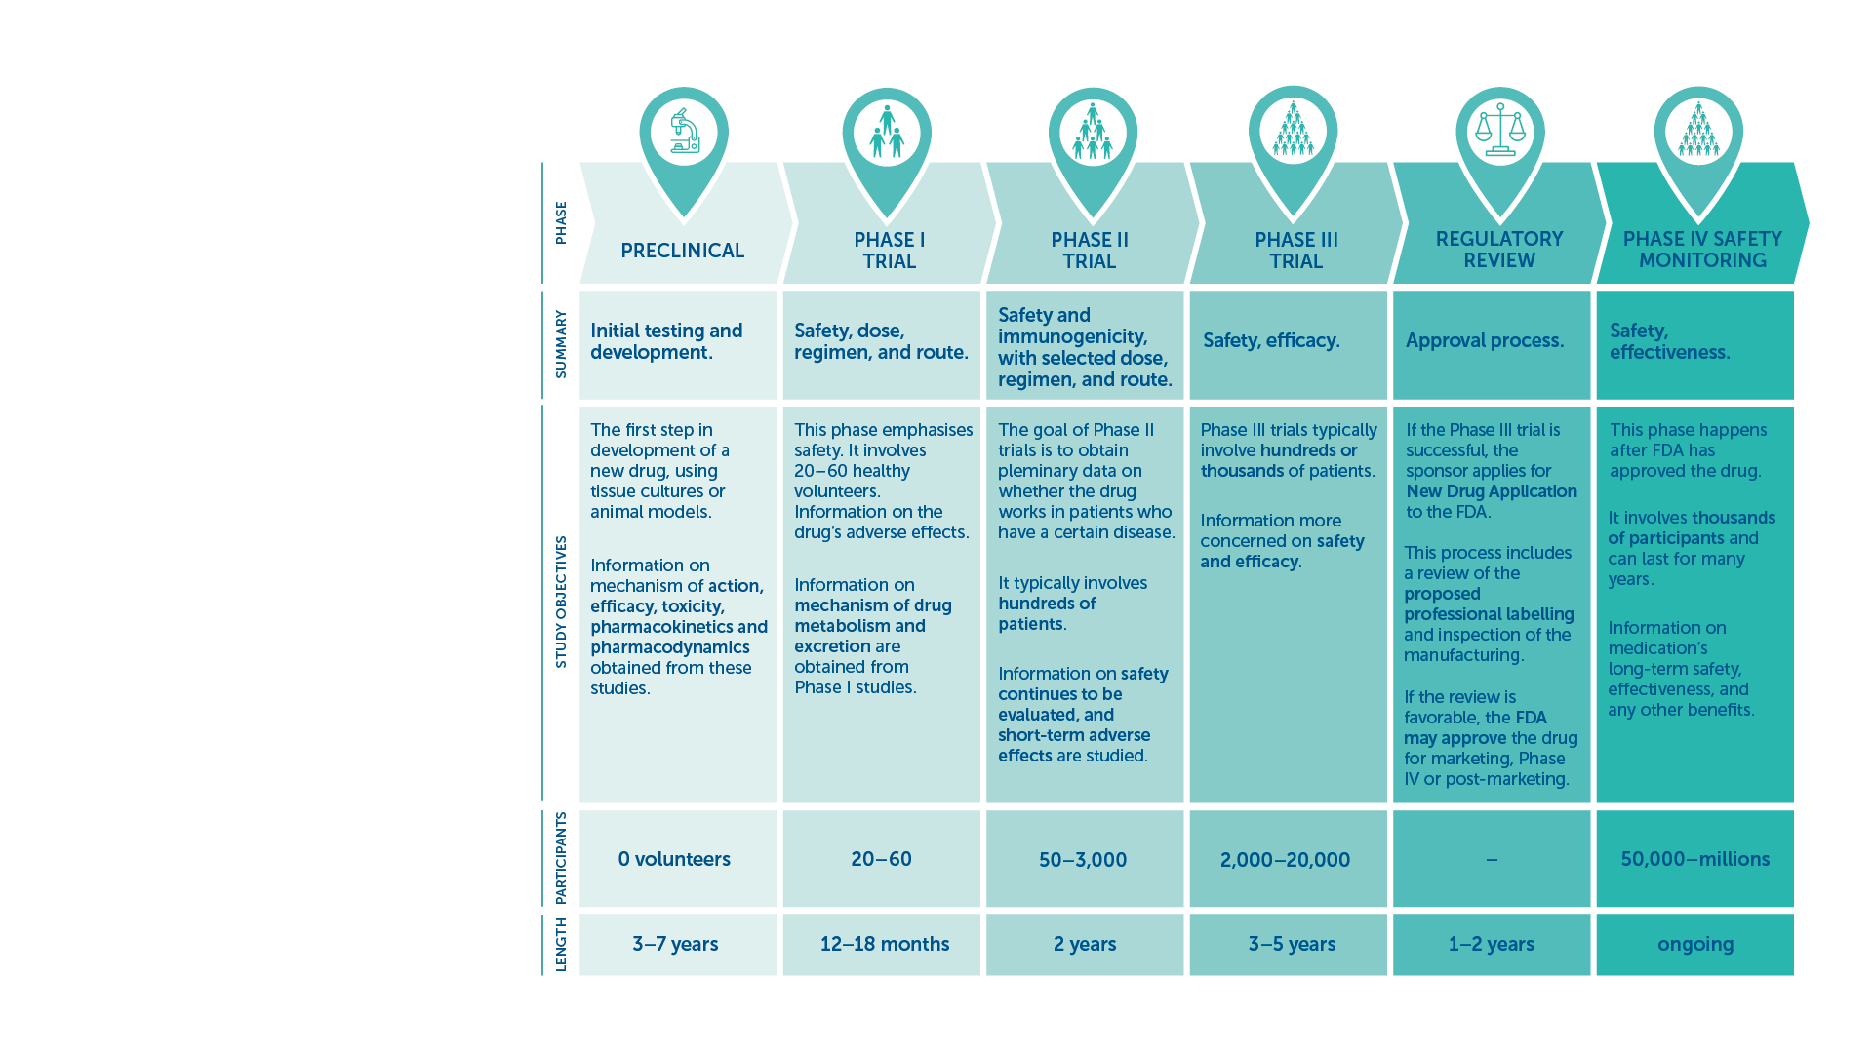
Phases of Clinical Trials
Highlights:​
Safety​
Efficacy​
Effectiveness​
IAVI VACCINE LITERACY LIBRARY | MODULE 5

Slide 6

Safety
To make sure that all possible side-effects are recorded, even rare or uncommon ones.​
‘Adverse events’ can be mild, moderate, or severe.​
Common reactions that are expected for vaccines include fever, headache, tiredness, or body aches.​
Serious reactions to vaccines are very rare.​
Safety monitoring continues through the reporting of side effects even after a vaccine has been approved for use.​
Safety is evaluated in the different clinical trial phases of a candidate vaccine to establish the product(s) does not cause serious reactions, or side effects that would prevent its use.​
IAVI VACCINE LITERACY LIBRARY | MODULE 5

Slide 7
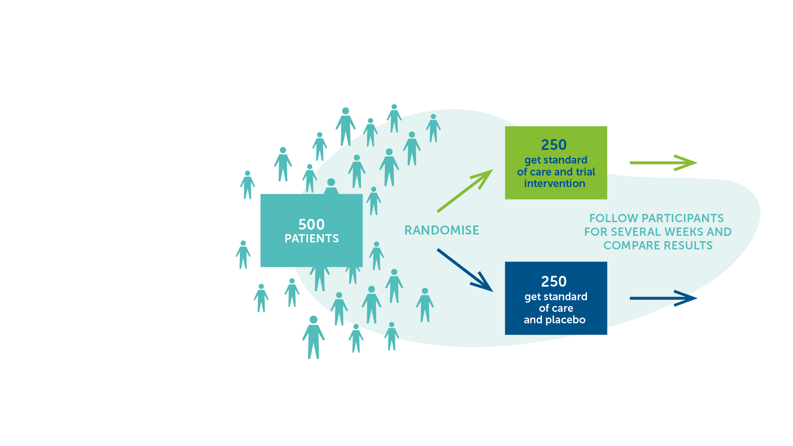
Placebo
A harmless, inactive substance.​
Given to one group of participants in a clinical trial, while the candidate vaccine is given to another group.​
The group receiving the placebo is usually called the control group. ​
In this way researchers have a comparator to tell if the vaccine candidate is safe and effective.​
IAVI VACCINE LITERACY LIBRARY | MODULE 5

Slide 8
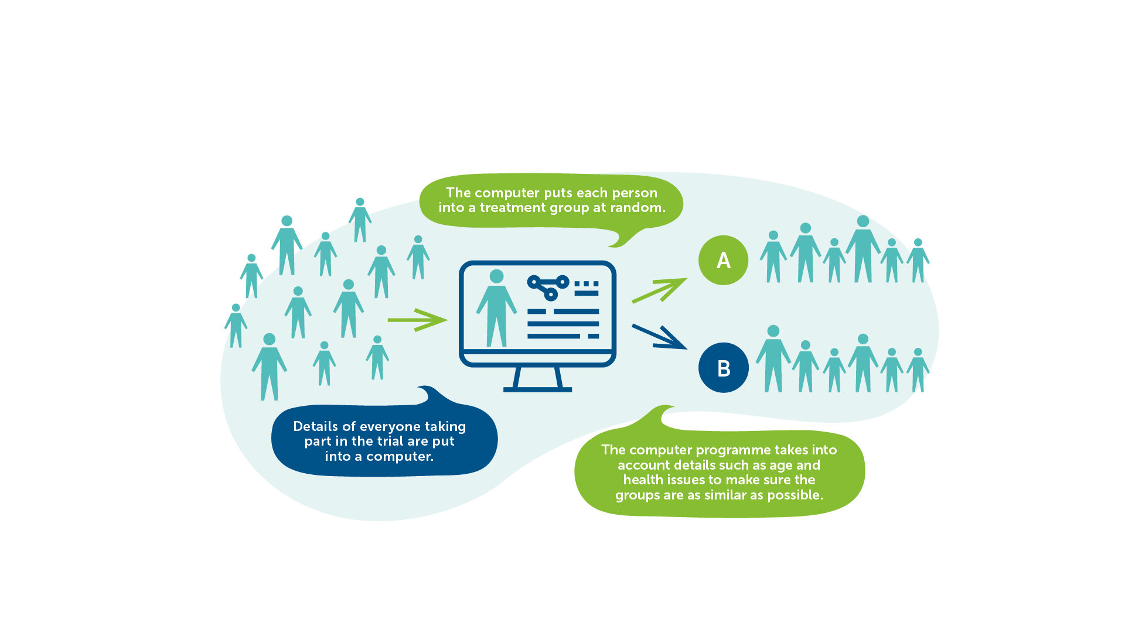
Randomisation
IAVI VACCINE LITERACY LIBRARY | MODULE 5

Slide 9
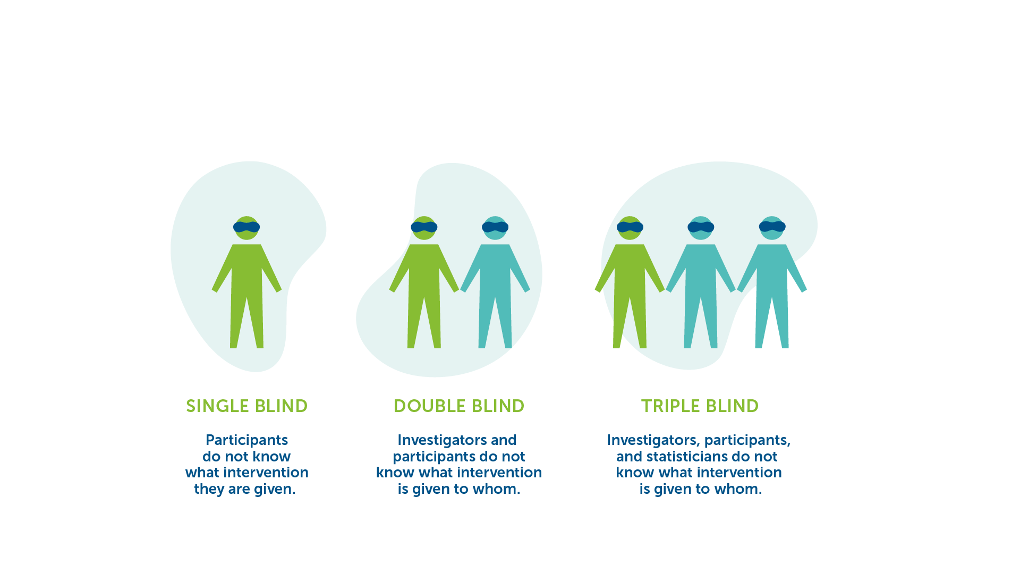
Blinding
Having a blind trial helps prevent any bias.​
IAVI VACCINE LITERACY LIBRARY | MODULE 5

Slide 10
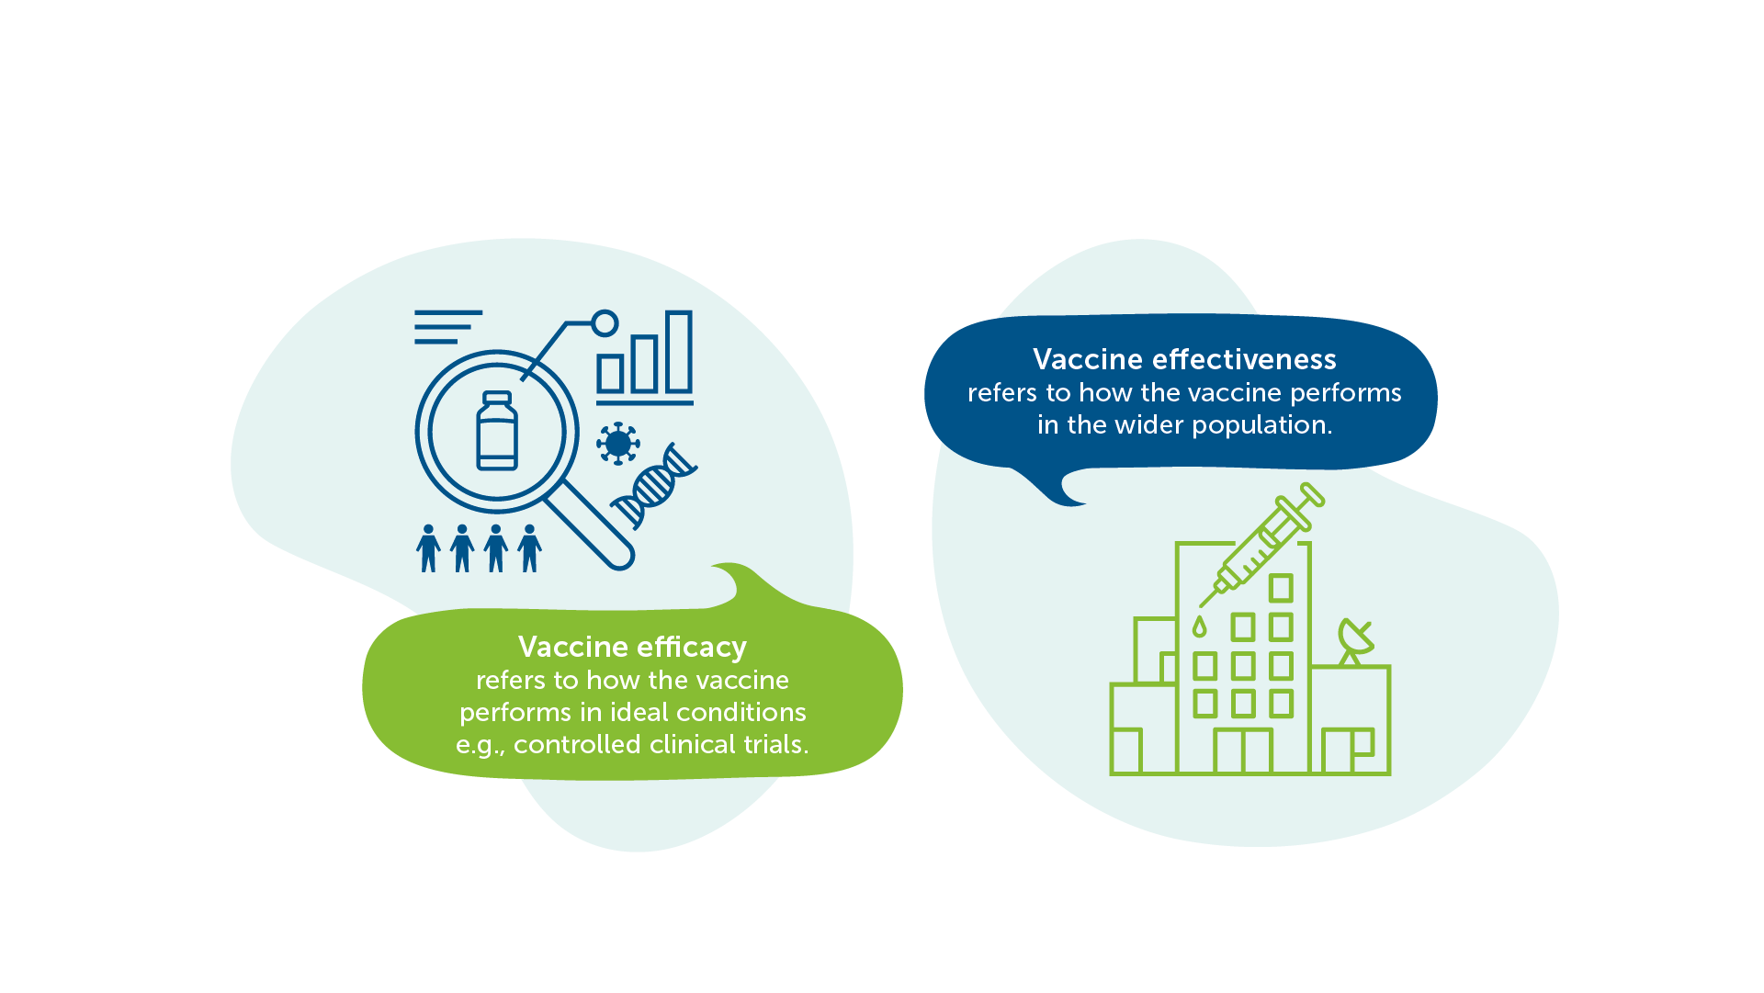
Efficacy vs Effectiveness
Source: Adapted from WHO
IAVI VACCINE LITERACY LIBRARY | MODULE 5

Slide 11

Clinical Trials in Low- and Middle- Income Countries
To ensure that vaccines are safe and effective for those populations where vaccines are needed most.​
Demonstrates whether or not the vaccine can be delivered effectively in the local conditions.​
Provide the evidence needed to speed approval and access.​
Raises knowledge and awareness of vaccine research among key stakeholders and communities, which will help ready communities for a vaccine when one is available.​
IAVI VACCINE LITERACY LIBRARY | MODULE 5

Slide 12
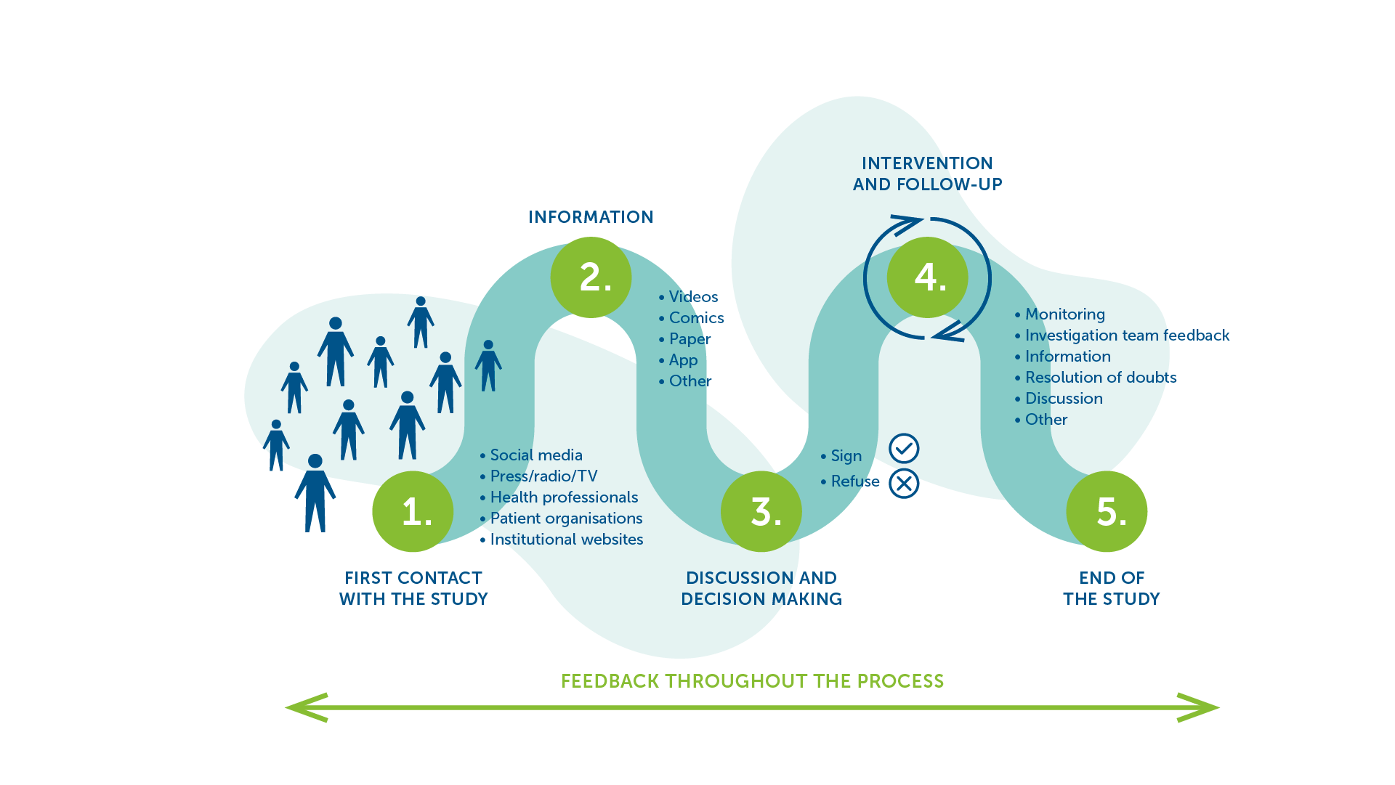
Participation in Clinical Trials​
IAVI VACCINE LITERACY LIBRARY | MODULE 5

Slide 14
Acknowledgements
IAVI would like to acknowledge the contribution of Doreen Asio, Monica Bagaya, Vincent Basajja, Kundai Chinyenze, William Dekker, Evanson Gichuru, Nyokabi Jacinta, Sarah Joseph, Dagna Laufer, Sharon Lipesa, Shelly Malhotra, Miliswa Magongo, Blossom Makhubalo, Roselyn Malogo, John Mdluli, Ireen Mosweu, Juliet Mpendo, Gaudensia Mutua, Vincent Muturi-Kioi, Conwell Mwakoi, Jauhara Nanyondo, Gertrude Nanyonjo, Jacinta Nyakobi, Faith Ochieng, Fred Otieno, Daisy Ouya, Gayle Patenaude, Hilda Phiri, Nicole Sender, Lewis Schrager, Elana Van Brakel, Kelvin Vollenhoven, Jeffery Walimbwa, Mathias Wambuzi, Anja Van der Westhuizen for reviewing the content of the IAVI Vaccine Literacy Library.
Lead Consultants: Roger Tatoud and Rebekah Webb.
Design and Illustration: Anthea Duce.
© International AIDS Vaccine Initiative, Inc. 2022

Slide 15


