Slide 1



2022

Slide 3





MODULE 3:
THE IMMUNE
SYSTEM
HIV
TB
Lassa Virus
Vaccines

Slide 4
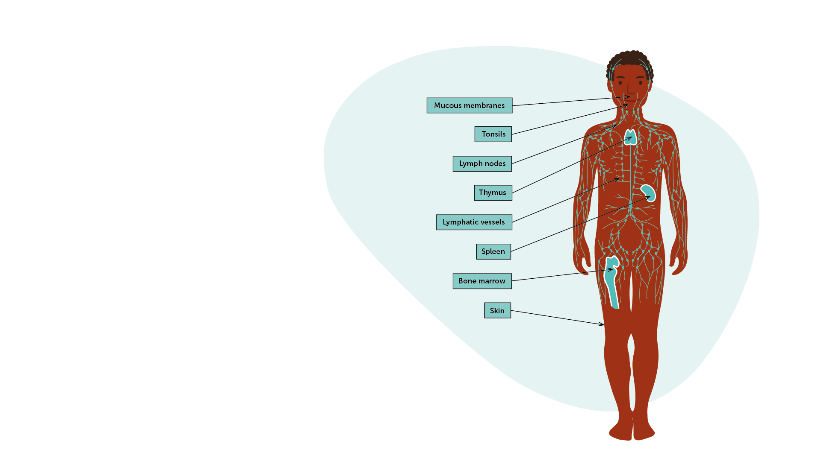
The Immune System
IAVI VACCINE LITERACY LIBRARY | MODULE 3
A complex system of organs, tissues, cells, and processes that protect us from disease.​
Enables the body to recognise anything that is different from itself (i.e. “foreign”) and that is potentially harmful.​
Creates defences against these invaders, which are called pathogens.​
Divided into two broad categories: ‘innate immunity’ and ‘acquired immunity.’​

Slide 5
Immunity and Immune Responses​
Type of immunity​
Innate immune defences​
  First to respond to any pathogen.​
  Not specific to one pathogen.​
  Cannot usually be “taught” to respond better by a vaccine.​
  Often not enough to get rid of pathogens as the first line of defence and a second line of defence kicks in.​
Acquired immunity
  Second line of defence of the body.​
  Activated only after our immune system has “seen” and “recognised” a pathogen.​
  Directed towards a single, specific pathogen.​
  The acquired immune responses are those involved in the function of a vaccine.​
Arms of the acquired immune response
Antibody-mediated or humoral immune response
  Includes antibodies and ‘B-cell’ responses.​
Cell-mediated or cellular immune response
  Coordinated by ‘T cells’ which targets cells that have already been infected with a pathogen.​
IAVI VACCINE LITERACY LIBRARY | MODULE 3

Slide 6
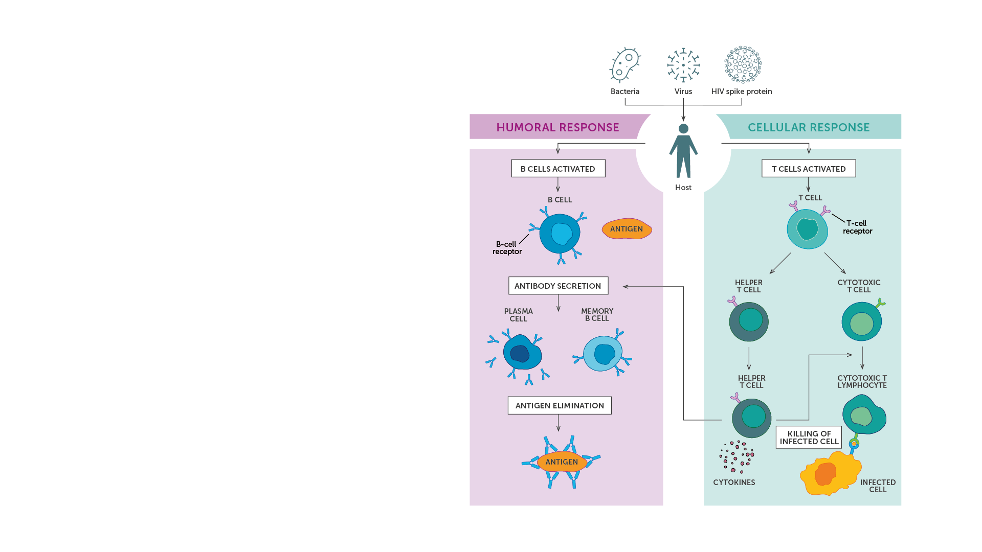
Cells of the Immune System​
Macrophages/dendritic cells/phagocytes​
Antigen-presenting cells (APCs)​
  B cells​
  Macrophages​
  Dendritic cells​
Lymphocytes​
T cells​
  CD4+ cells​
  CD8+ cells​
B cells​
Memory B cells and memory T cells​
Natural killer (NK) cells​
IAVI VACCINE LITERACY LIBRARY | MODULE 3

Slide 7
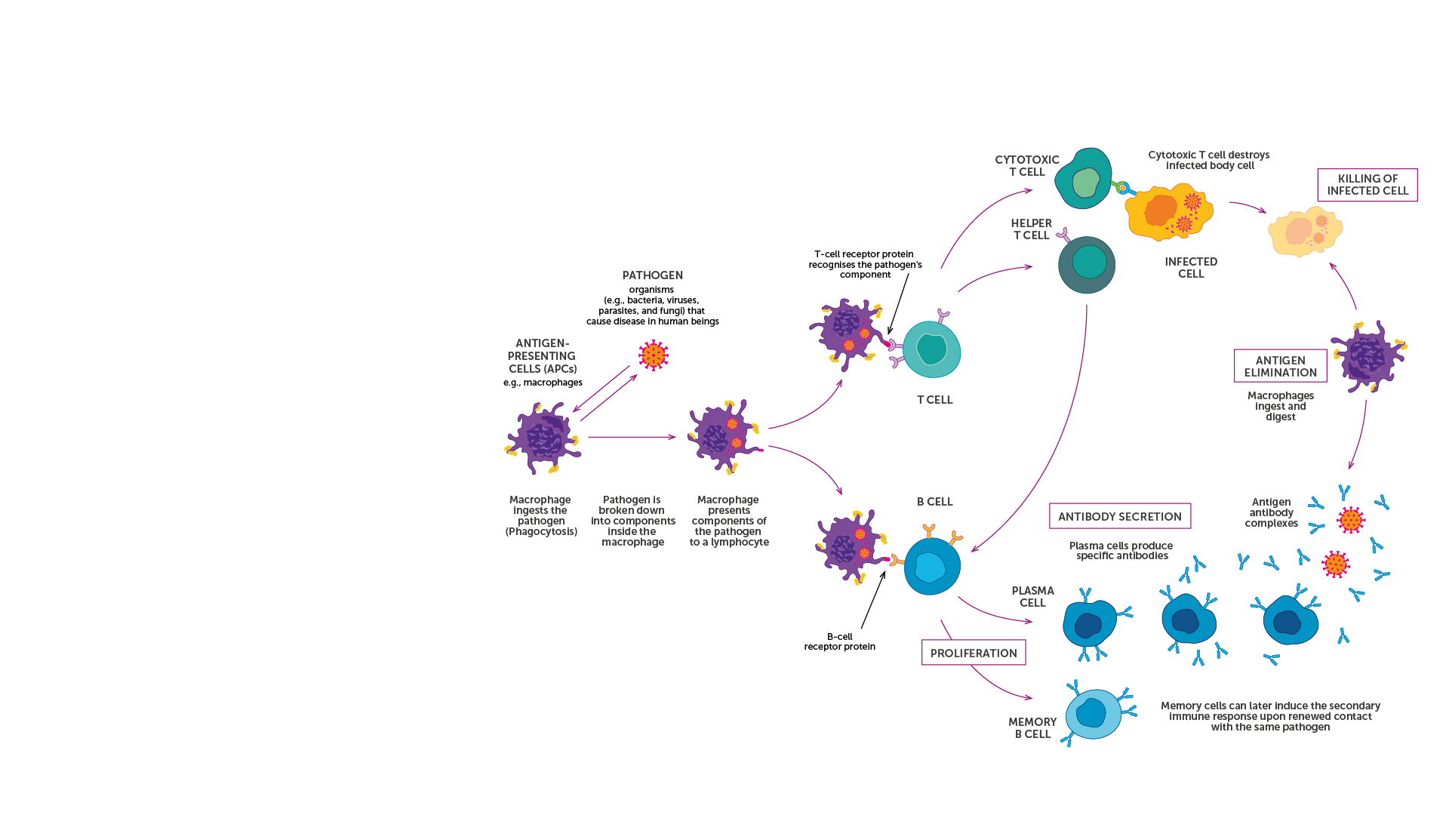
The Immune Response
The immune system comprises many cells located in different organs. Each plays a role in recognising pathogens and mounting a response.​
B-cell receptors and T-cell receptors are key proteins responsible for specific antigen recognition in acquired immunity.​
They are found at the surface of the T and B cells of the immune system, and they can recognise antigens or part of the antigens presented by the antigen-presenting cells (APCs).​
There is a vast diversity of B- and T- cell receptors allowing the human immune system to recognise a very large number of pathogens.​
IAVI VACCINE LITERACY LIBRARY | MODULE 3

Slide 8
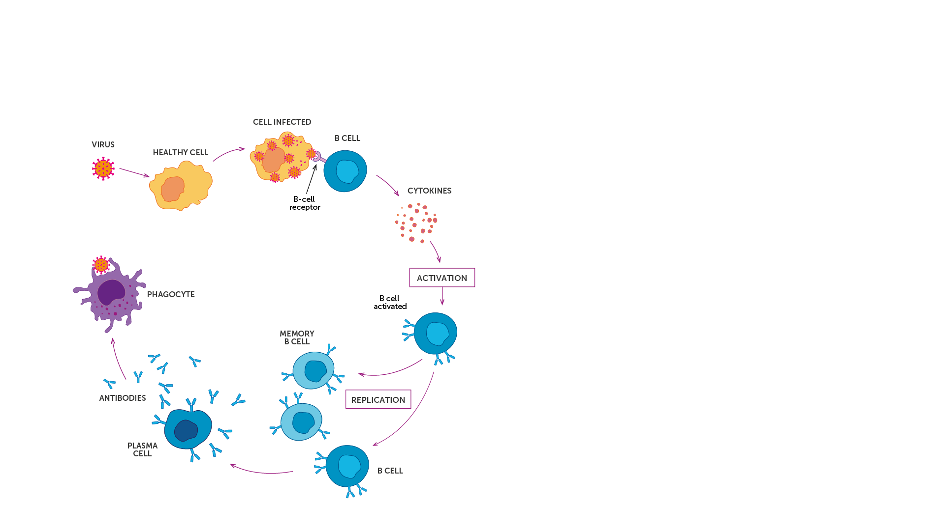
Humoral Immune Response
Binding antibody​
Produced in large quantities following infection.​
Recognises and binds to parts of a foreign body but cannot directly prevent infections or destroy the pathogen.​
Requires the involvement of other immune mechanisms to destroy the foreign agent.​
Neutralising antibody​
Recognises and binds to a pathogen.​
Can neutralise pathogens by blocking the pathogen from entering its host cell.​
Neutralisation can result in loss of infectivity.​
Broadly neutralising antibody (bnAb)​
Can recognise a wide range of viruses even if they are different from the virus that initially infected the individual.​
IAVI VACCINE LITERACY LIBRARY | MODULE 3

Slide 9
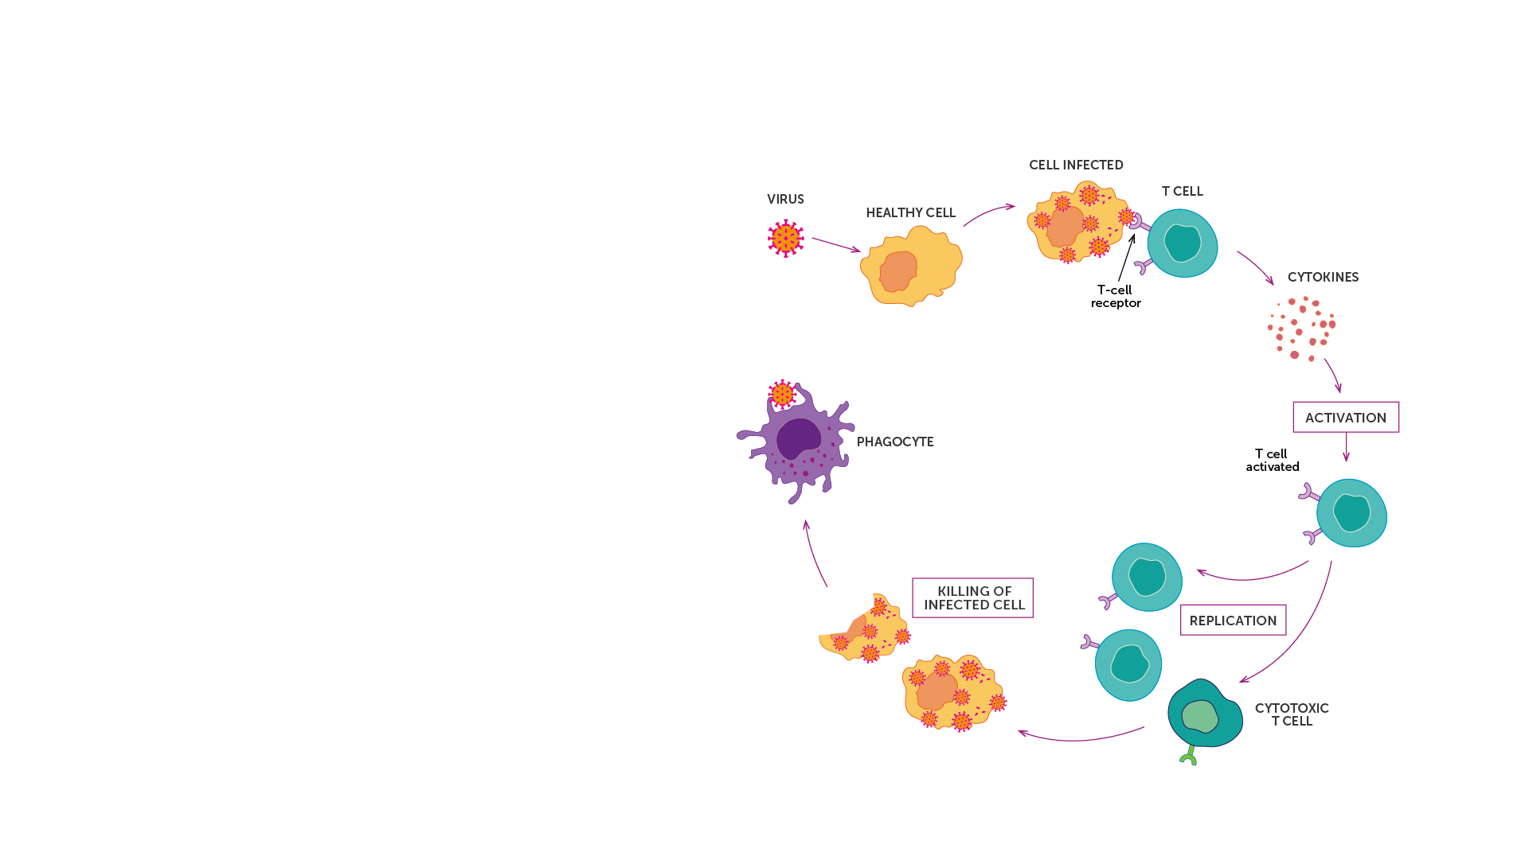
Cellular Immune Response
The cellular response is the arm of the immune response mediated by cells from the immune system and the production of cytokines.​
Cellular immunity is most effective in destroying virus-infected cells, and bacteria within cells.​
Cytokines are proteins that act as messengers between cells to regulate and coordinate the immune responses.​
Cellular immunity works by activating antigen-specific cytotoxic T lymphocytes (CTLs), macrophages and natural killer cells that can destroy cells displaying antigens of foreign antigen on their surface.​
IAVI VACCINE LITERACY LIBRARY | MODULE 3

Slide 10
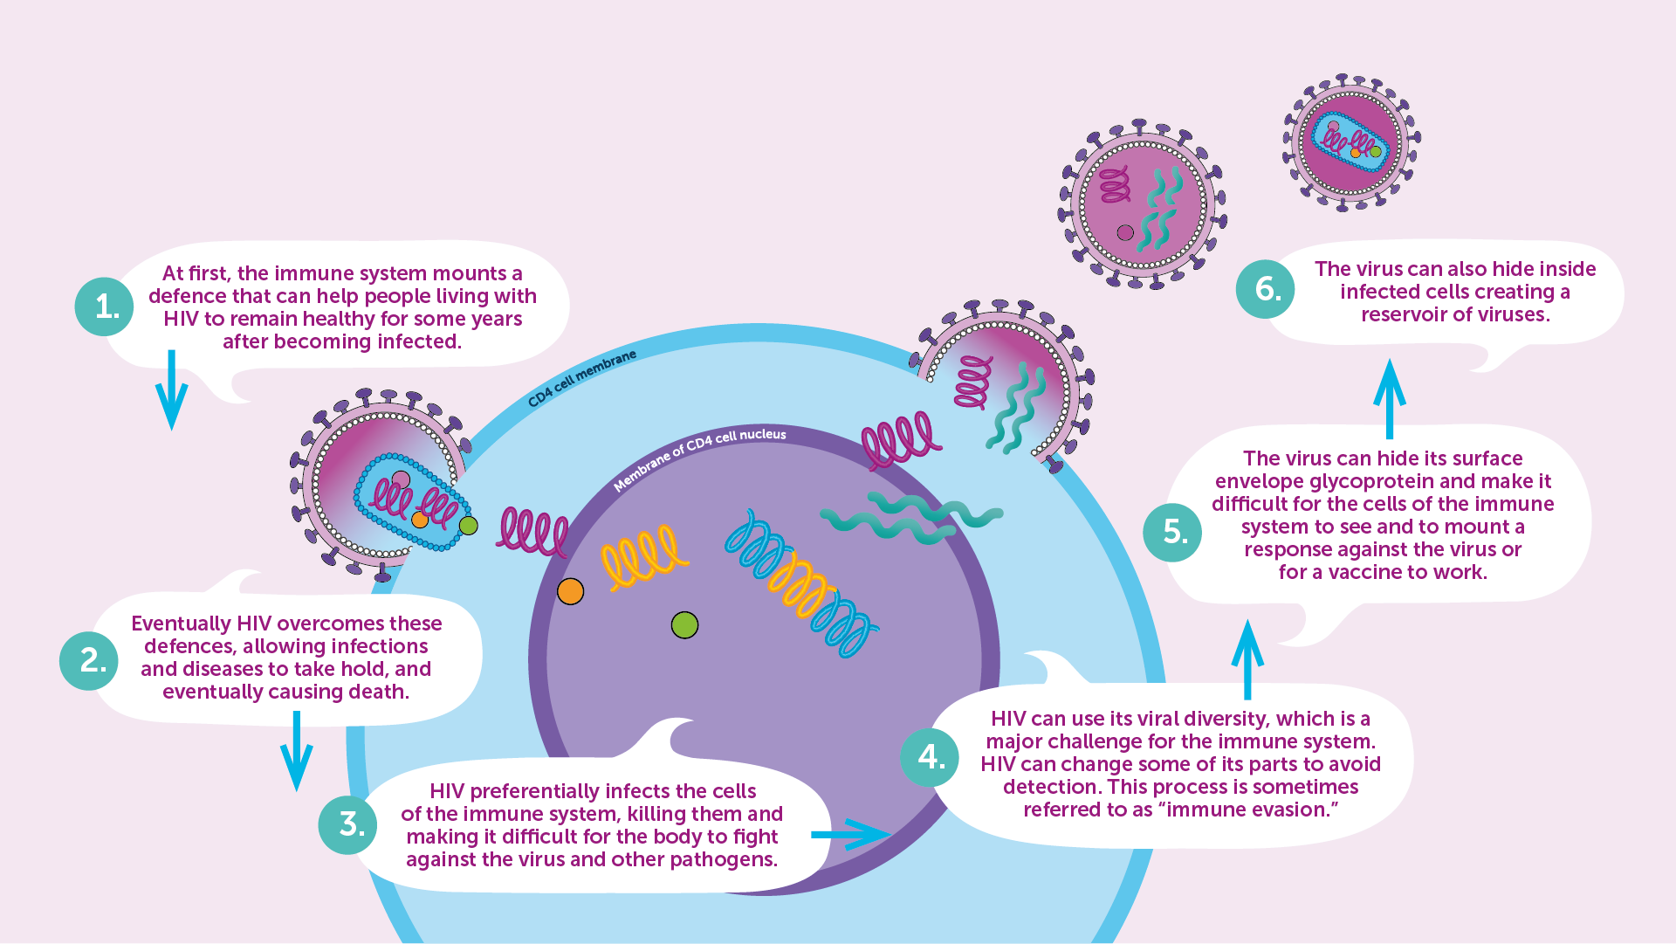
HIV and the Immune System
IAVI VACCINE LITERACY LIBRARY | MODULE 3

Slide 11
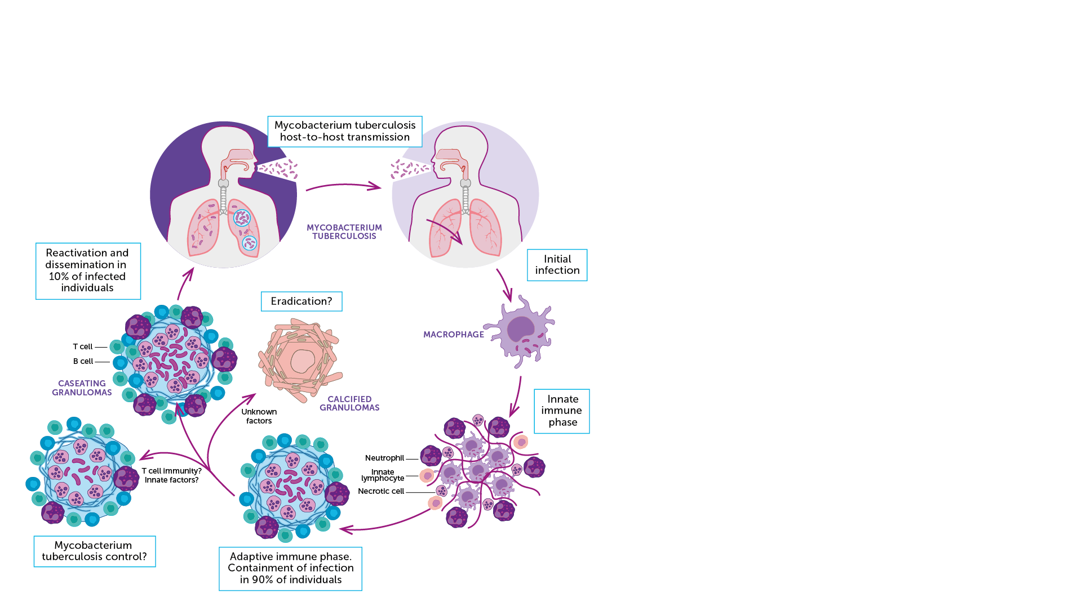
TB and the Immune System
The interaction between the immune system and Mycobacterium tuberculosis are complex and either lead to:​
  Clearance of the bacteria​
  Latent TB infection​
  Active TB disease ​​
M.tb can prevent the activation of pathogen destruction systems within macrophages where it can hide, reproduce slowly, and modify the cell to its advantage.​
M.tb can affect the function of dendritic cells by altering the production of various cytokines involved in the immune responses and the suppression of T lymphocyte activity.​
M.tb can also interfere with the interactions between the different cells of the immune system and hamper their ability to work together and kill or constrain the organism.​
IAVI VACCINE LITERACY LIBRARY | MODULE 3

Slide 12

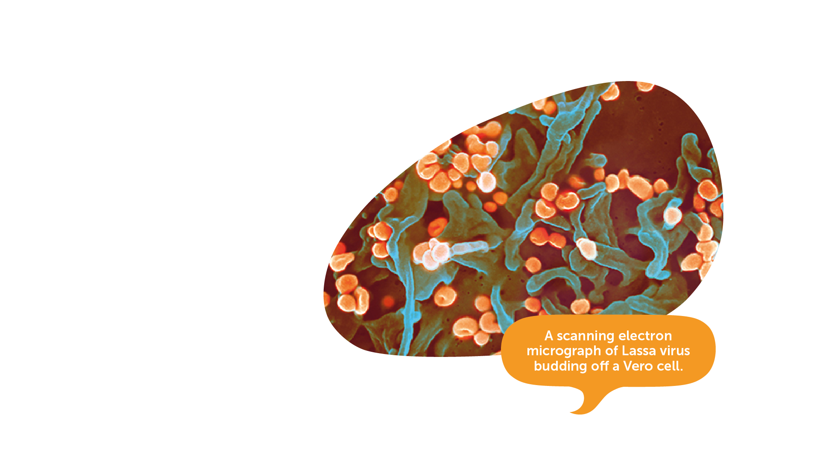
Lassa and the Immune System​
The immune response to natural Lassa virus infection (LASV) has yet to be fully explained by scientists.​
Outbreaks of the disease are typically sporadic and often in remote locations.
The virus needs to be handled in a special high safety laboratory​.
LASV results in immunosuppression and is able to evade and undermine effective immune response.​
Image credit: National Institute of Allergy and Infectious Diseases, NIH.
IAVI VACCINE LITERACY LIBRARY | MODULE 3
Notes:
https://www.iavi.org/news-resources/press-releases/2021/edctp-and-cepi-funding-moves-iavi-s-lassa-fever-vaccine-candidate-into-advanced-clinical-development

Slide 13

Key Messages
The immune system is the set of organs, tissues, and cells that defend the body against infections.​
It is very sophisticated and is designed to recognise common pathogens that enter the body, such as viruses, bacteria, or parasites.​
The immune system develops defence responses to invading organisms and usually will ‘remember’ and respond more rapidly during future encounters.​
Some pathogens such as HIV can disrupt or evade immune responses.​
IAVI VACCINE LITERACY LIBRARY | MODULE 3

Slide 15
Acknowledgements
IAVI would like to acknowledge the contribution of Doreen Asio, Monica Bagaya, Vincent Basajja, Kundai Chinyenze, William Dekker, Evanson Gichuru, Nyokabi Jacinta, Sarah Joseph, Dagna Laufer, Sharon Lipesa, Shelly Malhotra, Miliswa Magongo, Blossom Makhubalo, Roselyn Malogo, John Mdluli, Ireen Mosweu, Juliet Mpendo, Gaudensia Mutua, Vincent Muturi-Kioi, Conwell Mwakoi, Jauhara Nanyondo, Gertrude Nanyonjo, Jacinta Nyakobi, Faith Ochieng, Fred Otieno, Daisy Ouya, Gayle Patenaude, Hilda Phiri, Nicole Sender, Lewis Schrager, Elana Van Brakel, Kelvin Vollenhoven, Jeffery Walimbwa, Mathias Wambuzi, Anja Van der Westhuizen for reviewing the content of the IAVI Vaccine Literacy Library.
Lead Consultants: Roger Tatoud and Rebekah Webb.
Design and Illustration: Anthea Duce.
© International AIDS Vaccine Initiative, Inc. 2022

Slide 16
