Slide 1



2022

Slide 3




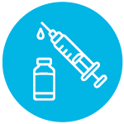
MODULE 2:
INTRODUCTION TO HIV, TUBERCULOSIS, AND LASSA FEVER
HIV
TB
Lassa Virus
Vaccines

Slide 4
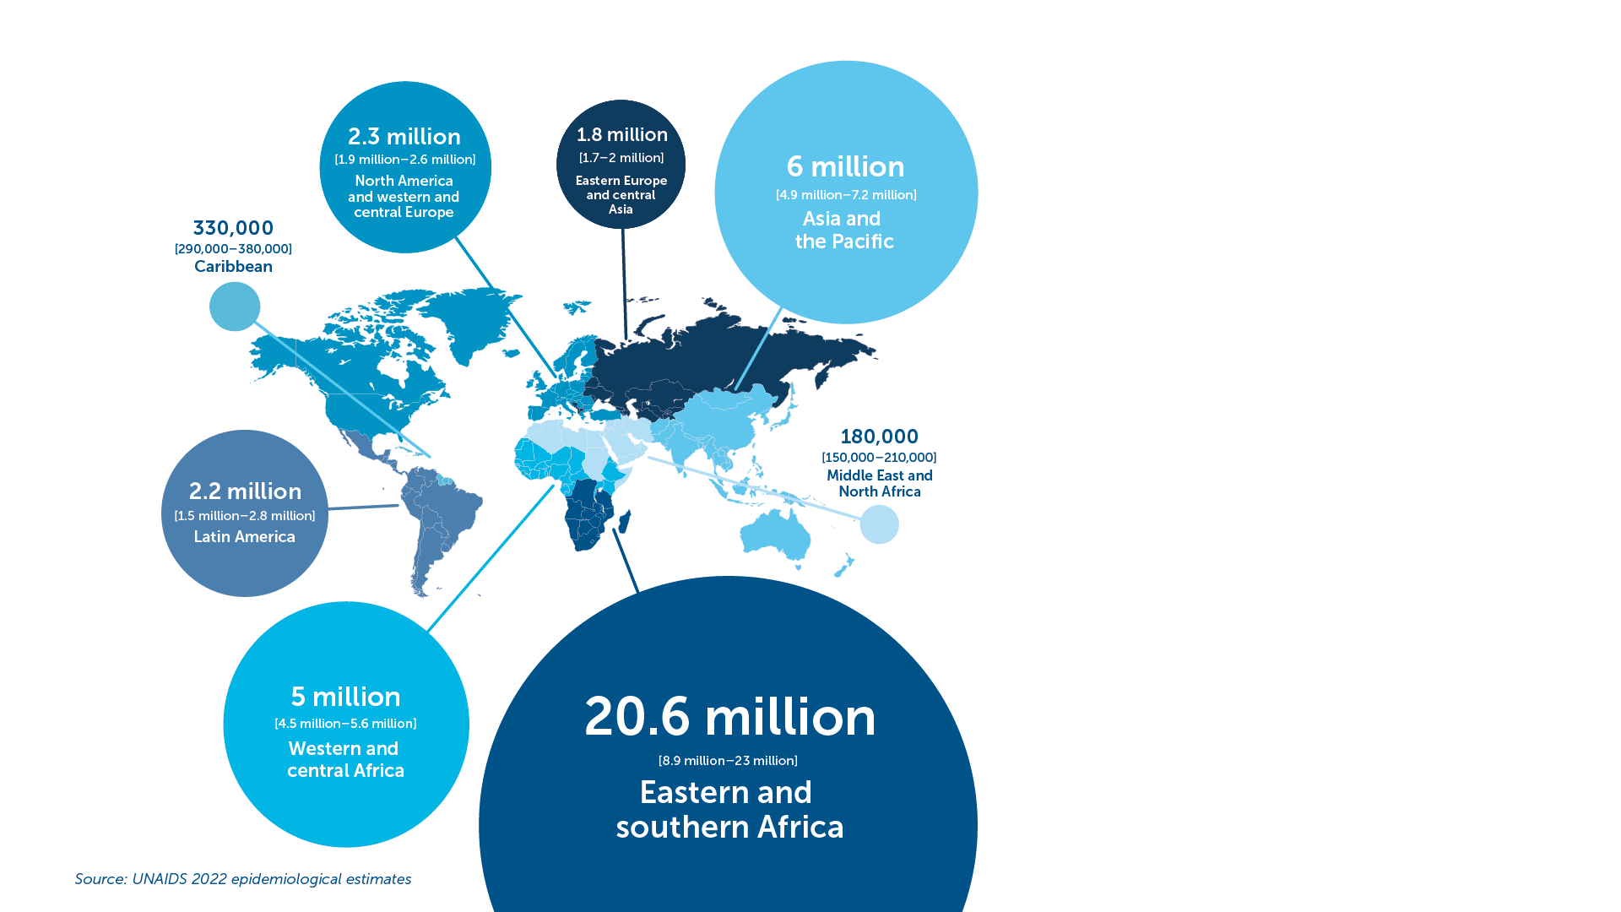
HIV
First case of AIDS recorded in 1981.​
38.4 million people globally were living with HIV in 2021.​
1.5 million people became newly infected with HIV in 2021.​
Around 650,000 people died from AIDS-related illnesses worldwide in 2021 compared to 1.9 million people in 2004 and 1.3 million people in 2010 thanks to effective treatment and progress with prevention.​
HIV transmission:​
  Blood​
  Semen and pre-seminal fluid​
  Rectal fluids​
  Vaginal fluids​
  Breast milk​
IAVI VACCINE LITERACY LIBRARY | MODULE 2

Slide 5
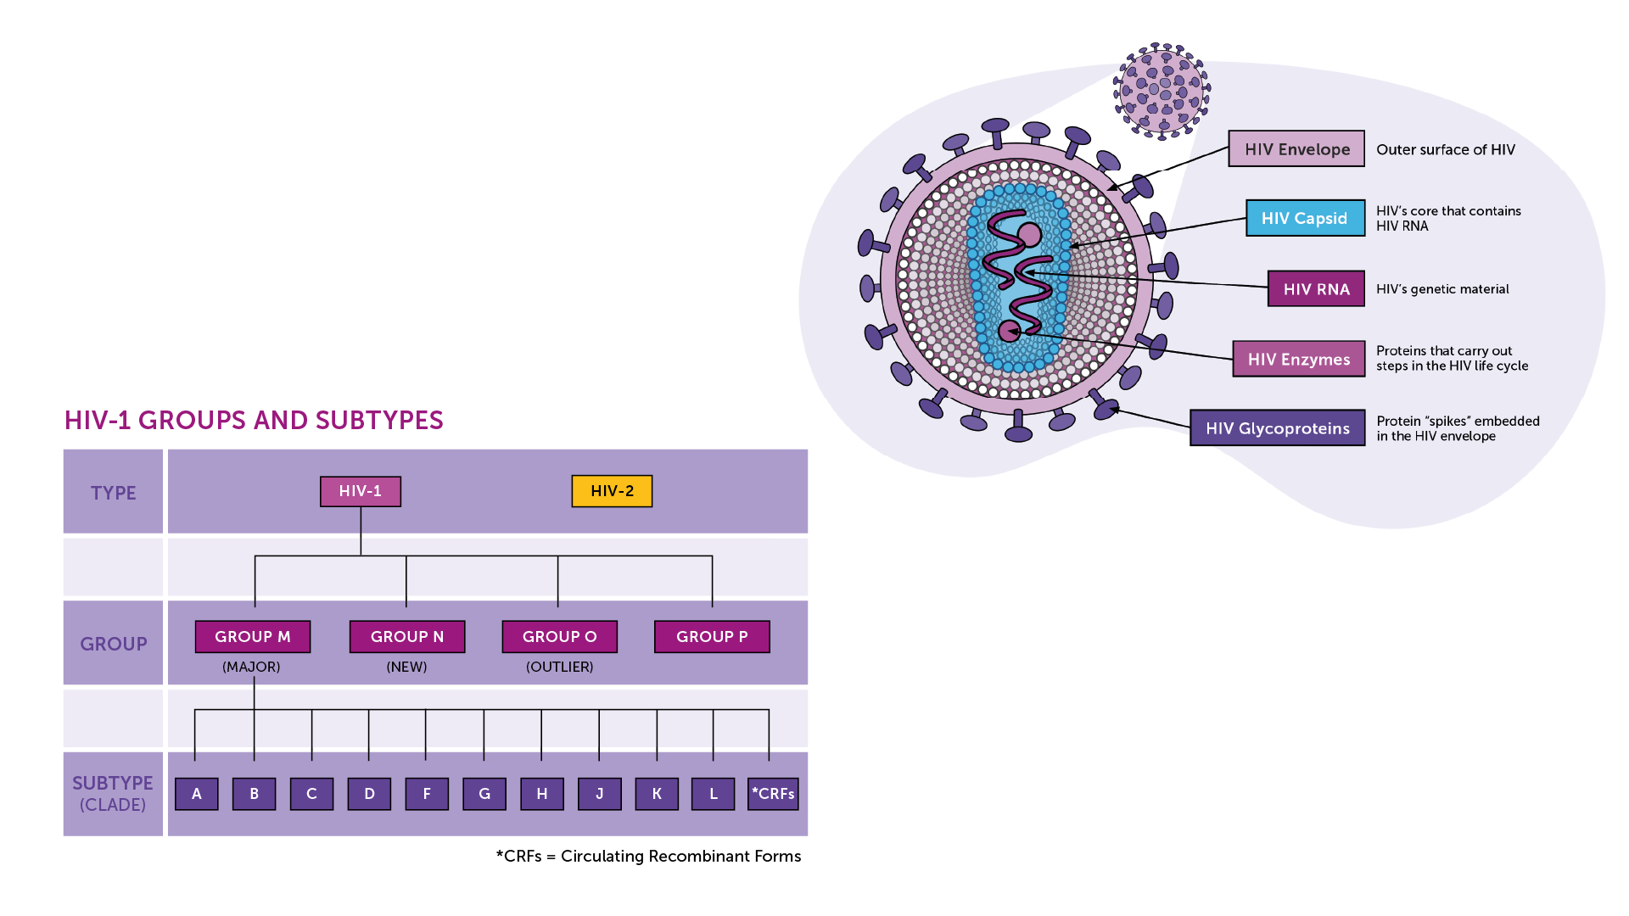
The Human Immunodeficiency
Virus​
Diversity is a challenge for vaccine development​
Retrovirus: a virus that uses RNA as its genetic material. ​
HIV-1: the most common virus found all over the world.​
HIV-2: much less common and less infectious and harmful, found mostly in West Africa.​
Four Groups (M, N, O, and P).​
10 Subtypes in the M group.​
IAVI VACCINE LITERACY LIBRARY | MODULE 2

Slide 6
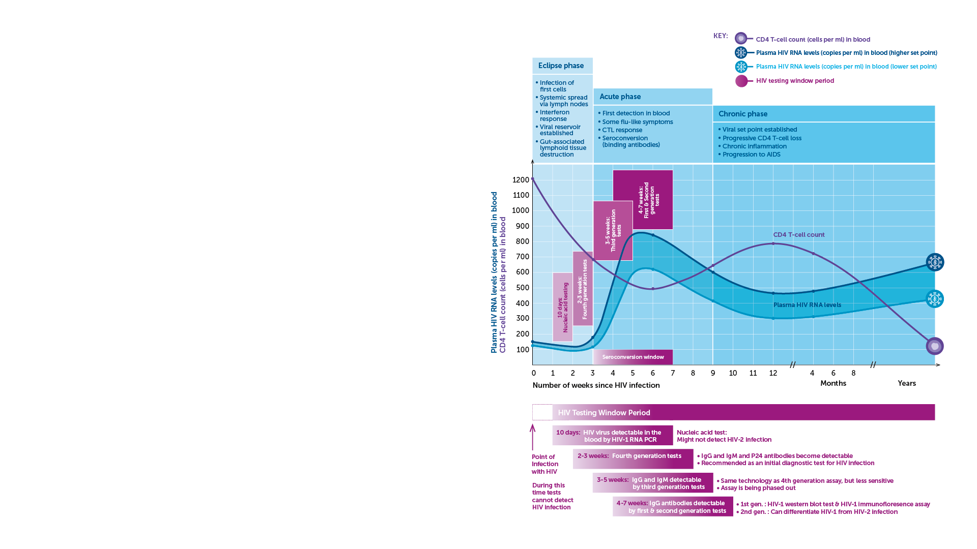
HIV Diagnosis and Disease Progression​
Diagnosis​
Nucleic acid tests (NAT) that can detect HIV RNA in the blood.​
Antigen/antibody tests to detect parts of the virus, for example the viral capsid protein (p24) along with antibodies generated in response to the infection. ​
Tests to detect antibodies generated by the body in response to the infection.​
Disease progression
Acute Infection​
Chronic Infection​
AIDS​
IAVI VACCINE LITERACY LIBRARY | MODULE 2

Slide 7
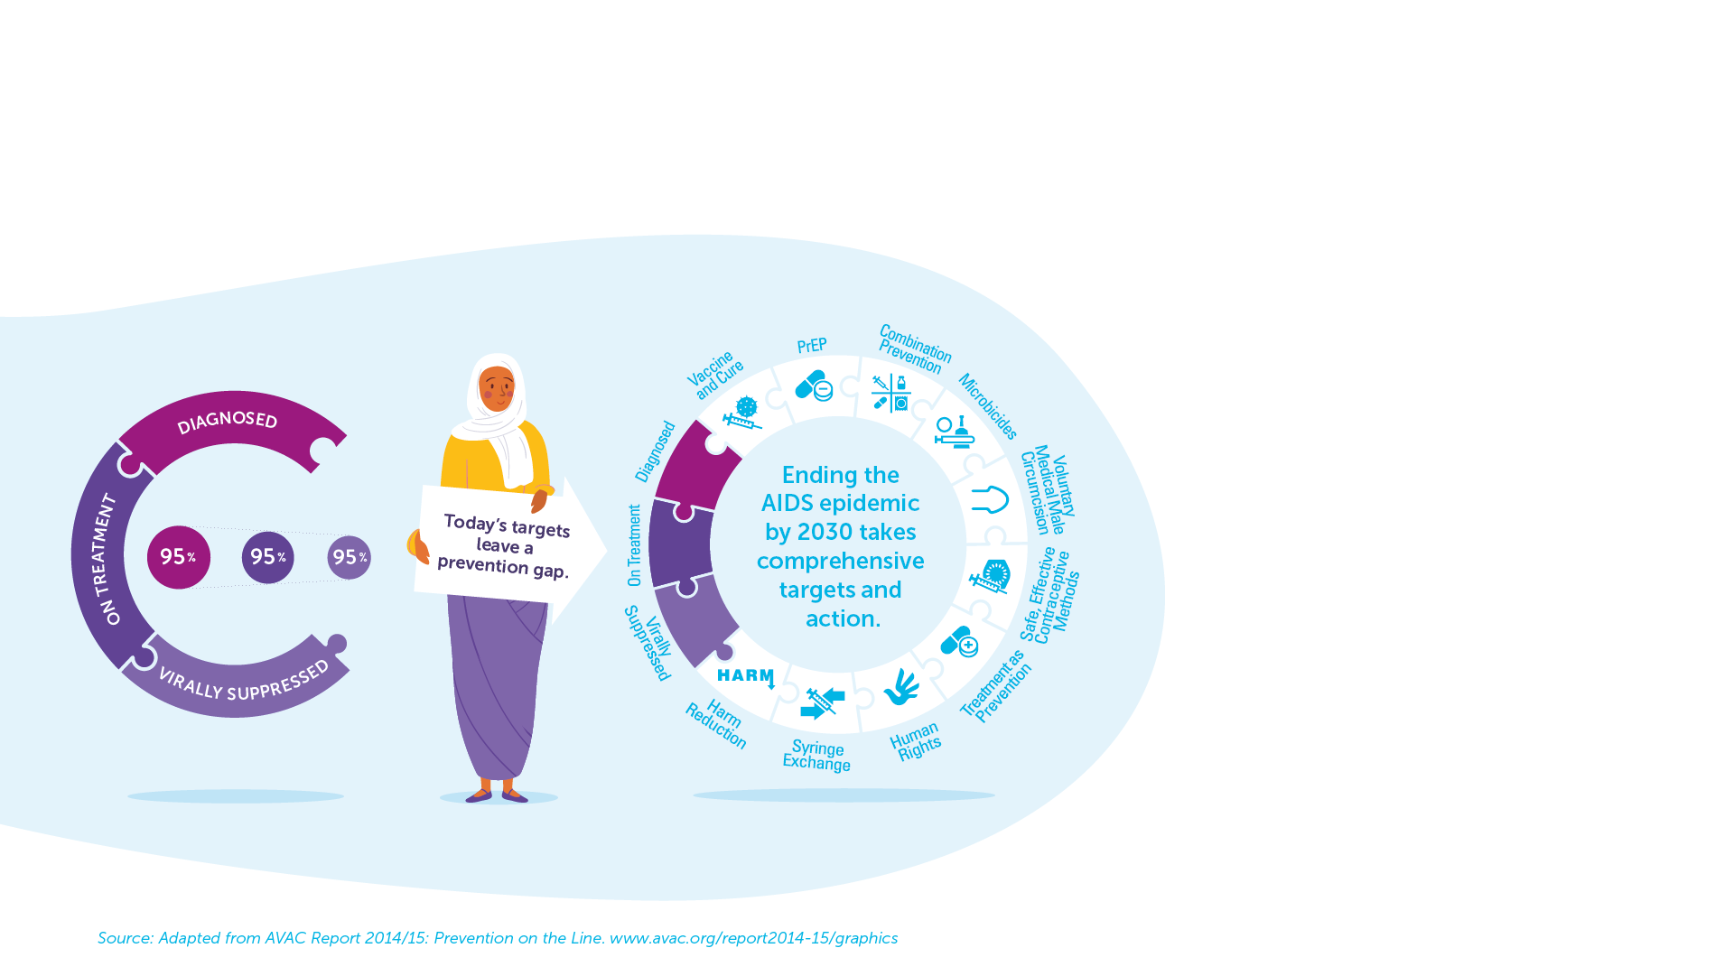
HIV Prevention and Treatment
Comprehensive prevention tools and interventions.​
To date, there is no cure and no vaccine for HIV.​
There are now more than 30 antiretrovirals (ARVs) that can be used in first, second, and third-line therapy.​
95-95-95
In 2021, 85% of people living with HIV knew their HIV status.​
Among people who knew their status, 88% were accessing treatment.​
And among people accessing treatment, 92% were virally suppressed.​
IAVI VACCINE LITERACY LIBRARY | MODULE 2

Slide 8
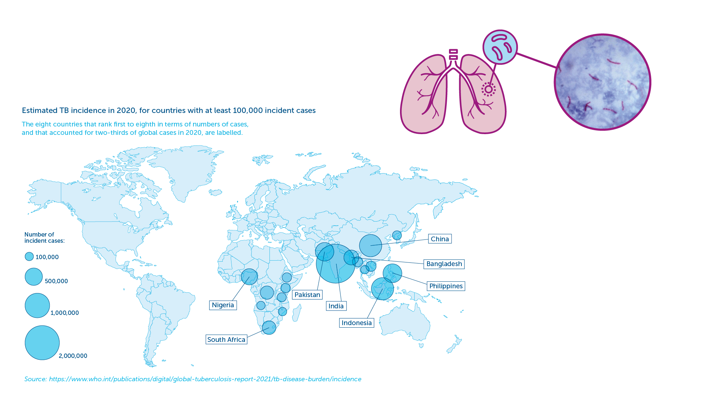
Tuberculosis (TB)
An ancient disease.​
Mycobacterium tuberculosis (M.tb) bacteria discovered in 1882.​
Over 2 billion people are infected with M.tb worldwide.​
Only 5–10% will develop TB disease during their lifetime.​
1.2 million children get sick with TB each year.​​
Spread through the air.​
IAVI VACCINE LITERACY LIBRARY | MODULE 2

Slide 9
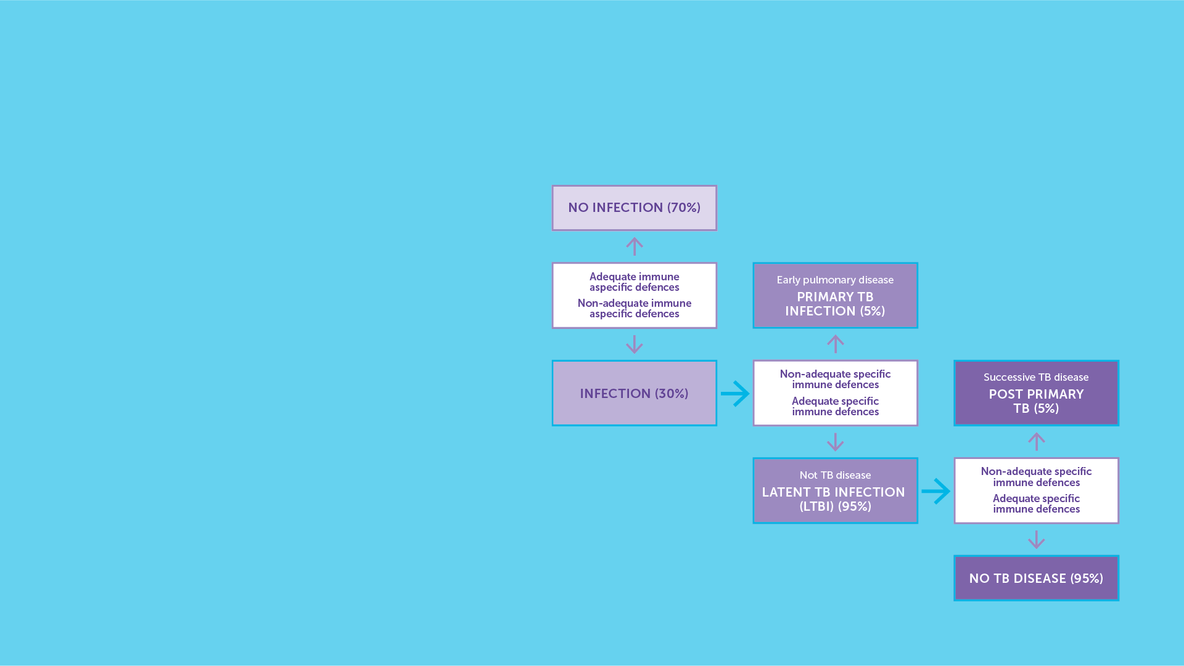
Tuberculosis – Diagnosis and Disease Progression​
The symptoms of tuberculosis infection are diverse depending on where the bacteria are in the body.​
TB presents in people in two forms: active TB disease and latent TB infection. ​
People with latent TB disease may have no symptoms.​
Diagnosing TB requires a clinical examination and confirmatory diagnostic tests.​
Disease progression.​
IAVI VACCINE LITERACY LIBRARY | MODULE 2

Slide 10
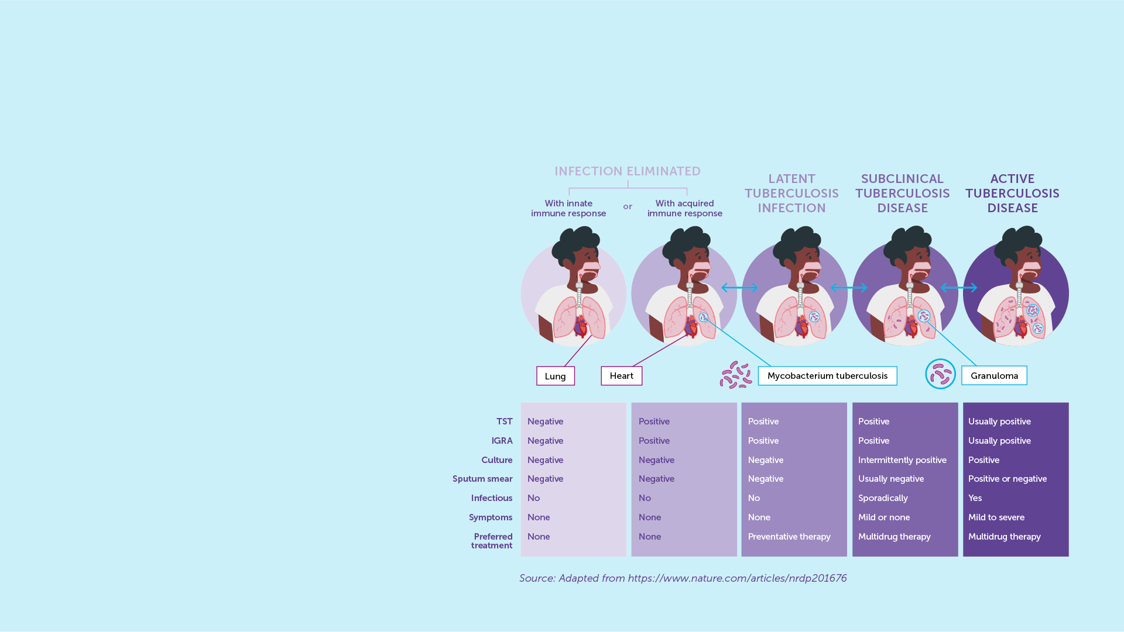
TB Prevention and Treatment​
Tuberculosis is preventable.​
BCG is the only approved vaccine for TB.​
Variable level of protection.​
Drug-sensitive TB is curable with a four- to six-month course of currently available TB treatment.​
Resistance to treatment can occur.​
Multidrug-resistant TB (MDR-TB) is treatable, but with a much longer course of multiple drugs that can cause many side-effects.​
Extensively drug-resistant TB (XDR-TB) is more difficult, and sometimes impossible, to treat successfully.​
IAVI VACCINE LITERACY LIBRARY | MODULE 2

Slide 11
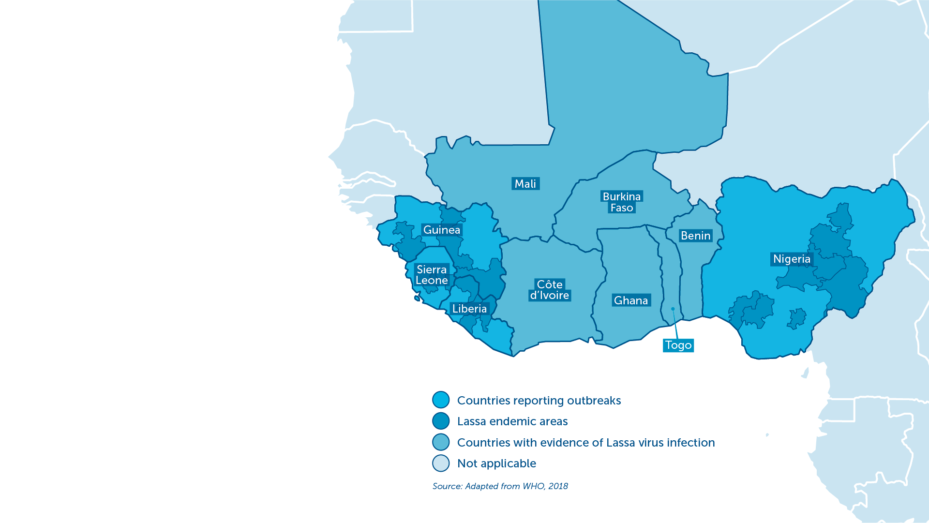
Lassa Fever
First described in the 1950s.​
Acute viral haemorrhagic illness endemic in some parts of West Africa.​
An estimated 100,000–300,000 cases and 5,000 related deaths each year. ​
Particularly dangerous to pregnant women and small children.​
Neurological problems have also been described, including various degrees of deafness, which occur in approximately one-third of infections, and in many cases hearing loss is permanent.​
WHO has identified Lassa fever as one of the top emerging pathogens likely to cause severe outbreaks in the near future.​
IAVI VACCINE LITERACY LIBRARY | MODULE 2

Slide 12
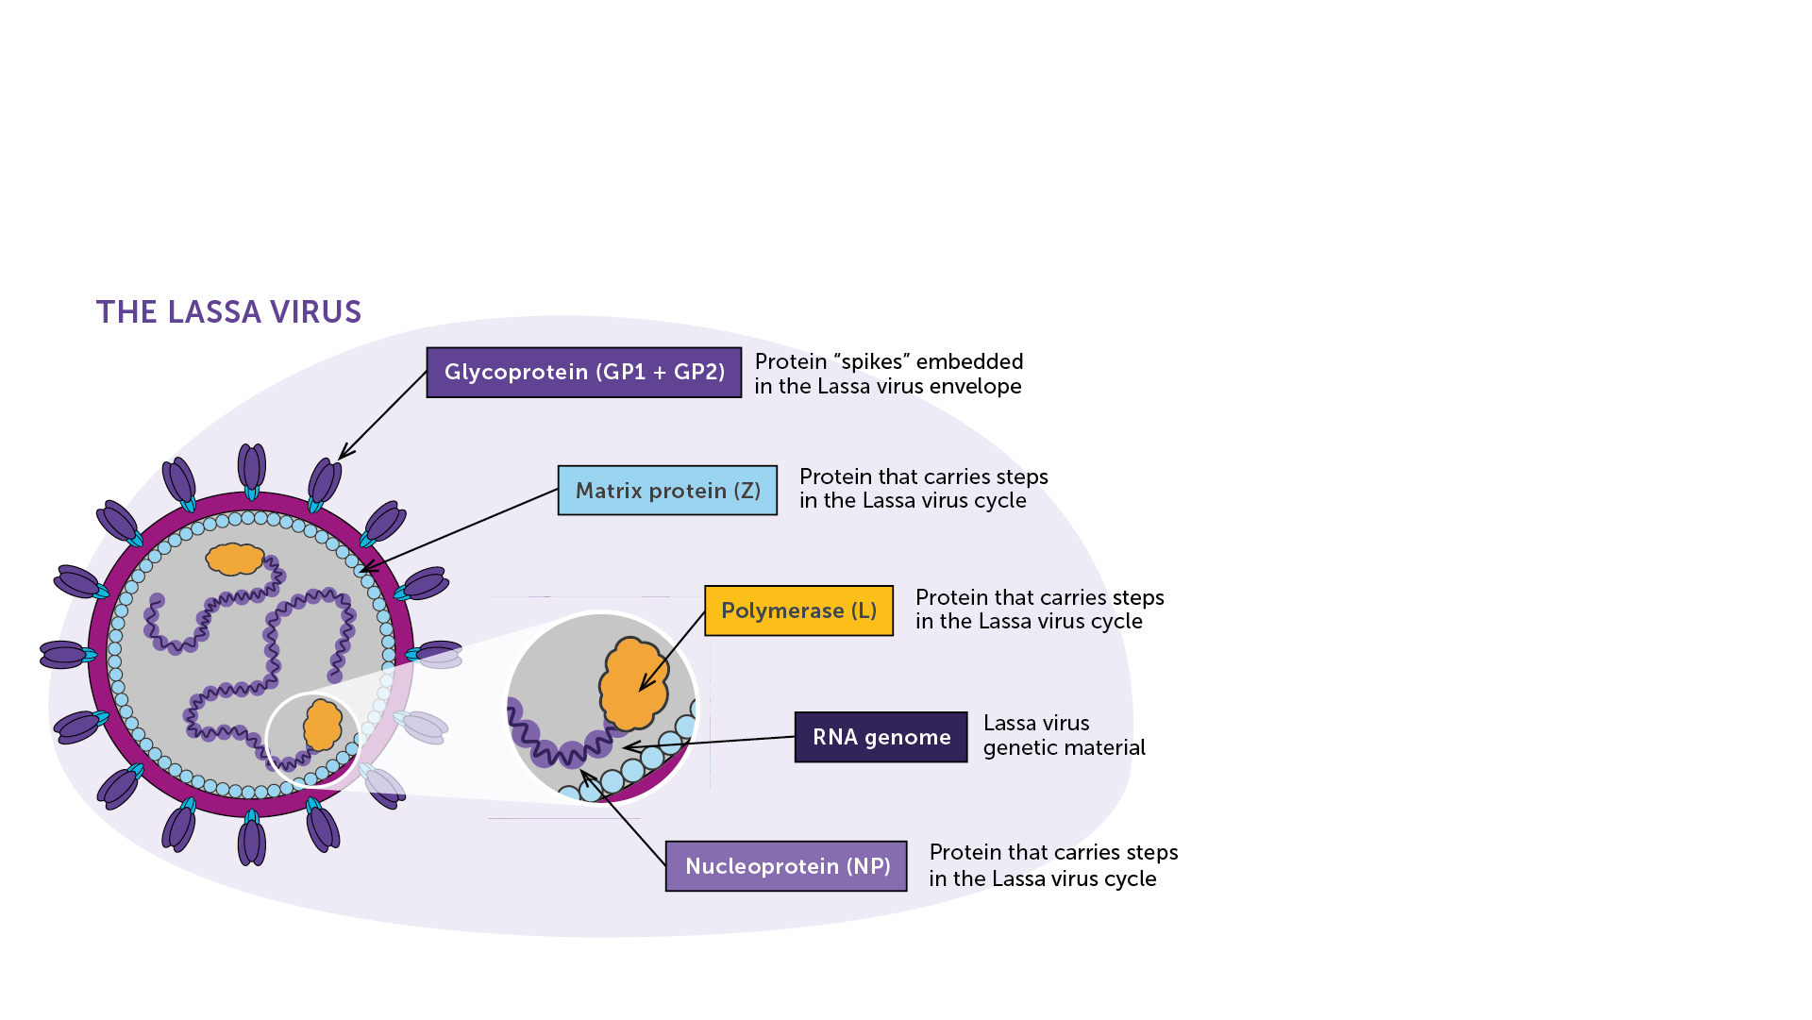
Lassa Mammarenavirus (LASV)
LASV responsible for the disease identified in 1969.​
Retrovirus: a virus that uses RNA as its genetic material. ​
Six types of LASV.​
Ingestion of food or inhalation of air contaminated with urine or faeces from infected rodents that spread the disease.​
Not spread through direct contact (hugging, shaking hands, or sitting near someone).​
Person-to-person transmission may occur after exposure to Lassa virus in the blood, tissue, secretions, or excretions of a Lassa-infected individual.​
IAVI VACCINE LITERACY LIBRARY | MODULE 2

Slide 13
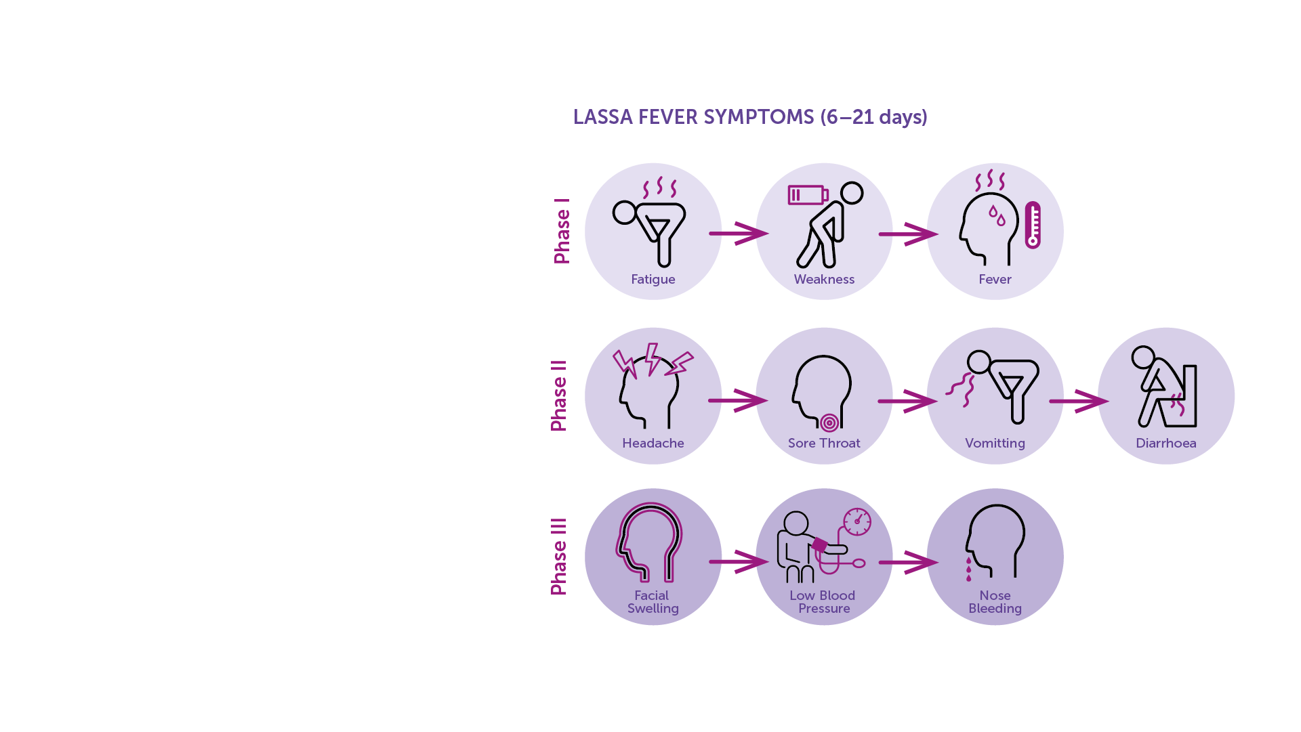
Lassa Fever Diagnosis​
Clinical diagnosis of Lassa fever is often difficult due to the variety of non-specific symptoms.​
Diagnosis​
Nucleic acid tests (NAT) that detect RNA from the virus in the blood.​
Tests to detect antibodies generated by the body in response to the infection.​
Antigenic tests to detect parts of the virus.​
Virus isolation by cell culture.​
IAVI VACCINE LITERACY LIBRARY | MODULE 2

Slide 14
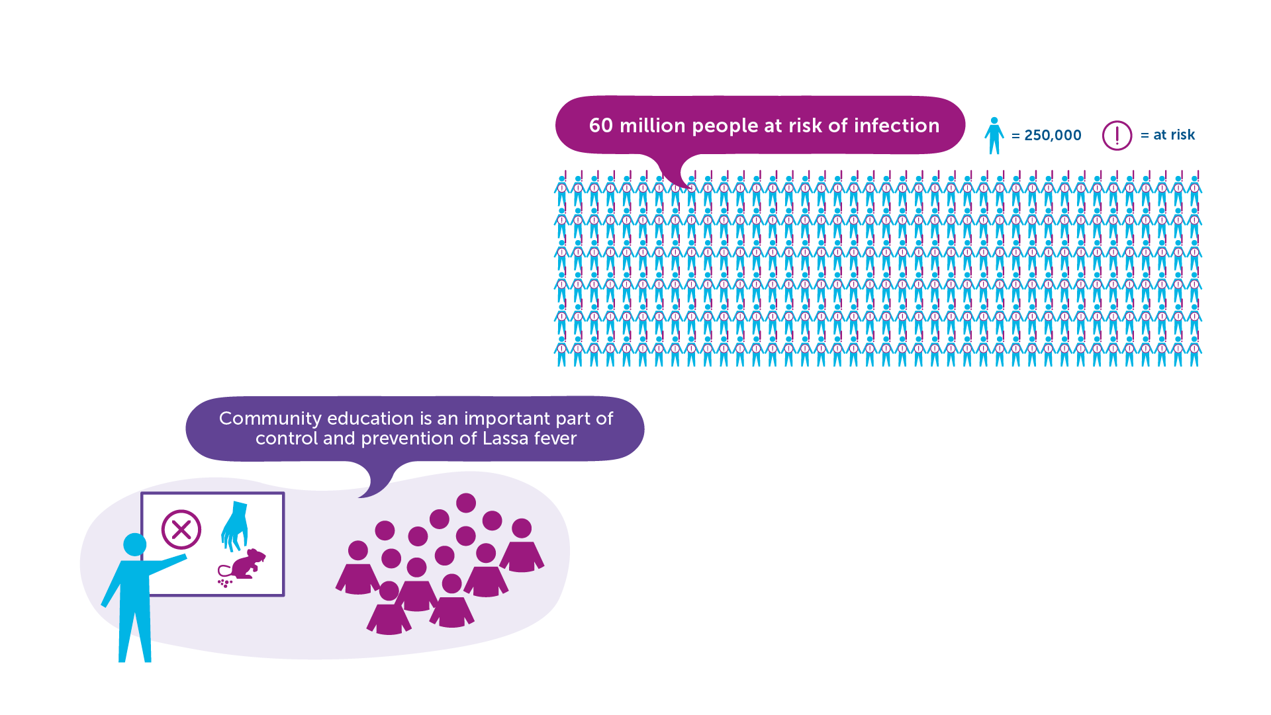
Lassa Fever Prevention and Treatment​
Nearly 60 million people are estimated at risk of infection.​
Community education in areas affected is an important part of the control and prevention of Lassa fever.​
No vaccine.​
No approved treatment for Lassa fever.​
IAVI VACCINE LITERACY LIBRARY | MODULE 2

Slide 16
Acknowledgements
IAVI would like to acknowledge the contribution of Doreen Asio, Monica Bagaya, Vincent Basajja, Kundai Chinyenze, William Dekker, Evanson Gichuru, Nyokabi Jacinta, Sarah Joseph, Dagna Laufer, Sharon Lipesa, Shelly Malhotra, Miliswa Magongo, Blossom Makhubalo, Roselyn Malogo, John Mdluli, Ireen Mosweu, Juliet Mpendo, Gaudensia Mutua, Vincent Muturi-Kioi, Conwell Mwakoi, Jauhara Nanyondo, Gertrude Nanyonjo, Jacinta Nyakobi, Faith Ochieng, Fred Otieno, Daisy Ouya, Gayle Patenaude, Hilda Phiri, Nicole Sender, Lewis Schrager, Elana Van Brakel, Kelvin Vollenhoven, Jeffery Walimbwa, Mathias Wambuzi, Anja Van der Westhuizen for reviewing the content of the IAVI Vaccine Literacy Library.
Lead Consultants: Roger Tatoud and Rebekah Webb.
Design and Illustration: Anthea Duce.
© International AIDS Vaccine Initiative, Inc. 2022

Slide 17


