Slide 1
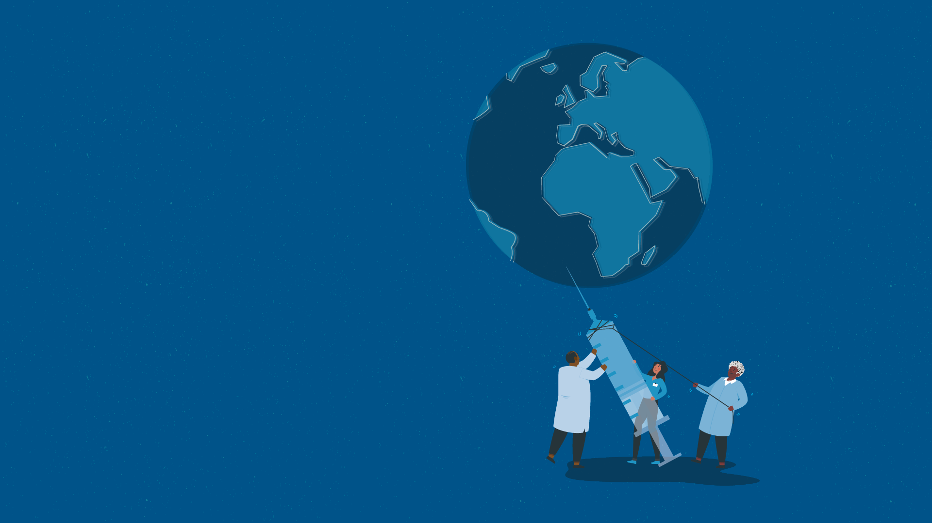


2022

Slide 3
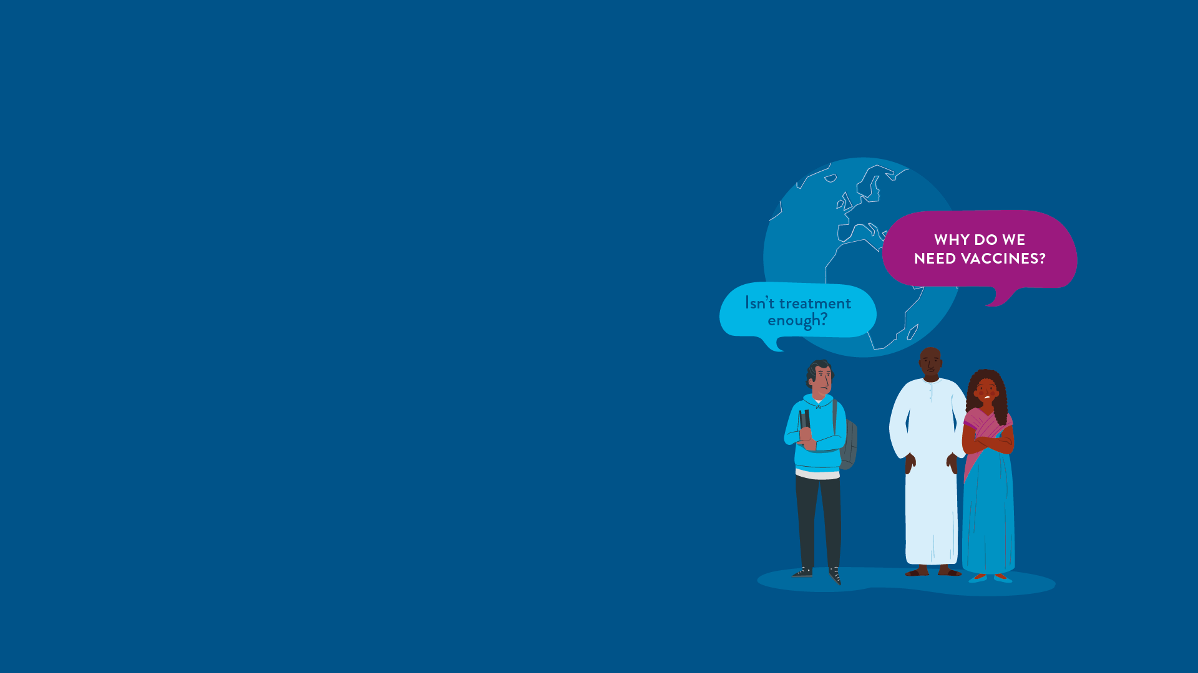



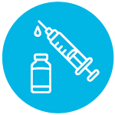
MODULE 1:
VACCINES AND THE GLOBAL RESPONSE TO INFECTIOUS DISEASES
HIV
TB
Lassa Virus
Vaccines

Slide 4
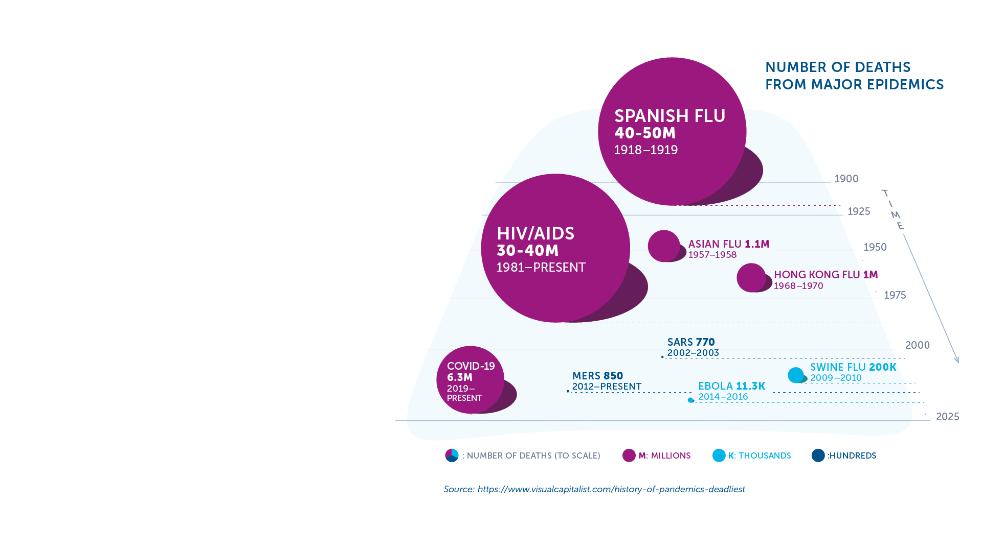
Global Health and Emerging Epidemics​
Every year, millions of people worldwide are affected by infectious diseases caused by bacteria, viruses, fungi or parasites.​
COVID-19 has taught us the danger of new, emerging epidemics that have the power to bring our world to a standstill.​
Infectious diseases are leading causes of death for children under five (WHO).​
Six of the top 10 causes of death in low-income countries are infectious diseases.​
Despite significant advances in research, prevention, and treatment, the successful control of these diseases faces major challenges​.
IAVI VACCINE LITERACY LIBRARY | MODULE 1

Slide 5
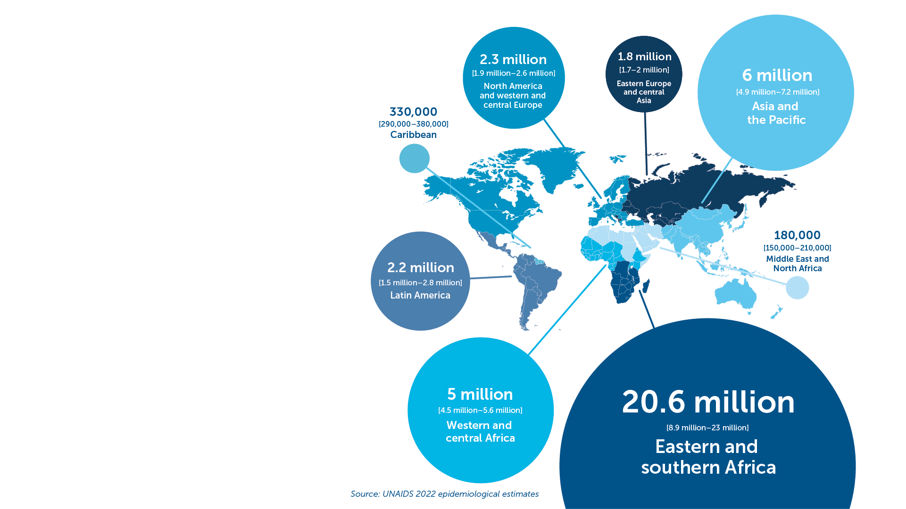
HIV
HIV is one of the worst epidemics the world has ever seen.​
84.2 million people have acquired HIV since it was identified in 1981.​
38.4 million people globally were living with HIV in 2021, including 1.7 million children.​
AIDS is a leading cause of death in sub-Saharan Africa.​
Over half of all people living with HIV are women and girls.​
IAVI VACCINE LITERACY LIBRARY | MODULE 1
Adults and children estimated to be living with HIV, 2021
TOTAL: 38.4 million

Slide 6
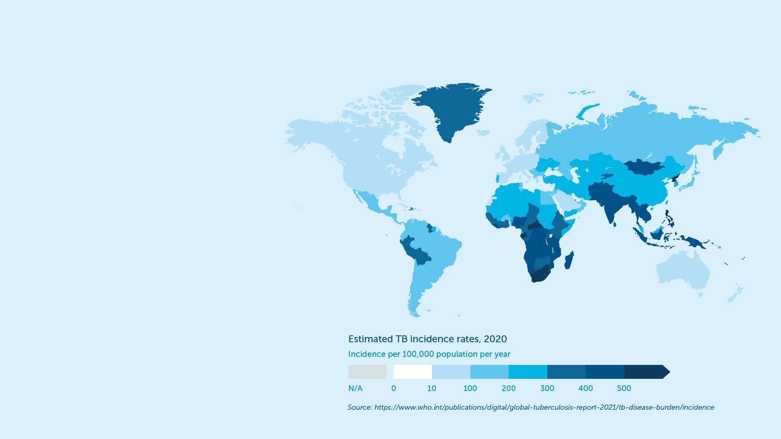
Tuberculosis (TB)
Over 2 billion people are living with TB worldwide and 1.5 million die every year.​
1.2 million children get sick with TB each year.​
Africa accounts for a quarter of all TB cases and deaths globally.​
Due to TB, people can typically face costs or suffer income loss equivalent on average to more than 50% of their income.​
IAVI VACCINE LITERACY LIBRARY | MODULE 1
Prior to COVID-19, TB was the leading infectious disease killer worldwide.​

Slide 7
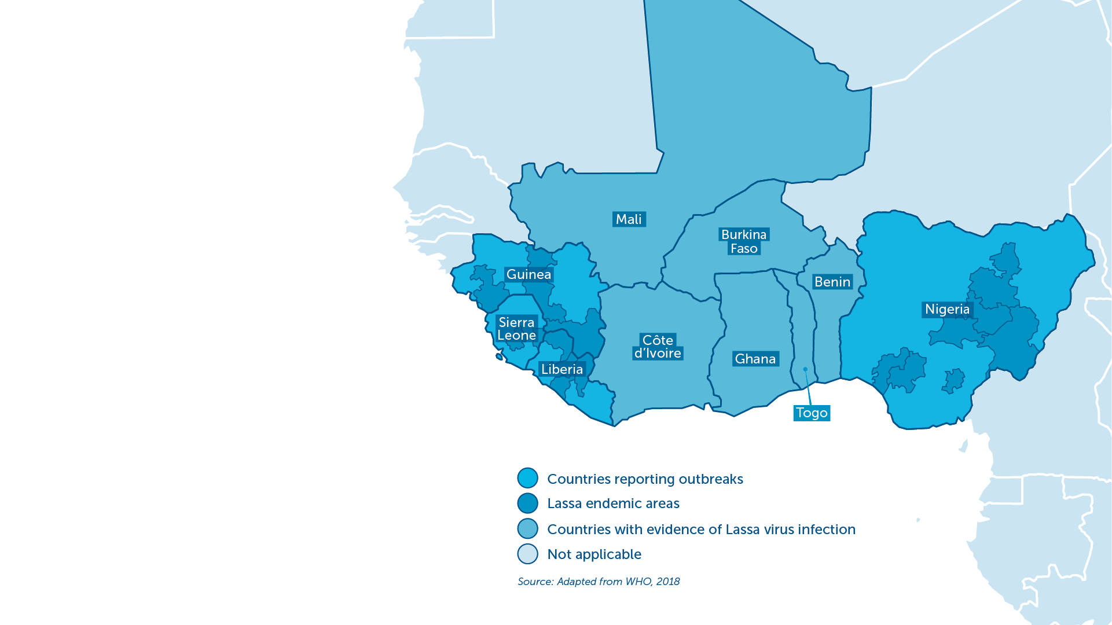
Lassa Haemorrhagic Fever
An acute viral illness endemic in parts of West Africa.​
An estimated 100,000–300,000 cases and 5,000 related deaths each year.​
Particularly dangerous to pregnant women and small children.​
Deafness occurs in approximately one-third of infections, and in many cases hearing loss is permanent.​
WHO has identified Lassa fever as one of the top emerging diseases likely to cause severe outbreaks in the near future.
IAVI VACCINE LITERACY LIBRARY | MODULE 1

Slide 8
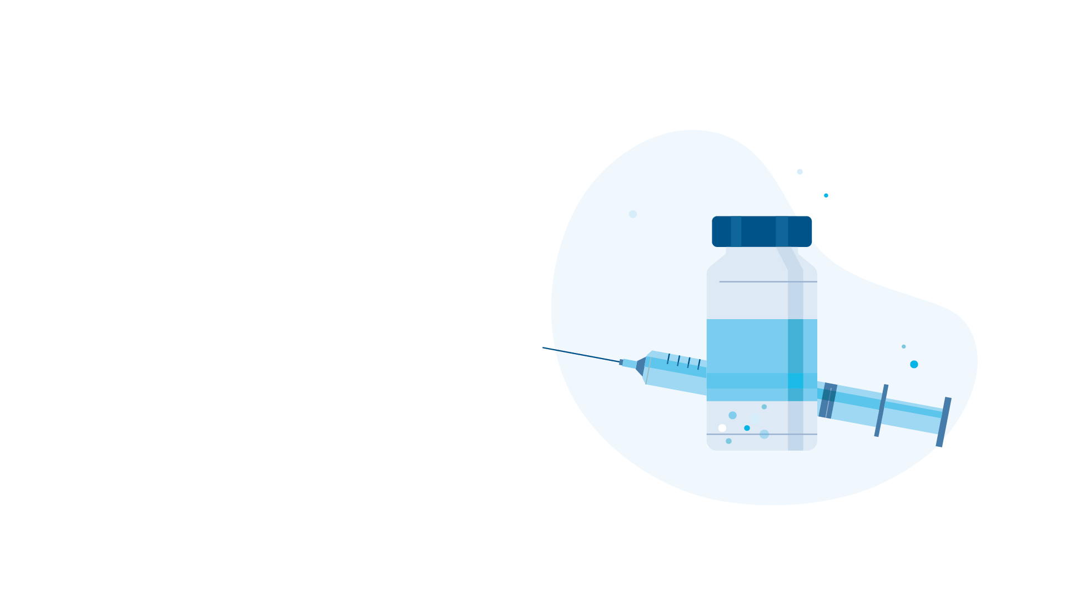
The World Needs Vaccines
Vaccines are the most powerful tool at our disposal to defeat epidemics and pandemics caused by infectious diseases.​
Without immunisation, epidemics can easily cause health systems to collapse. Health professionals looking after the sick can be at risk of infection themselves.​
Vaccines work by preparing a person's immune system (the body’s natural defences) to recognise and defend itself against a specific disease.​
No epidemics have been successfully brought under control without the use of vaccines.
IAVI VACCINE LITERACY LIBRARY | MODULE 1

Slide 9
Vaccines Save Lives
Vaccines are a crucial tool in controlling the spread of infectious diseases together with addressing long-term structural factors such as poverty, poor housing, and inadequate sanitation that put people at increased risk of certain infectious diseases.​
By providing protection from disease at an individual level and stopping its spread in the community, vaccines can protect highly vulnerable people from severe illness and death.​
Vaccination prevents 2–3 million deaths every year.
IAVI VACCINE LITERACY LIBRARY | MODULE 1

Slide 10
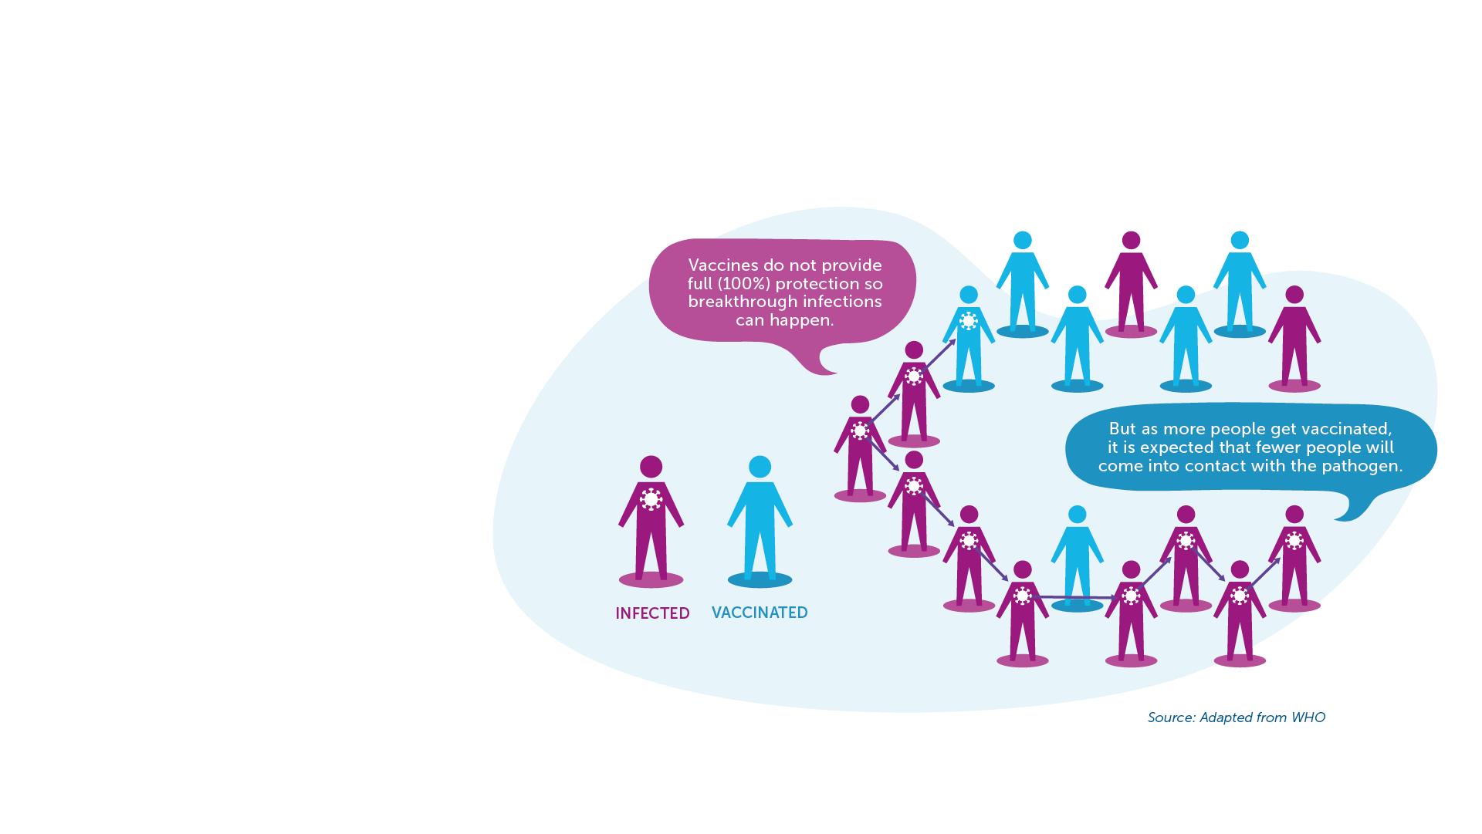
Vaccines End Epidemics
Infectious diseases can spread rapidly through a community, and with today’s international travel, reach every part of the world.​
Vaccines play a critical role in the prevention and control of disease outbreaks and in promoting global health.​
Without vaccination, we are unlikely to see an end to the big killer diseases such as HIV, TB, and other emerging infectious diseases.​
Vaccines and Herd Immunity​
When many people are vaccinated, even those who are not vaccinated in that community may also get some protection.
IAVI VACCINE LITERACY LIBRARY | MODULE 1

Slide 11
Vaccines Are Cost Effective
Vaccination is one of the most cost-effective health interventions that money can buy.​
Vaccines provide savings to the health system by lowering the number of people who need treatment and lifetime care.​
Vaccination also prevents lost wages and lost productivity.​
Border controls, quarantine, lockdowns, self-isolation, and social distancing measures can all play a role but can have a huge negative impact on society and the economy.​
It is estimated that every dollar invested in vaccination saves US$16 in health care costs
IAVI VACCINE LITERACY LIBRARY | MODULE 1

Slide 13
Acknowledgements
IAVI would like to acknowledge the contribution of Doreen Asio, Monica Bagaya, Vincent Basajja, Kundai Chinyenze, William Dekker, Evanson Gichuru, Nyokabi Jacinta, Sarah Joseph, Dagna Laufer, Sharon Lipesa, Shelly Malhotra, Miliswa Magongo, Blossom Makhubalo, Roselyn Malogo, John Mdluli, Ireen Mosweu, Juliet Mpendo, Gaudensia Mutua, Vincent Muturi-Kioi, Conwell Mwakoi, Jauhara Nanyondo, Gertrude Nanyonjo, Jacinta Nyakobi, Faith Ochieng, Fred Otieno, Daisy Ouya, Gayle Patenaude, Hilda Phiri, Nicole Sender, Lewis Schrager, Elana Van Brakel, Kelvin Vollenhoven, Jeffery Walimbwa, Mathias Wambuzi, Anja Van der Westhuizen for reviewing the content of the IAVI Vaccine Literacy Library.
Lead Consultants: Roger Tatoud and Rebekah Webb.
Design and Illustration: Anthea Duce.
© International AIDS Vaccine Initiative, Inc. 2022

Slide 14
